Slide 1
John Day Innovation gateway
February 6, 2020

Slide 2
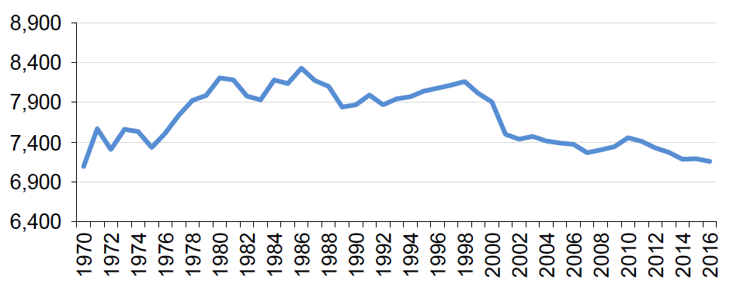
POPULATION TRENDS
JOHN DAY INNOVATION GATEWAY
5o-years of “Net Zero” population growth

Slide 3
DECLINING STUDENT ENROLLMENT
JOHN DAY INNOVATION GATEWAY

Slide 4
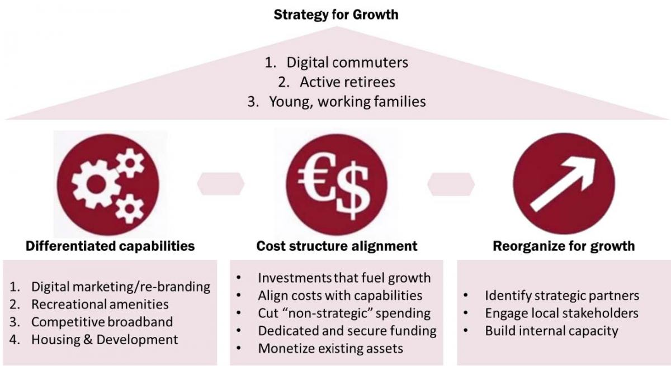
Introduction
JOHN DAY INNOVATION GATEWAY
John Day’s Growth Strategy
Combating population decline through public-sector investments
Pursuing joint investment strategies with public & private agencies

Slide 5
John Day Integrated Park System
JOHN DAY INNOVATION GATEWAY
Adopted as John Day Innovation Gateway Area Plan amendment to Comp Plan
Brownfield redevelopment connecting five parks along the John Day River
Creates a variety of new amenities and attractions
Received 2019 League of Oregon Cities Award for Excellence
One of 10 communities chosen for Environmental Protection Agency’s Recreation Economies for Rural Communities (RERC) planning grant

Slide 6
GATEWAY EAST
JOHN DAY INNOVATION GATEWAY
7th Street Aquatic Center, Fairground and Hill Family Park – Future Integrated Park System

Slide 7
GATEWAY CENTRAL
JOHN DAY INNOVATION GATEWAY
Davis Creek Park, Future Campground, River Restoration Area/Greenway to Kam Wah Chung

Slide 8
GATEWAY WEST
JOHN DAY INNOVATION GATEWAY
Wastewater Treatment Plant, Hotel/Convention Center, Pavilion, Greenhouse, Public Works Shop, Future Office Space, Riverfront Trails

Slide 9
JOHN DAY INNOVATION GATEWAY TRAIL SYSTEM PHASE 1
JOHN DAY INNOVATION GATEWAY
$191,300 awarded by OPRD for recreational trails in Davis Creek, Kam Wah Chung and Riverfront
Phase 1 Trail systems completed October 1, 2019

Slide 10
TRAIL FEATURES
OPRD | PROJET UPDATES
Davis Creek Trail (top) features rustic stairs, stone and moderate ascents
North Trail (bottom) features wide avenues with scenic vistas

Slide 11
JOHN DAY RIVERFRONT TRAIL
JOHN DAY INNOVATION GATEWAY
River trail offers 0.25 miles of river views on six- to eight-foot paths

Slide 12
PARKS PRIOR TO OPRD GRANTS
JOHN DAY INNOVATION GATEWAY
Existing trail systems prior to RTP and Integrated Park System awards

Slide 13
INTEGRATED PARK SYSTEM
JOHN DAY INNOVATION GATEWAY
Trails connecting Davis Creek and John Day River now complete; Integrated Park System grant will fund trail expansion to 7th Street and Kam Wah Chung

Slide 14
MOUNTAIN BIKE PARK
JOHN DAY INNOVATION GATEWAY
7-acre facility with flow and pump tracks

Slide 15
NEW PLAYGROUND & SPLASHPAD
JOHN DAY INNOVATION GATEWAY
7th Street Complex Playground & Splash Pad

Slide 16
NEW PLAYGROUND & SPLASHPAD
JOHN DAY INNOVATION GATEWAY
7th Street Complex Playground & Splash Pad

Slide 17
NEW AQUATICS/REC CENTER
JOHN DAY INNOVATION GATEWAY
$40,000 OPRD Planning Assistance Grant

Slide 18
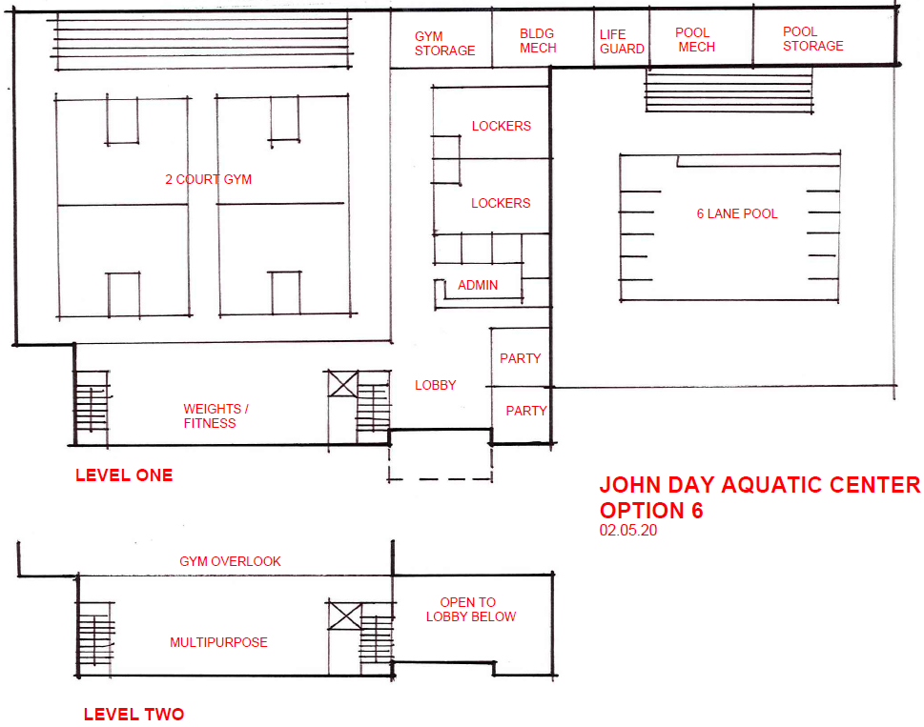
AQUATIC CENTER FLOORPLAN
JOHN DAY INNOVATION GATEWAY

Slide 19
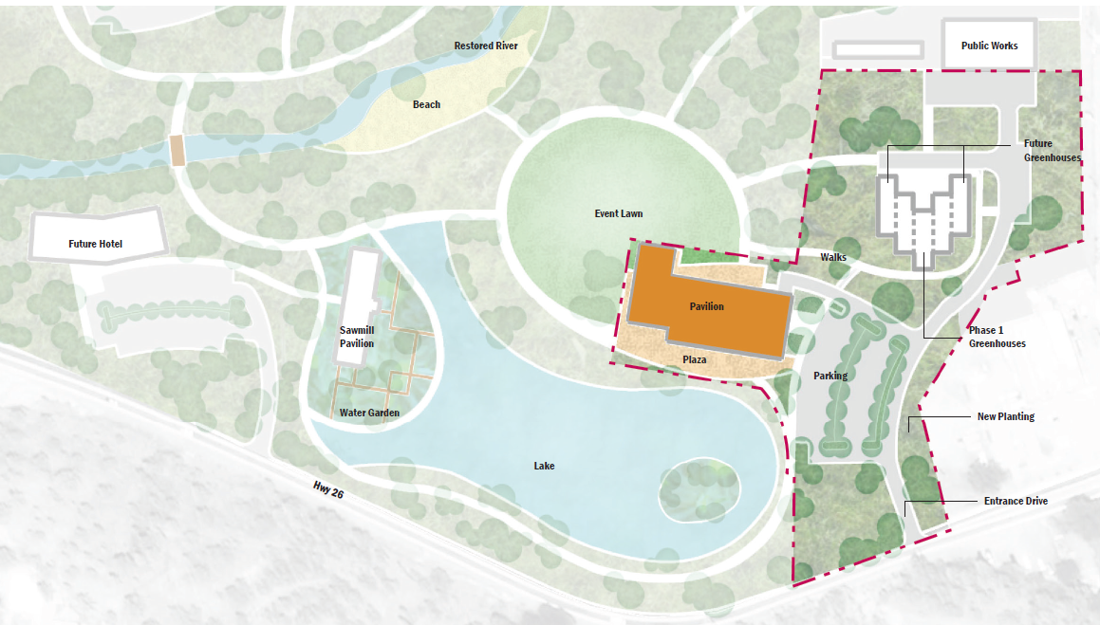
COMMUNITY PAVILION / MARKET
JOHN DAY INNOVATION GATEWAY
Integrated investment with the City Greenhouse and Public Works facility

Slide 20
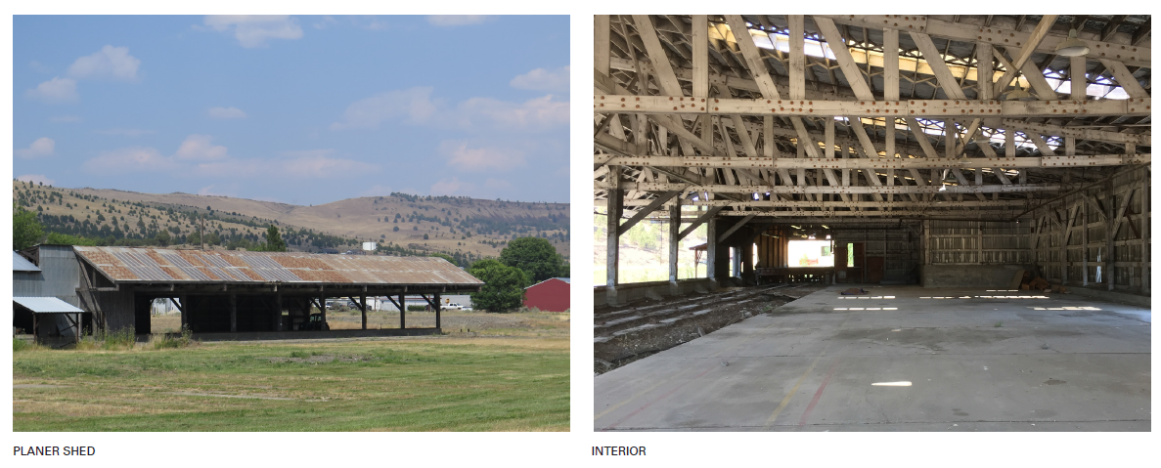
PRESERVING OUR HERITAGE
JOHN DAY INNOVATION GATEWAY
Preservation and adaptive reuse of historic structures

Slide 21
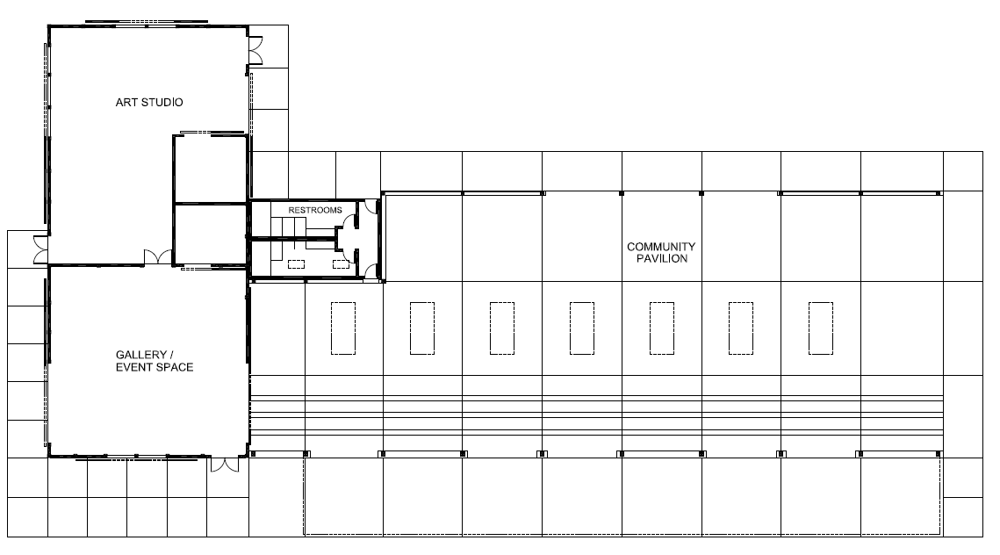
PAVILION FLOORPLAN
JOHN DAY INNOVATION GATEWAY
Art studio, gallery/event space and community pavilion for market

Slide 22
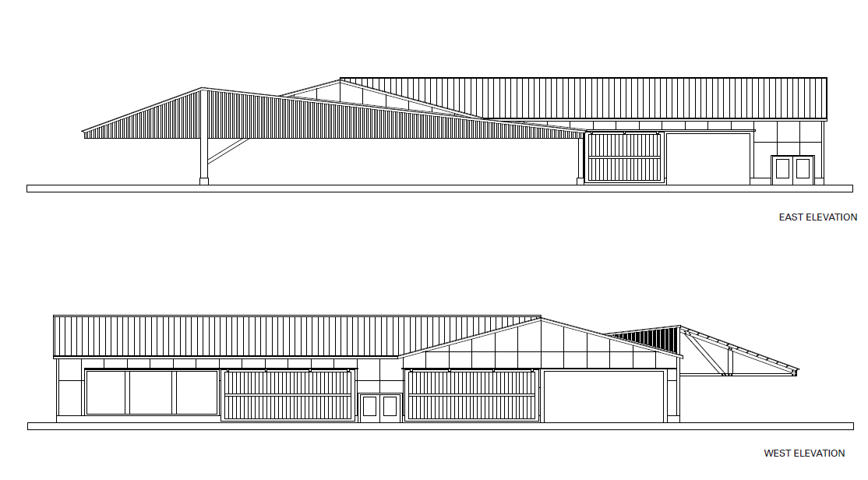
PAVILION ELEVATIONS
JOHN DAY INNOVATION GATEWAY
East West Elevations

Slide 23
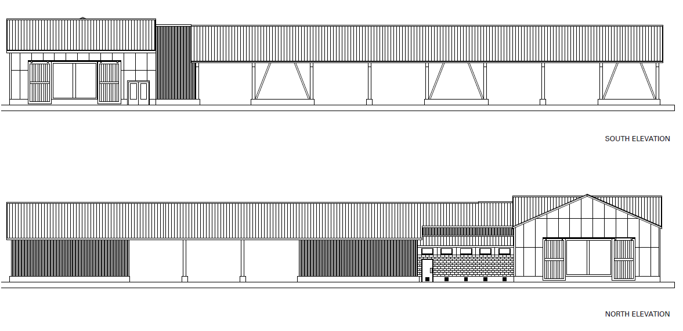
PAVILION ELEVATIONS
JOHN DAY INNOVATION GATEWAY
North South Elevations

Slide 24
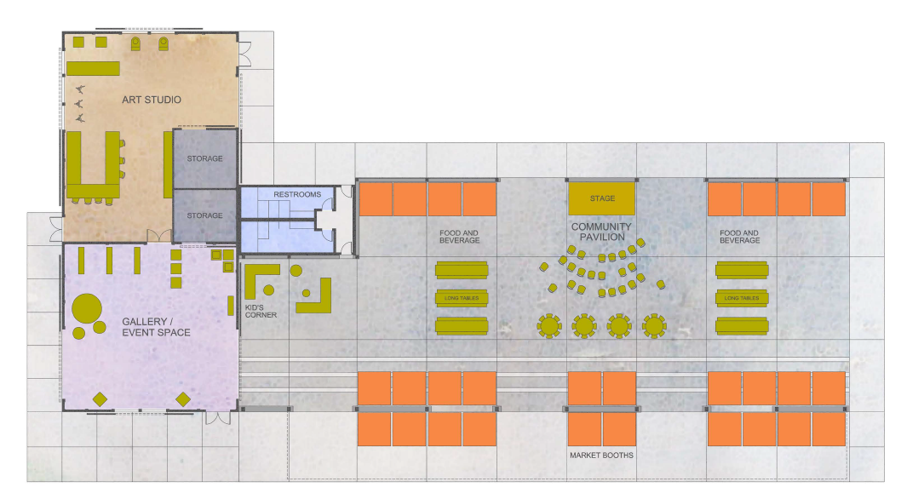
PAVILION SPACES
JOHN DAY INNOVATION GATEWAY

Slide 25
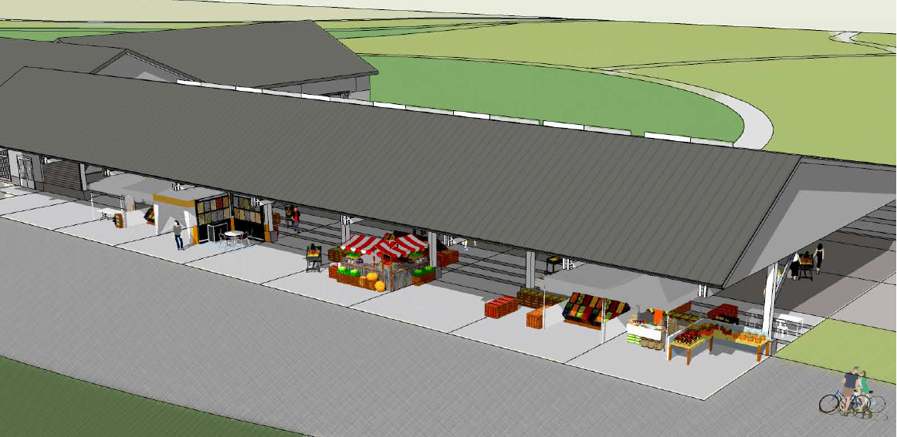
PAVILION RENDERINGS
JOHN DAY INNOVATION GATEWAY

Slide 26
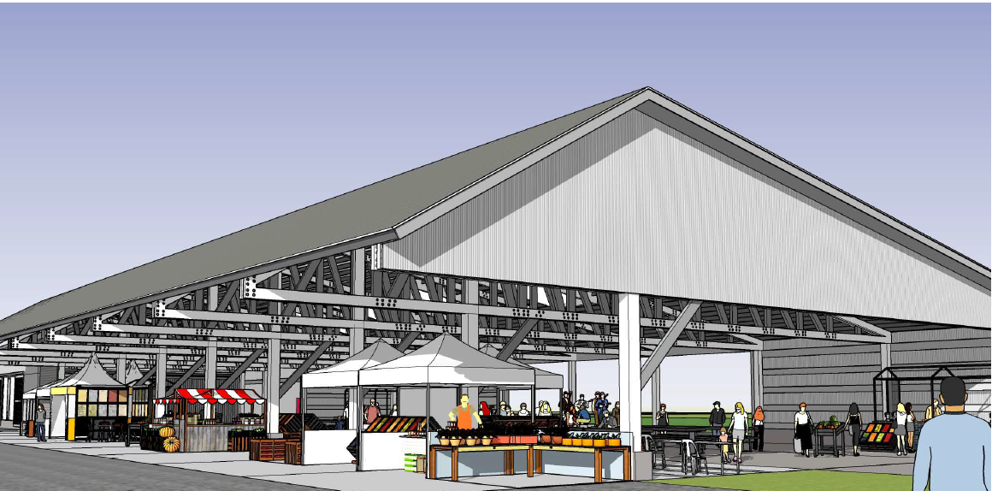
PAVILION RENDERINGS
JOHN DAY INNOVATION GATEWAY

Slide 27
HOTEL & CONVENTION CENTER
JOHN DAY INNOVATION GATEWAY
Coming Summer 2021

Slide 28
PROGRESS SUMMARY
JOHN DAY INNOVATION GATEWAY
$90 Million Master Planned Development for 100-acre Project
$4.5 million public sector funding invested since 2017
$18.5 million planned/committed for 2021-2023
$6M hotel
$12M water reclamation facility
$500K park system/trail improvements
$15 million in new applications to be submitted in 2020
Street improvements
Convention center
Greenhouse expansion
(Apx. ¼ of funding goal reached)

