Slide 1
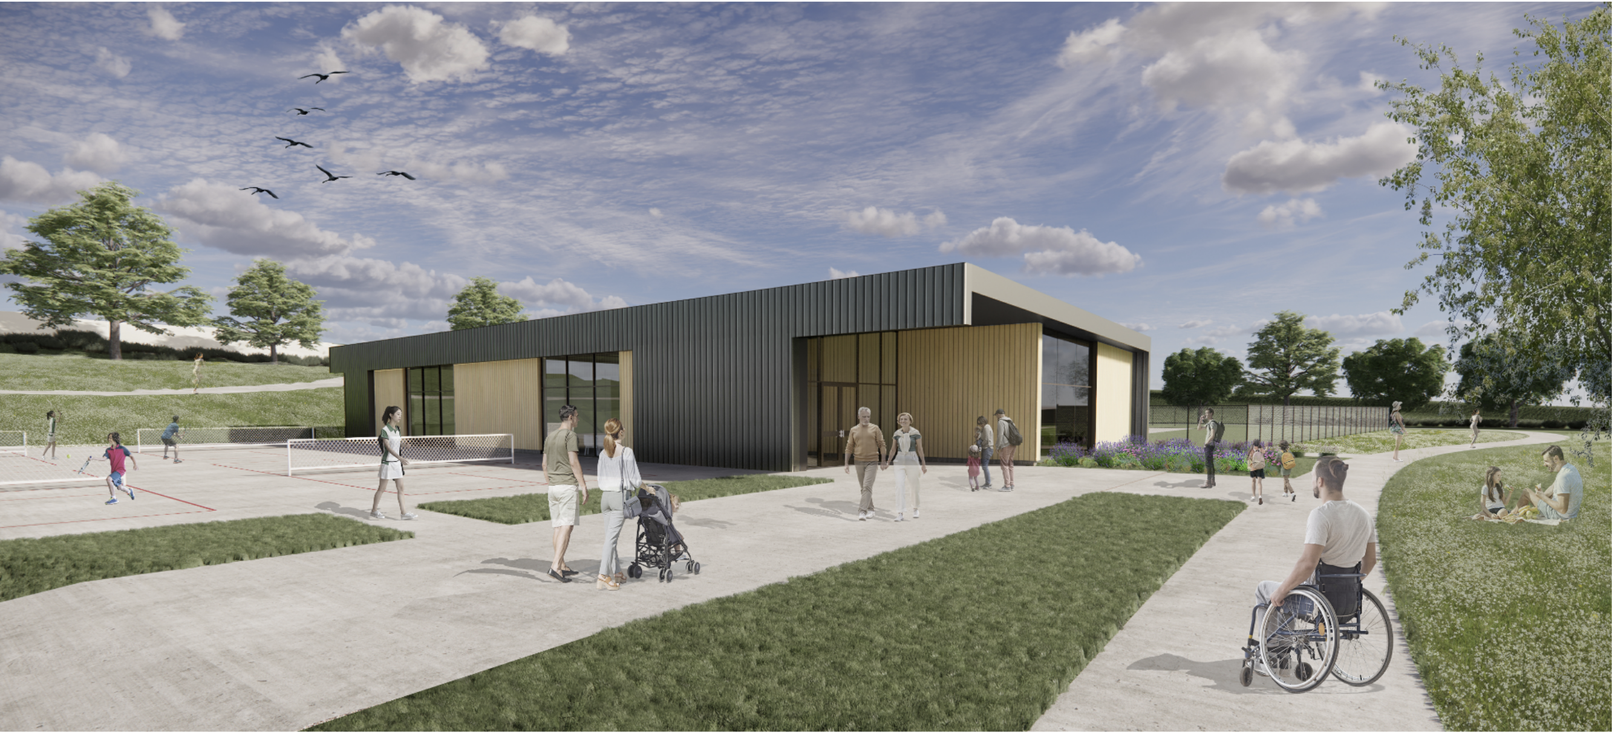
swim center financing & PROGRESS update
October 11, 2022

Slide 2
Background
SWIM CENTER FINANCING & PROGRESS Update
At least 12 public meetings have been held on the pool by the city council from July 2018 through August 2022 (not counting study sessions or open houses)
Work from 2018-2020 performed by city staff and steering committee participants on preliminary designs
Report on Aquatics Center + Aquatics District published May 8, 2020
All affected jurisdictions invited via email on June 5, 2020, to hold public meetings to review the proposal
COJD meeting held June 9, 2020, to discuss proposed aquatics district
Summer 2020, District proposal fails – only John Day passed the resolution in support (Resolution No. 20-839-12)
Date | Forum | Topic | Participants
2018-07-24 | City Council Meeting | Counsilman Hunsaker Proposal | Council + Public
2019-04-06 | Budget Committee Meeting | Budget Meeting | Council + John Day Budget Committee + Public
2019-10-08 | City Council Meeting | LG19-032 Grant Agreement | Council + Public
2020-01-28 | City Council Meeting | Progress Report | Council + Public
2020-03-09 | Final Steering Committee Meeting | Pool Design + District Formation | Steering Committee (Cities + Districts + Swim Team)
2020-04-14 | City Council Meeting | Aquatics District Proposal | Council + Public
2020-06-09 | City Council Meeting | Pool Cost Tracking | Council + Public
2021-11-09 | City Council Meeting | Sale of KWC and Gleason Pool | Council + Public
2021-11-09 | Planning Commission Meeting | CUP-21-05 Site Design for Pool | Planning Commission + Public
2022-01-01 | City Council Meeting | Opsis Proposal | Council + Public
2022-02-22 | Joint Meeting with Parks + Rec | Intergovernmental Agreement | Council + JDCC Parks & Rec District + Public
2022-08-09 | Joint Meeting with Parks + Rec | Intergovernmental Agreement | Council + JDCC Parks & Rec District + Public
2022-10-11 | City Council Meeting | Pool Progress Report | Council + Public

Slide 3
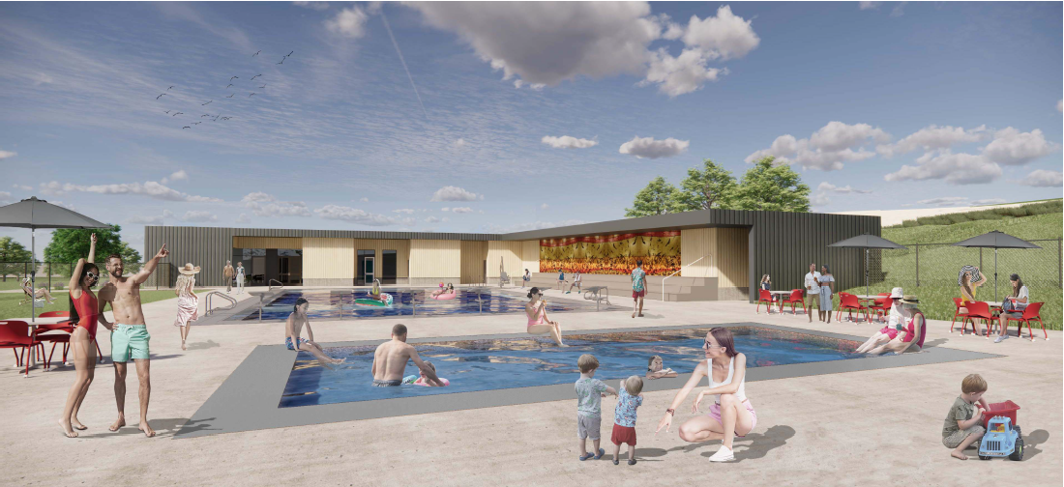
Background cont…
SWIM CENTER FINANCING & PROGRESS Update
Nov 9, 2021 – Planning commission review/approval of CUP-21-05 for swim center; City Council passed Resolution 21-868-16 approving the sale of Gleason following a duly noticed public hearing; Council approved solicitation for design RFP and reviewed terms of lottery bond grant agreement and notification letter
Proceeds from sale of Gleason, less demolition costs, resulted in $100,000 net contribution toward new swim center from City
Council approved IGA and funding agreement with OPRD and Parks and Recreation on

Slide 4
Background cont…
SWIM CENTER FINANCING & PROGRESS Update
Dec 14, 2021 – Council reviewed RFP responses and issued a notice of intent to award the design contract to Opsis architecture with a not-to-exceed amount of $550,000; Notified of John Morris’s appeal of CUP-21-05; appeal hearing scheduled for January 5, 2022
Jan 5, 2022 – Appeal hearing conducted, the council upheld the planning commission’s decision by a vote of 3-2
Jan 11, 2022 – First joint meeting with Parks and Rec District; review of FM3 community survey results on pool; presentation by D.A. Davidson on interim financing options to bridge fund the pool construction until 2023 lottery bonds issued; draft of the final findings and order presented for council approval.
“Green recommended a $3 million borrowing for the City to give the City options to assist the Parks and Recreation District but the City would not necessarily be required to spend more than the $2 million that will be reimbursed by the State of Oregon, other than the cost of the financing origination costs and interest, which are not reimbursable. Green said the City would not be required to accept the funds if the ballot does not pass, but if it does, this gives us the option to go into construction a year sooner than we would be able to if we waited for the lottery bonds to fund in 2023.”
https://www.cityofjohnday.com/sites/default/files/fileattachments/city_council/meeting/4541/2022_0111_council_minutes_-_approved.pdf

Slide 5
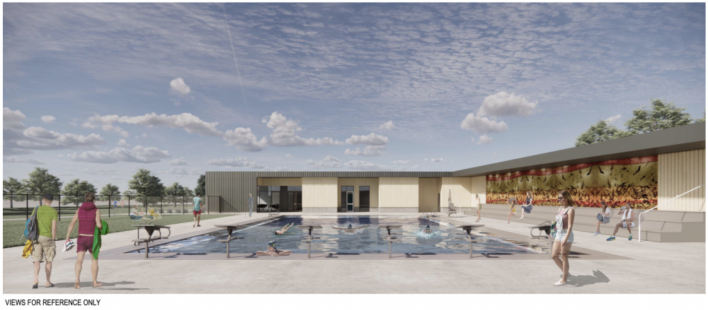
Background cont…
SWIM CENTER FINANCING & PROGRESS Update
Jan 11, 2022 cont…– Council voted to reopen the record for the CUP-21-05 appeal at the request of Lisa Weigum, Parks and Rec budget officer, to allow participants to submit additional written arguments; motion passed unanimously
  Council approved the professional services agreement with Opsis
Jan 25, 2022 – Council reviewed additional written argument and moved to approve the final written order and decision for CUP-21-05 with a unanimous vote; Lundbom and Adair abstained; swim center granted land use approval.

Slide 6
Background cont…
SWIM CENTER FINANCING & PROGRESS Update
Feb 22, 2022 – Council and Parks District hold a second joint meeting and pass resolutions approving the following actions through Resolution 22-881-02:
  $4,000,000 ballot measure referral to Parks and Recreation District voters on May 17, 2022
  Lottery Bond Grant Agreement for $2,000,000 in grant proceeds
  Intergovernmental Agreement between City and District for joint development of swim center
  LGGP grant application for $750,000 to construct a warm water pool
  Bond counsel appointed (Hawkins Delafield & Wood LLP)
  D.A. Davidson appointed to serve as City’s placement agent for the $3,000,000 Interim Financing
    Reimbursement of pre-agreement costs via interim financing
    Includes interim financing for the lottery bonds and up to $1,000,000 for pre-agreement and construction costs
Aug 9, 2022 – Council and Parks District hold a third joint meeting and pass resolutions re-authorizing ballot measure and interim financing for the Nov 8 election

Slide 7
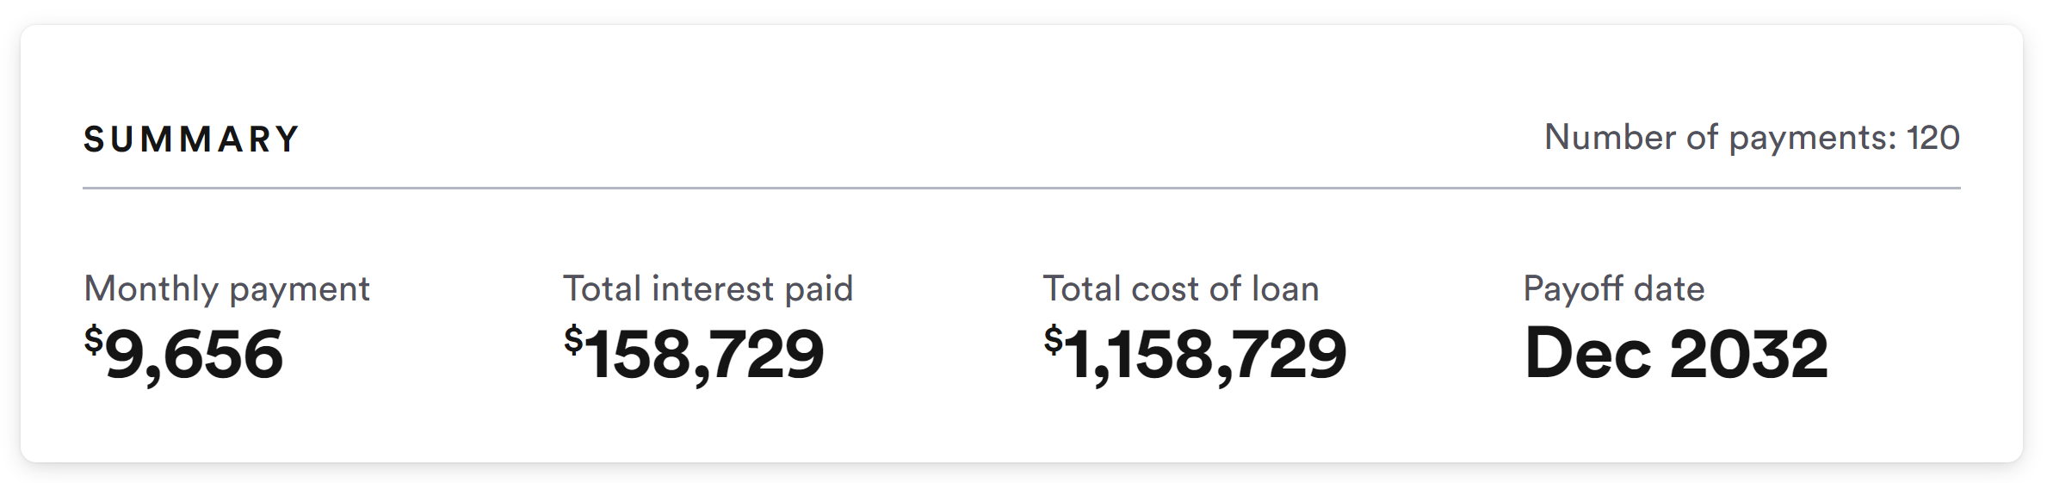
Sources and Uses of Funds – Capital Construction
SWIM CENTER FINANCING & PROGRESS Update
Funding Source | Expenses
$100,000 Sale of Gleason Pool (KWC) | $550,000 Design (Opsis Contract)
$2,000,000 Lottery Bond Proceeds $1,000,000 Interim Credit Facility $4,000,000 Capital Improvement Bond | $6,550,000 Direct Construction Cost
$7,100,000 Total Funding | $7,100,000 Total Expenditure + Int.*
Design changes or additional private contributions may be needed based on the final construction cost from bidders
**Interim Financing Costs

Slide 8
Pool operating cost assumptions
SWIM CENTER FINANCING & PROGRESS Update
Personnel cost
  2.5 months of full-time maintenance
  3-month full-time lifeguard lead
  7 part-time lifeguards
  $45,600 personnel cost
Materials and Services cost
  $17,500 in utilities
  Broadband by GC Digital
  $15,000 Insurance + misc. costs
  $57,500 mats+serv. Cost
Total operating expense
  $103,100
Utilties
propane | 6,500
electricity | 6,500
heating fuel | 3,000
trash | 1,000
telephone | 500
Total | 17,500

Slide 9
Pool operating revenue assumptions
SWIM CENTER FINANCING & PROGRESS Update
Operating income
  $1,200 pool rental
  $1,750 room rental
  $17,500 John Day utilities
  $7,250 swim lessons
  $23,500 swim receipts (avg.)
  $53,100 operating income
Parks District Transfers
  $50,000 general fund
Total operating revenue
  $103,100 total revenue
FY2023 Revenues | $230,000.00
JDCC Transfer | $ 50,000.00
% of pool operations | 22%
Actual Receipts per Audit
 | Swim | Candy
6/30/2010 | 20,001.38 | 381.60
6/30/2012 | 18,745.82 | 1,719.90
6/30/2013 | 19,346.66 | 1,541.70
6/30/2014 | 19,524.83 | 2,474.37
6/30/2015 | 24,919.07 | 3,539.07
6/30/2016 | 17,650.16 | 2,372.66
6/30/2017 | 20,971.60 | 3,408.44
6/30/2018 | 22,918.07 | 2,974.03
6/30/2019 | 27,164.90 | 1,886.45
Average | 21,153.69 | 2,248.13

Slide 10
Sources and Uses of Funds –
Pool Operations
SWIM CENTER FINANCING & PROGRESS Update

Slide 11
Sources and Uses of Funds –
Pool Operations
SWIM CENTER FINANCING & PROGRESS Update

Slide 12
Summary
SWIM CENTER FINANCING & PROGRESS Update
Yes, JDCC can afford to operate the new pool – it will cost them between 20-25% of their annual revenues, consistent with past spending on Gleason
Operating estimates are conservative estimates prepared by Anna Bass, Solutions CPAs
(costs are over-estimated, revenues underestimated)
John Day’s total contribution
  Up to $1 million in capital construction cost, which is approx. $115,000 per year over 10 years or $58,000 over 20
  $17,500 per year in utilities
Grant County Digital provides internet for 20-yrs
  Included in the scope of the EDA grant / no cost to taxpayers
This is an affordable option
Extensive public feedback and comments over the last 5 years

Slide 13
Next Steps
SWIM CENTER FINANCING & PROGRESS Update
Nov 8, 2022 – Ballot Measure 12-85 election
Dec 2022 –Feb 2023 – Geotech Investigation Final bid and permit docs
100% Design
Mar 2023 – May 2023 – Award Bids + Permits
Jun 2023 – Construction Starts
Summer 2024 – Pool open for the season

