Slide 1
Regional Rural Revitalization “R3” A Model for Shared Prosperity

Slide 2
Nick Green, Former City Manager, City of John Day Michele Parry, Town Manager, Town of Lakeview Dan Brown, City Manager, City of Burns
Participants

Slide 3
Introduction
The cities of John Day (Grant County), Burns (Harney County), and Lakeview (Lake County) are all located along U.S. Highway 395, about 4 hours apart. Each of our cities share similar challenges, opportunities, and constraints for land, housing, and community/economic development.
All three of our cities are about the same size, all are natural resource communities, all are the economic centers for each county, all are stagnant or in population decline, and all want to innovate, scale, and reinvest in our communities through innovation and entrepreneurship.

Slide 4
Why is There a Need For This?

Slide 5
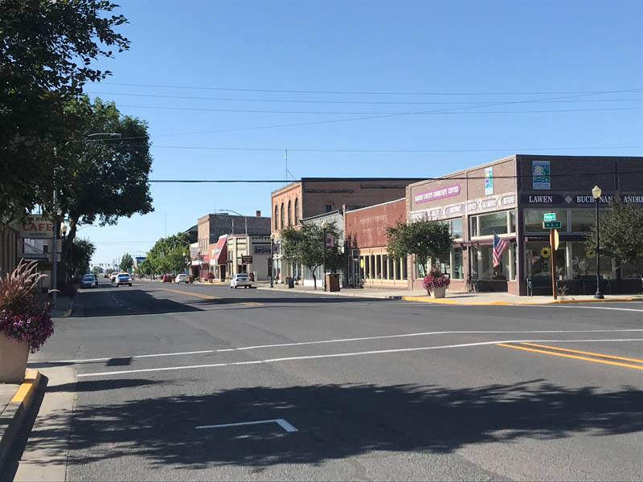
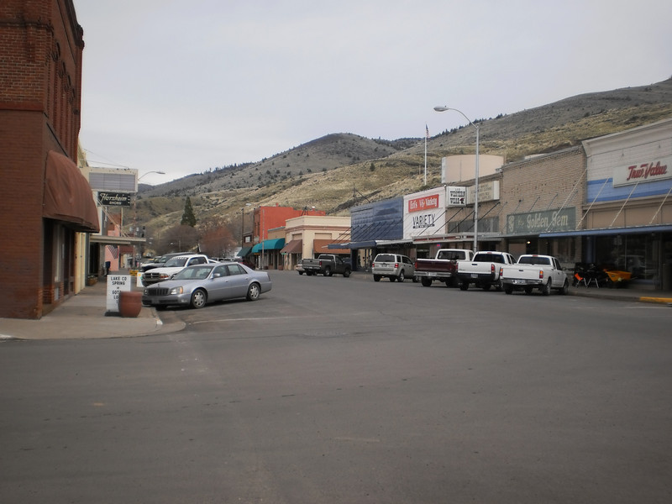
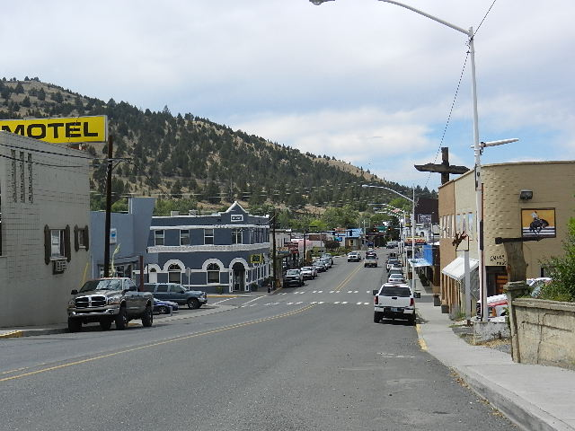
Rural Oregon has been in decline for decades.

Slide 6
What is Challenging
Shuttered basic industries
.
Lack of economic opportunity
Aging Population
Brain Drain

Slide 7
Why focus on growth?
To reverse the pattern of population and economic decline by achieving a modest and sustainable growth rate.

Slide 8
Attracting a Workforce
WORKFORCE
MEDICAL
INFRASTRUCTURE
These needs must be met in order to attract a workforce.
HIGH SPEED INTERNET
QUALITY OF LIFE
EDUCATION
HOUSING

Slide 9
Mission
To pursue new operating models, including shared: staffing, hardware/software; consulting/professional services; and capital equipment.
- John Day, Lakeview and Burns entered into an MOU to start this process.

Slide 10
ORS 190.010 Authority of local governments to make intergovernmental agreement A unit of local government may enter into a written agreement with any other unit or units of local government for the performance of any or all functions and activities that a party to the agreement, its officers or agencies, have authority to perform. The agreement may provide for the performance of a function or activity: (1) By a consolidated department; (2) By jointly providing for administrative officers; (3) By means of facilities or equipment jointly constructed, owned, leased or operated; (4) By one of the parties for any other party; (5) By an intergovernmental entity created by the agreement and governed by a board or commission appointed by, responsible to and acting on behalf of the units of local government that are parties to the agreement; or (6) By a combination of the methods described in this section. [Amended by 1953 c.161 §2; 1963 c.189 §1; 1967 c.550 §4; 1991 c.583 §

Slide 11
Shared
Grant County is ranked #1 and Harney/Lake Counties are tied for #5 most socioeconomically distressed counties in Oregon by the Oregon Secretary of State. All three cities face economic and social decline that is familiar in rural America.

Slide 12
Problem Cost Burdened
Housing Needs Analyses
All three cities lack quality, affordable housing
Demand
Each city is adopting URA’s with tailored incentive plans to address the cost-disconnect
Lack
R3 will used shared resources and processes and reduce barriers to housing.
Poor Condition
Existing housing will require rehabilitation or replacement
Cost Burdened
R3 shared staffing and processes will effectively reduce the price per square foot

Slide 13
Urban Renewal Area
Innovate
R3 proposed innovate affordable housing at scale by bringing 3D printing housing technology.
Land Use
R3 will coordinate land use entitlement w/DLCD and DCBS Building Codes Division.
Concept/Design
R3 will refine concepts through preliminary engineering
Manage
Expectations will be managed through contractual agreements
2021-2023
R3 will gain efficiencies, economies of scale to provide the gold standard

Slide 14
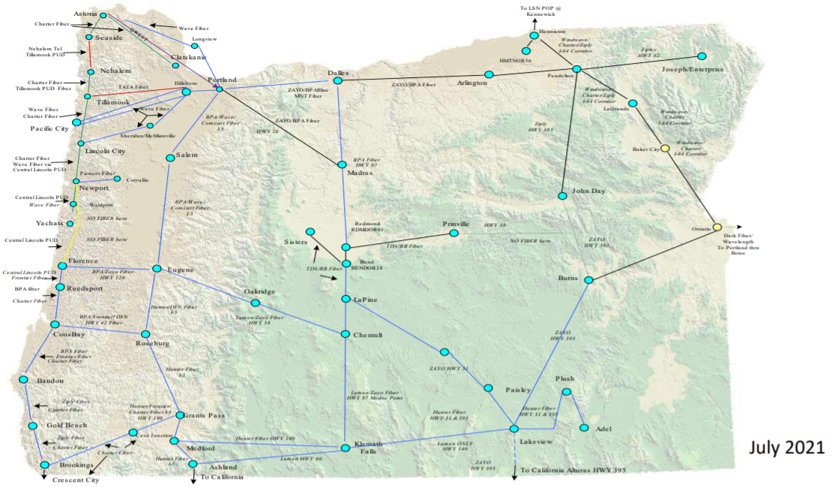
Middle Mile Network for the State of Oregon
Regional Challenge example - building broadband from Lakeview to Burns then Burns to Seneca, where it can tie into John Day’s build.

Slide 15
Shared Resources
Bringing Innovative Solutions to local government to save money, eliminate government layers, improve access to resources and skills offering better services, and creating sustainable futures for all our cities.
1
Administrative Functions
Able to gain economies of scale and purchase power in the market: accounting, planning, attorney fees,
2
Asset Management & Operations
Joint ownership, maintenance, construction, production and purchase.
3
Roads, Parks and Recreation
Contracting with another municipality, creating a special district

Slide 16
Approach
Create greater social and cultural vitality in our partner communities aimed at improving people’s social, physical, and economic well-being.

Slide 17
Build local capacity
Engaging the community in meaningful ways
Capitalize on existing asset and opportunities
Developing new narratives

Slide 18
Matching investments to desired outcomes
Stabilizing municipal budgets
Development of new housing stock
Creation of new jobs

Slide 19
Meeting the Housing Challenges

Slide 20
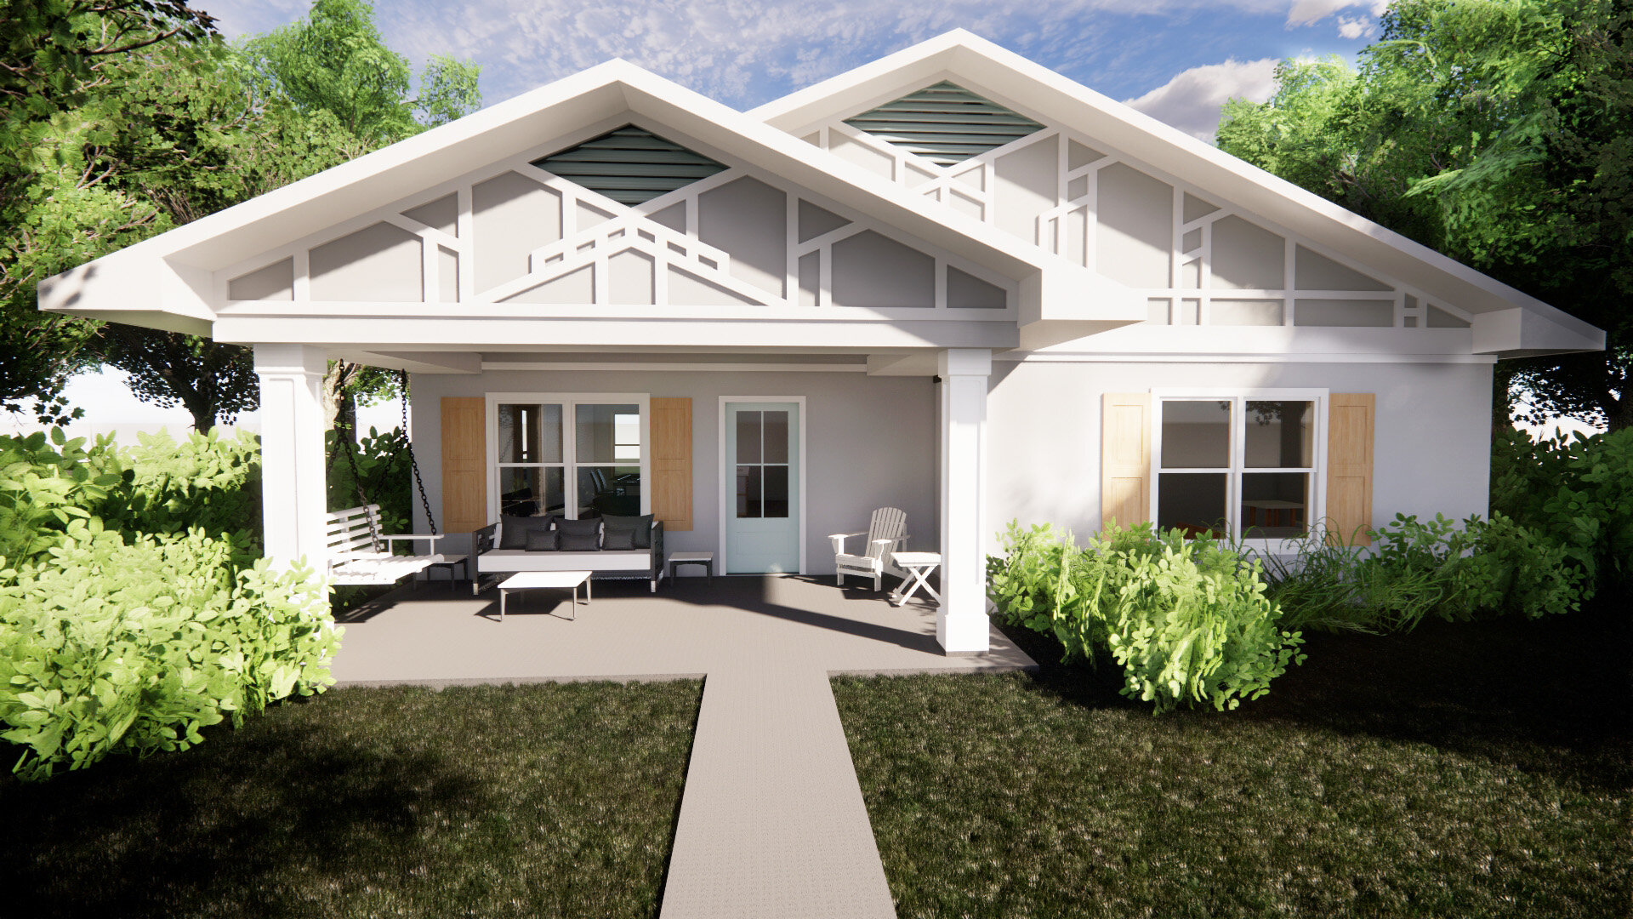
Alquist 3D Printed Housing

Slide 21
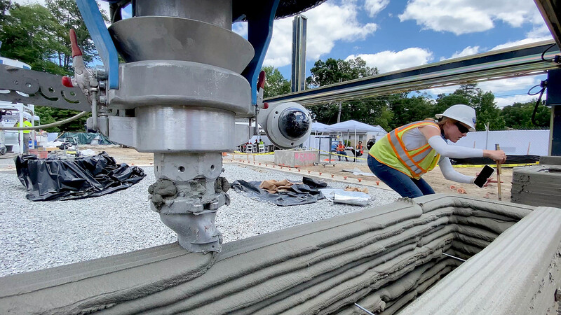
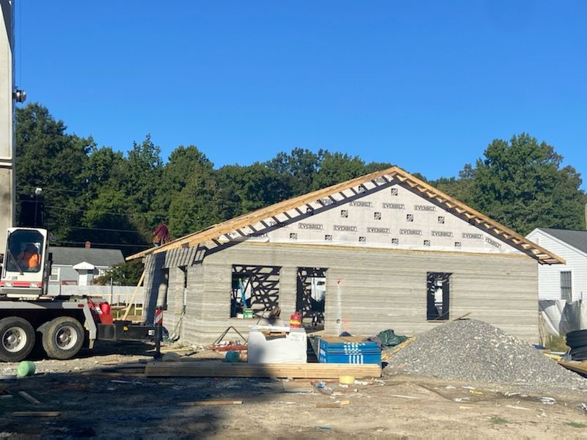
Alquist 3D Printed Housing
Change Rural Housing with affordable 3D printed houses.
4 different housing plans will be offered.
DLCD approved R3 for a Rural Placemaking Grant

Slide 22
https://www.youtube.com/watch?v=IS0pEqVIhWY

Slide 23
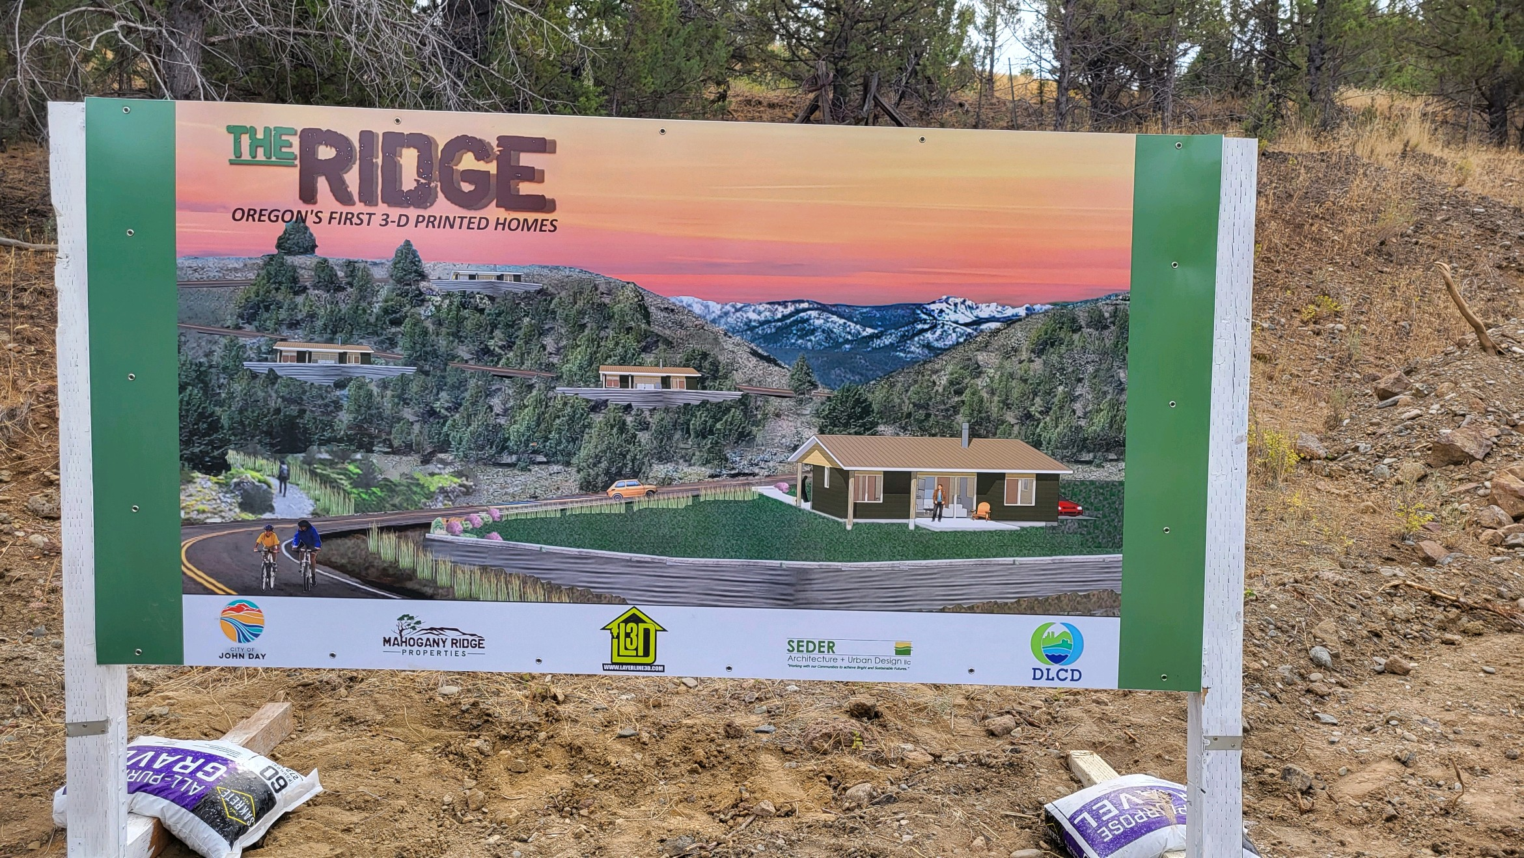
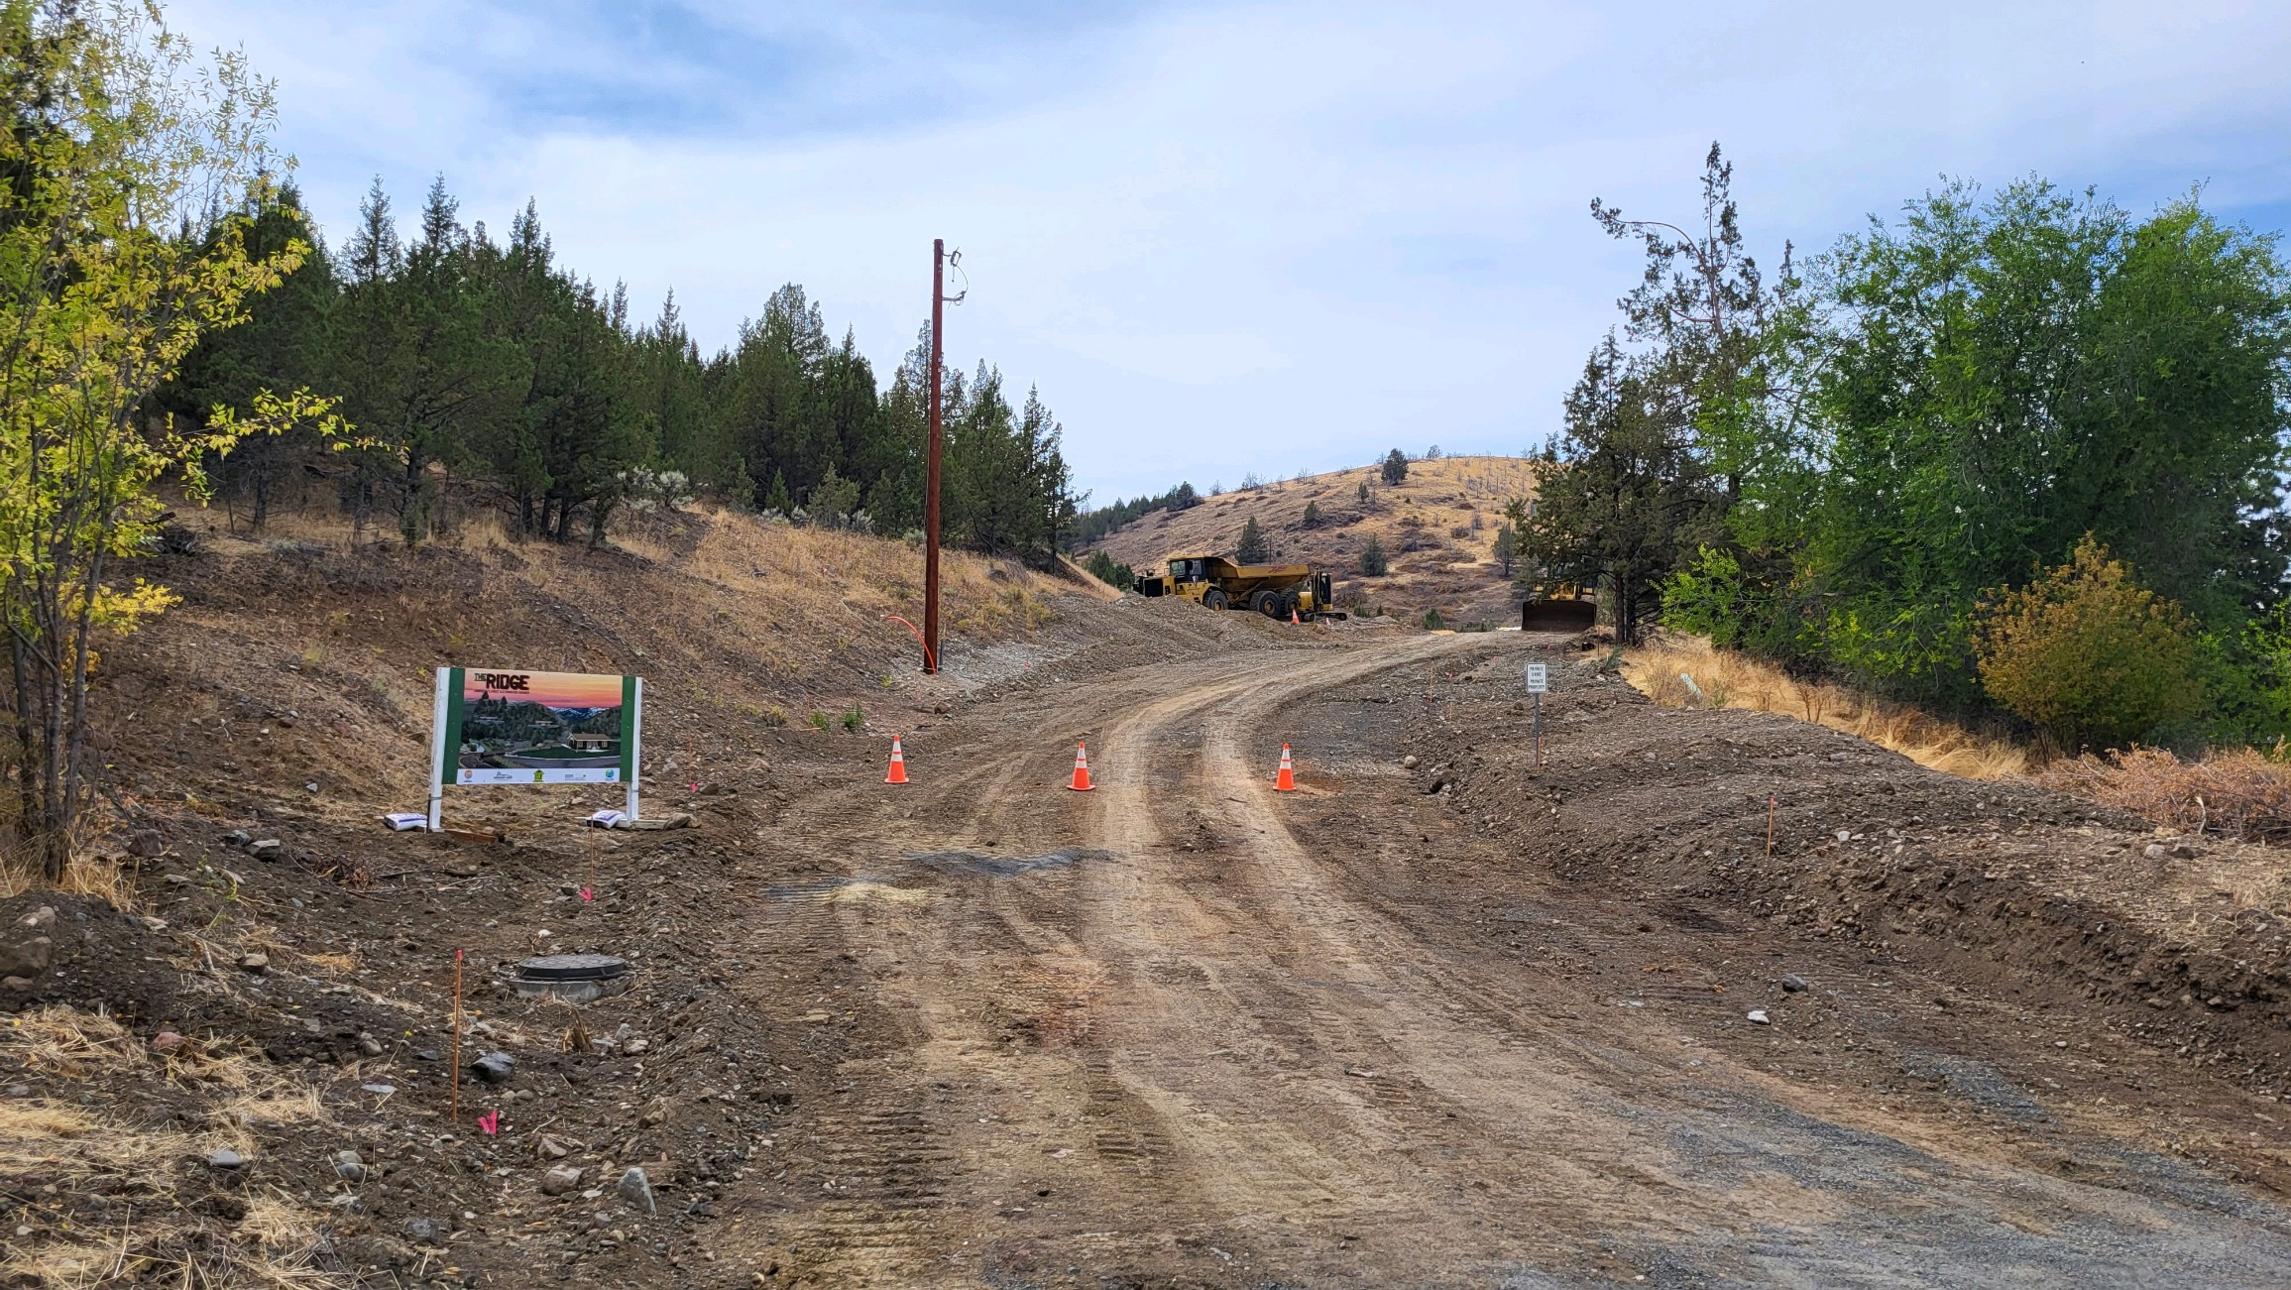
The Ridge Oregon’s 1st 3-D Printed Homes City of John Day

Slide 24
The Ridge Three new housing developments are under way in John Day that could add 100 new homes to the local housing supply over the next few years. The projects are being jumpstarted by funding from the city’s urban Renewal Agency as part of an effort to rebuild declining population, shore up the local tax base and address the city’s housing shortage. Constructing Oregon’s first 3D-printed home is also a part of the plans for the three developments, known as The Ridge, Ironwood Estates, and Holmstrom Heights.

Slide 25
Miller Springs City of Burns

Slide 27
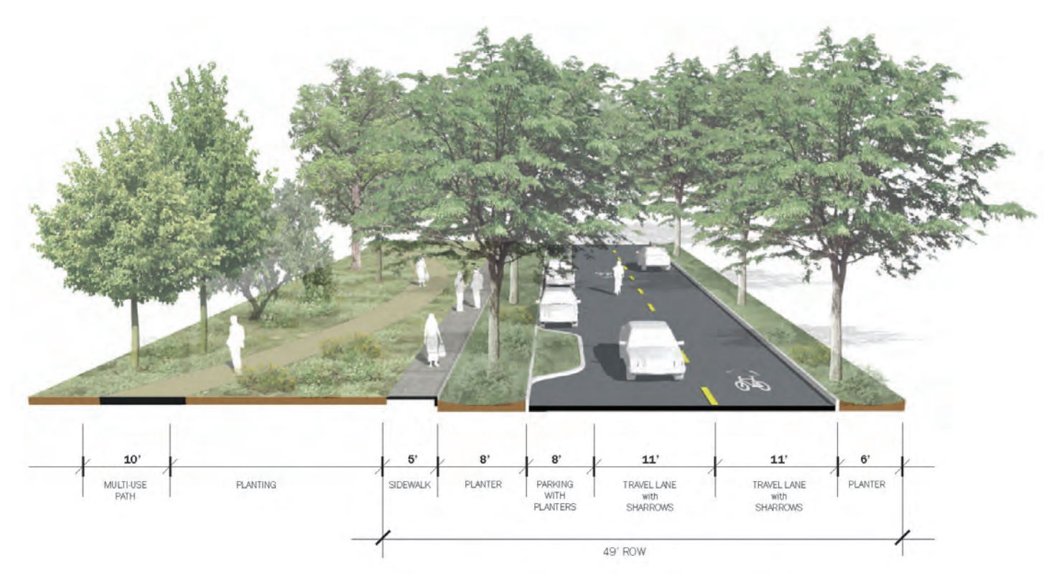
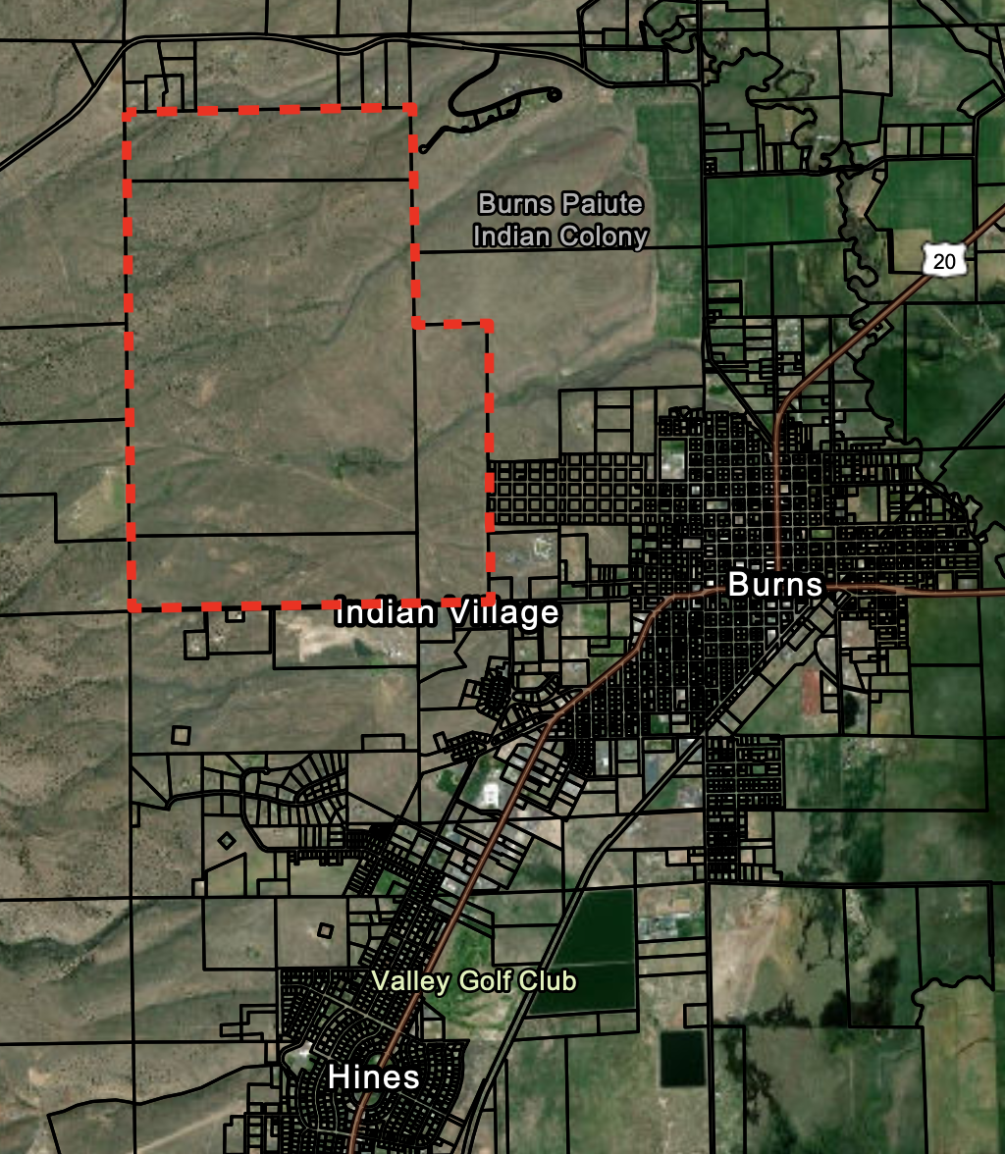
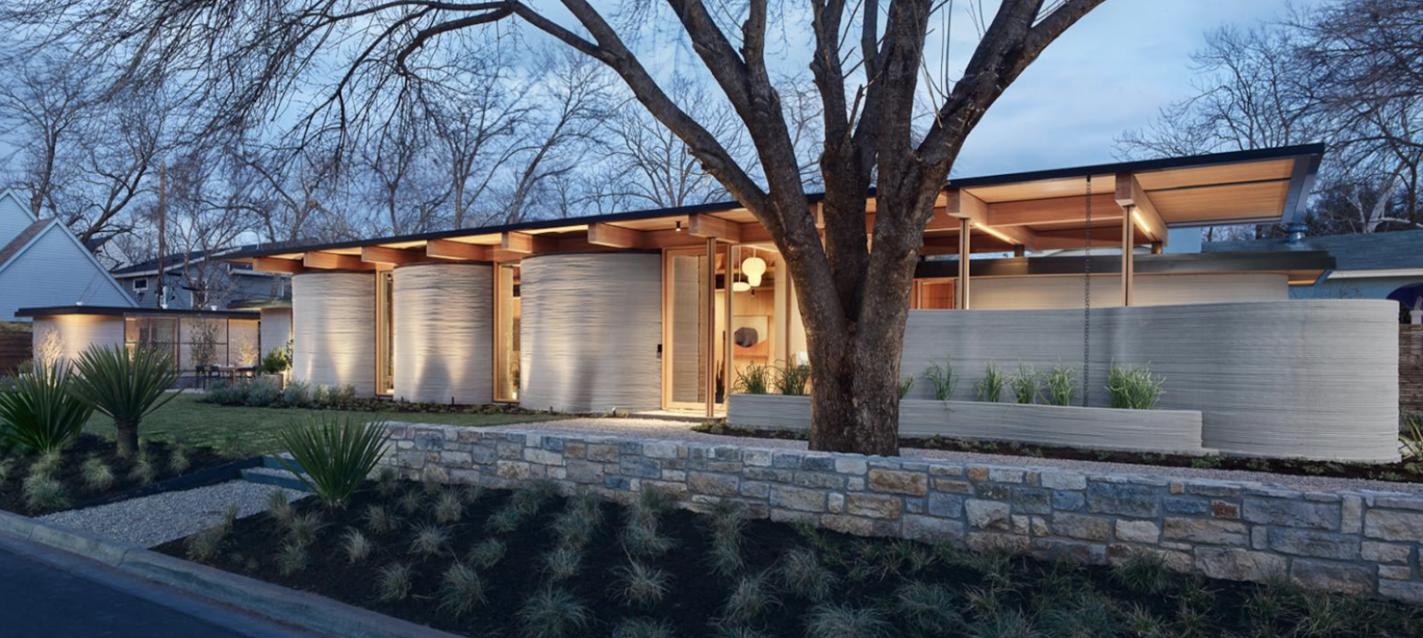

Slide 29
Context
Create a better understanding of rural Oregon context by working on statewide planning efforts with State officials and representatives.

Slide 30
OHNA Process and the missing middle house
BROADBAND INVESTMENTS
STATEWIDE INFRASTRUCTURE INVESTMENTS
REGIONAL TOURISM AND RECREATION

Slide 31
Strategy | Finance | Permits | Design | Development
Concepts | Internal | State Agencies | External | Joint Development Agreements
Plans | External | County | Internal | IGA’s
Land Use Decisions | Building Capital |  | RFP’s | Oversight
Scheduling | URA
Budgetary Planning | SDC’s

Slide 32
Example Street Maintenance
Pavement Condition Assessment
Pavement Management Plan
Potholing, tar, striping, curb and gutter, mill and pave, new pavement, chip seal, etc.
Project List
Labor
Budget (Capital and ORM)

Slide 33
THANK YOU
Questions??

