Slide 1
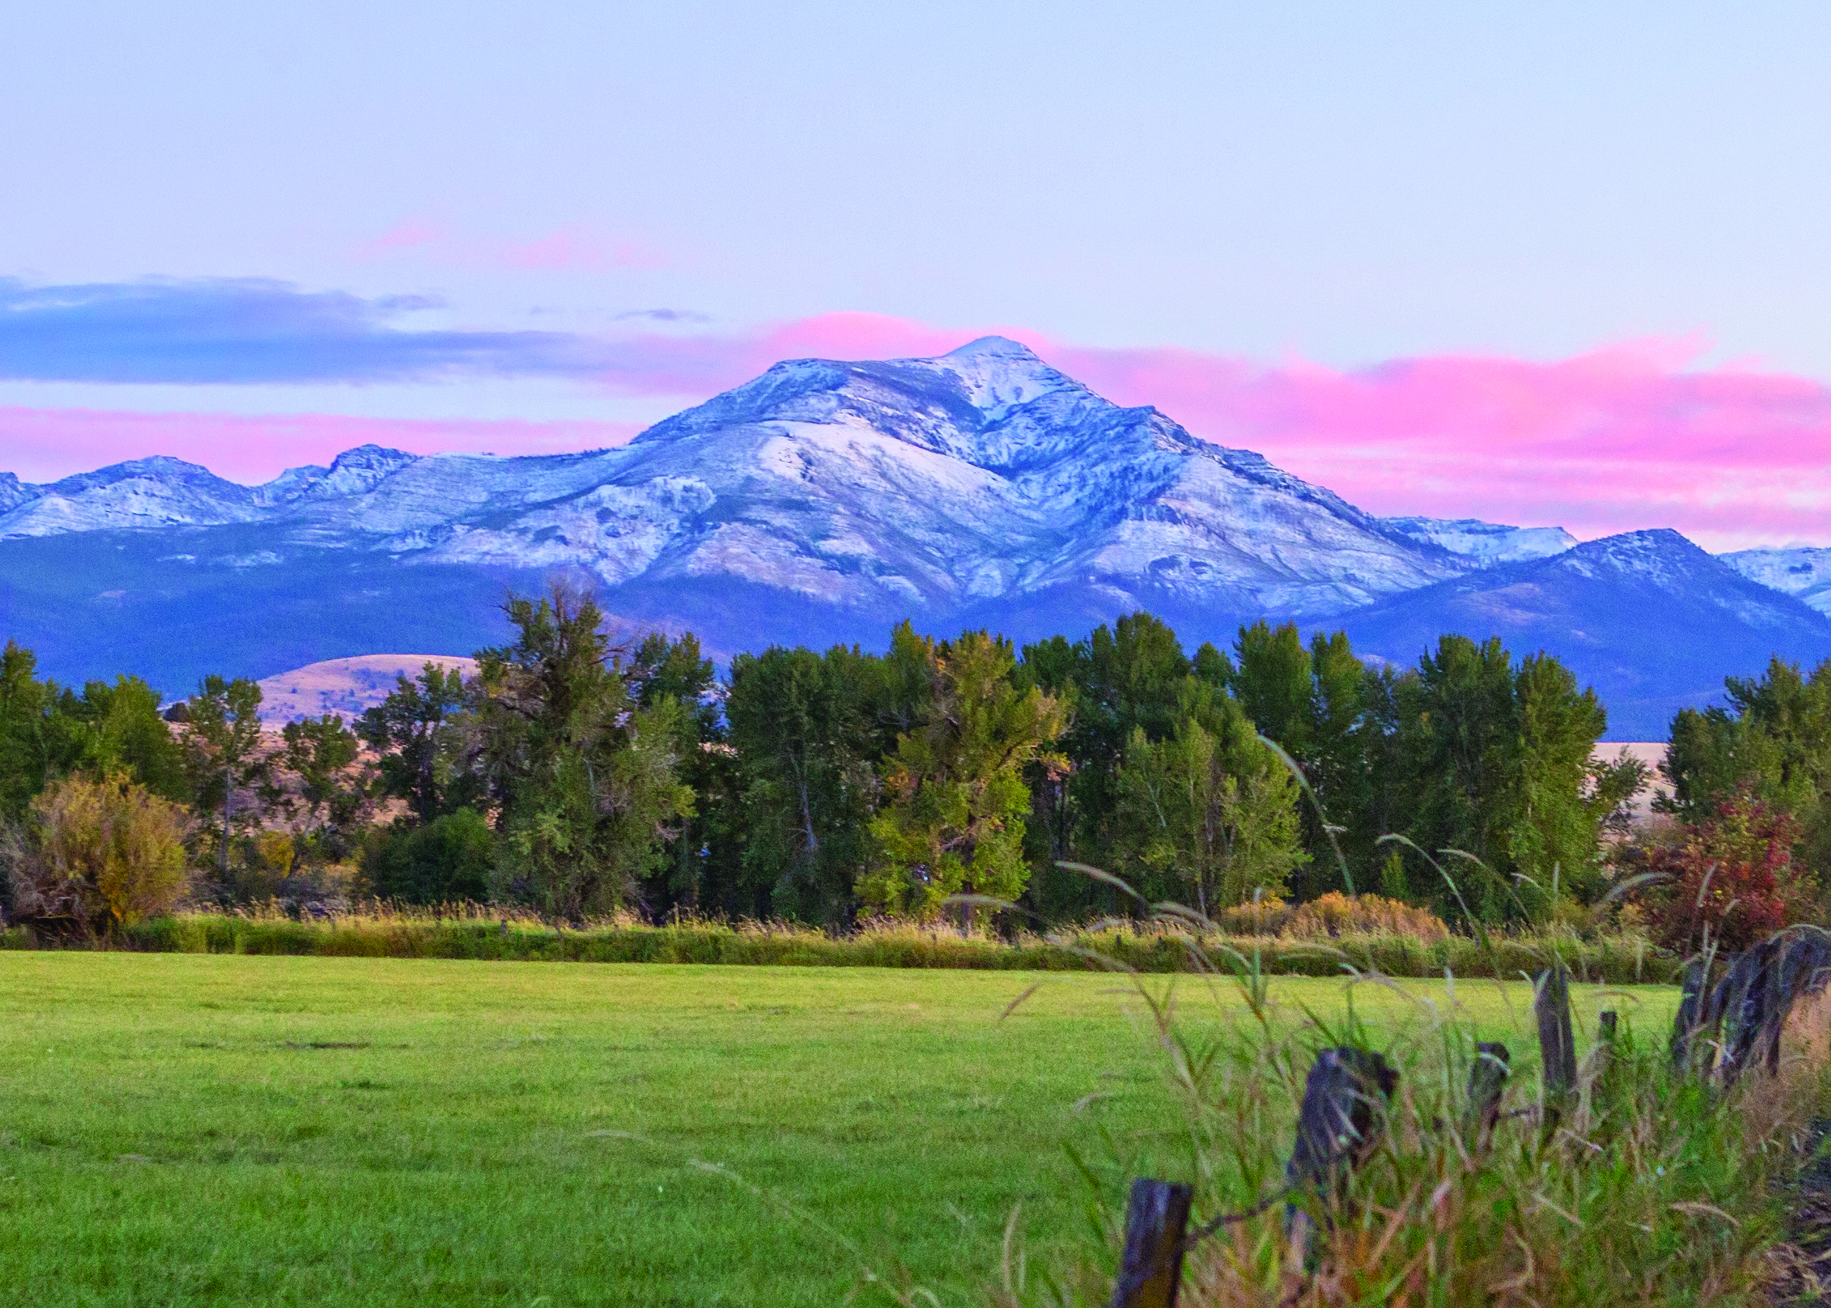
City of John Day, Oregon
Nick Green, City Administrator
Corum Ketchum, Community Dev. Director

Slide 2
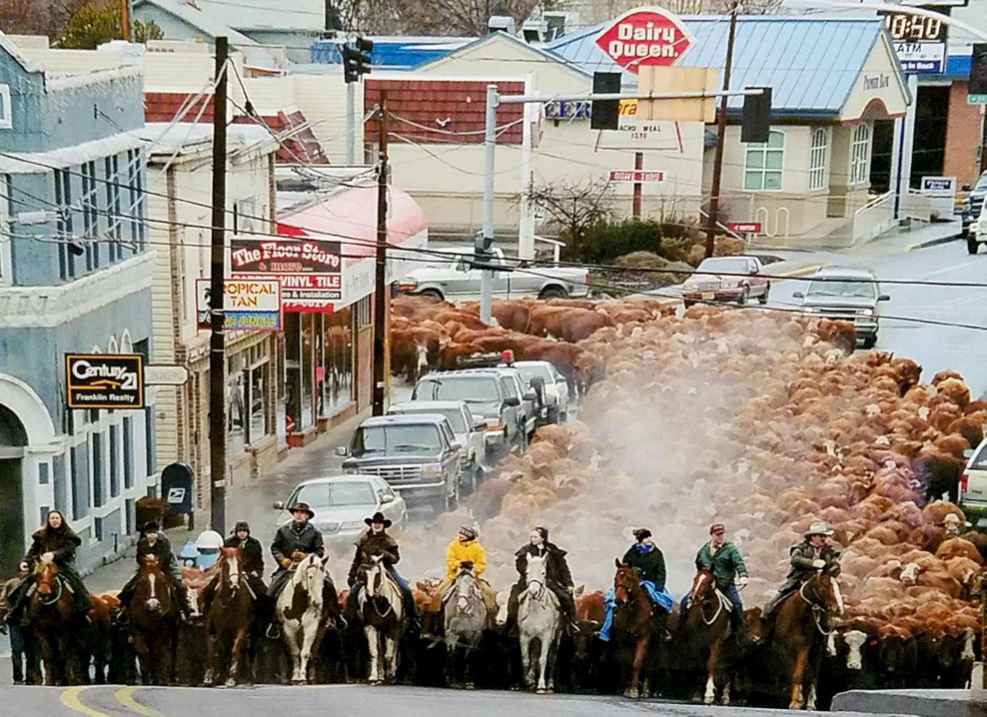

Slide 3
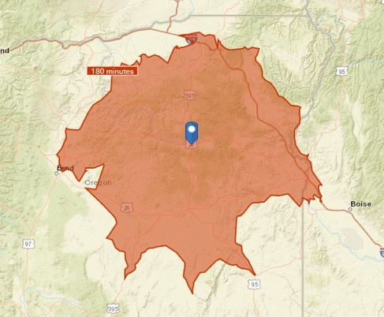
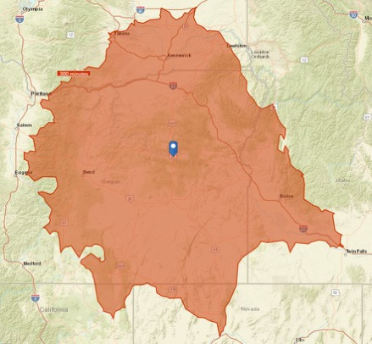
John Day OR is Frontier Country
~3 hours from Boise ID | ~5 hours from Portland, OR
2-Hour Driveshed
5-Hour Driveshed

Slide 4
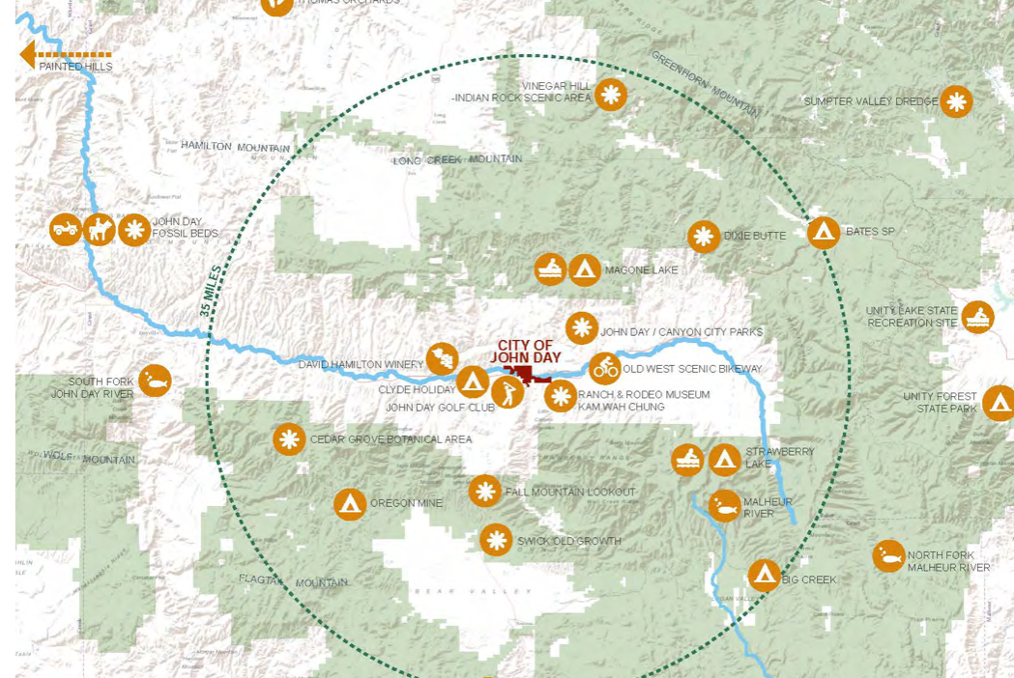
Recreation Opportunities
Recreation opportunities

Slide 5
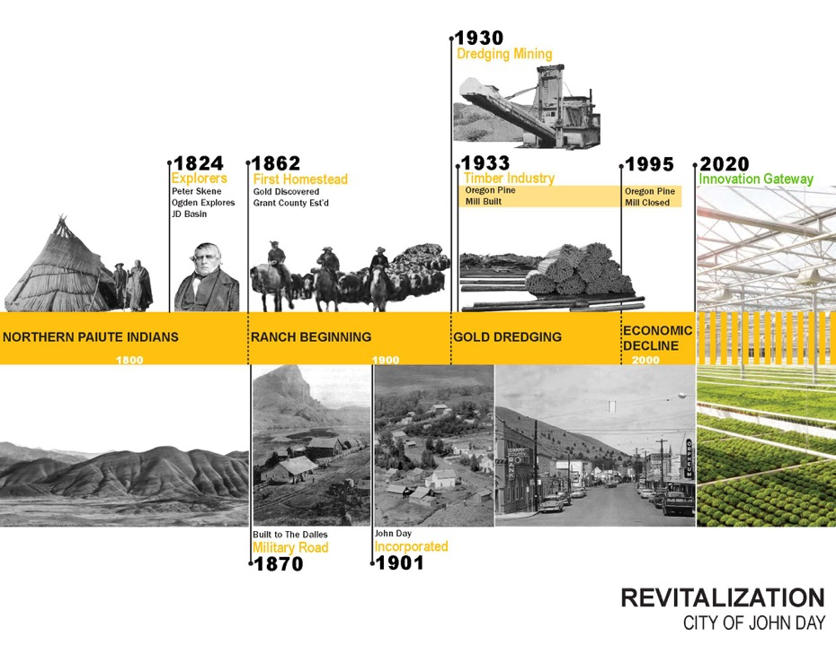

Slide 6
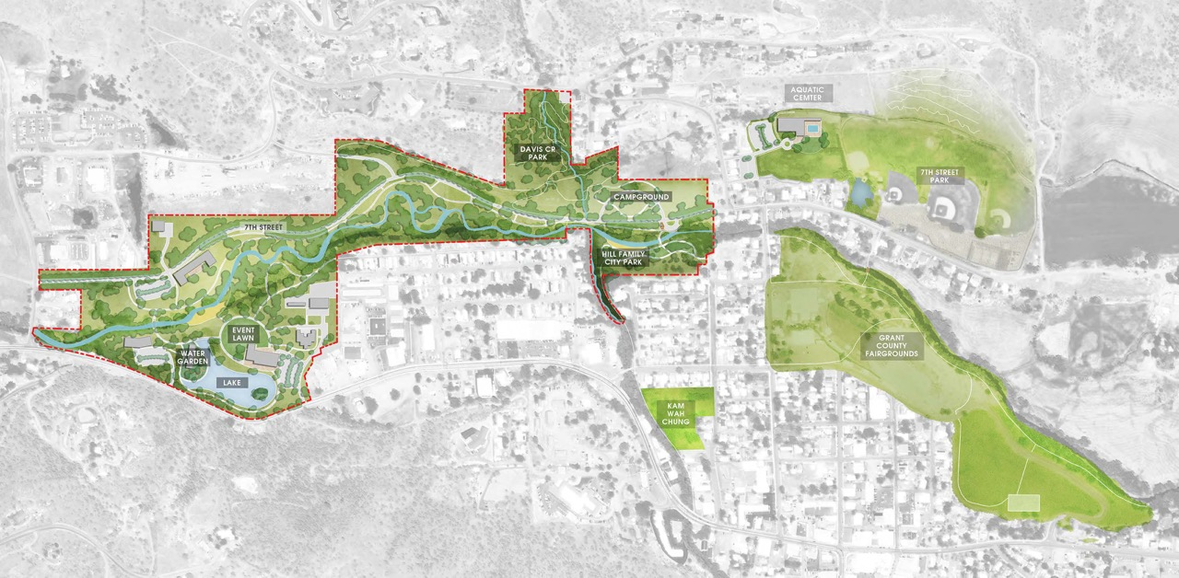
INNOVATION GATEWAY

Slide 7
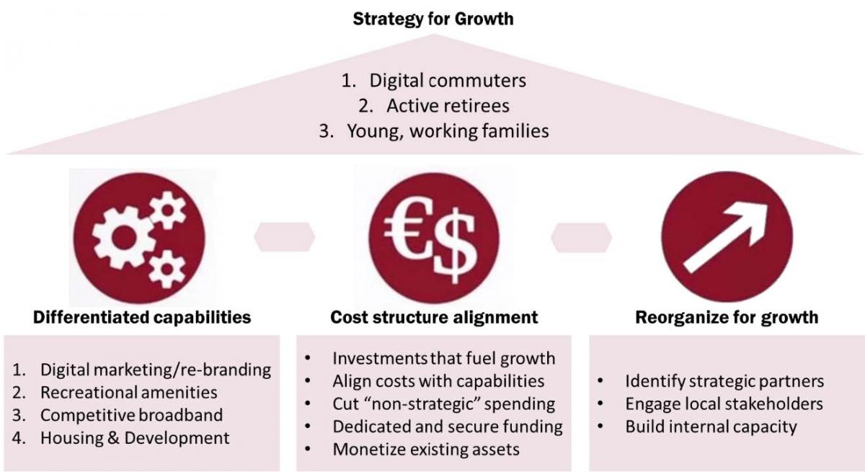
John Day’s Strategy
Introduction
Combating population decline through public-sector investments
Pursuing joint investment strategies with public & private agencies

Slide 8
Community Investment Strategy
Community Investment Strategy
A Five-Year Investment Plan for John Day, 2020-2025
Implement policies that promote recreation & tourism

Slide 9
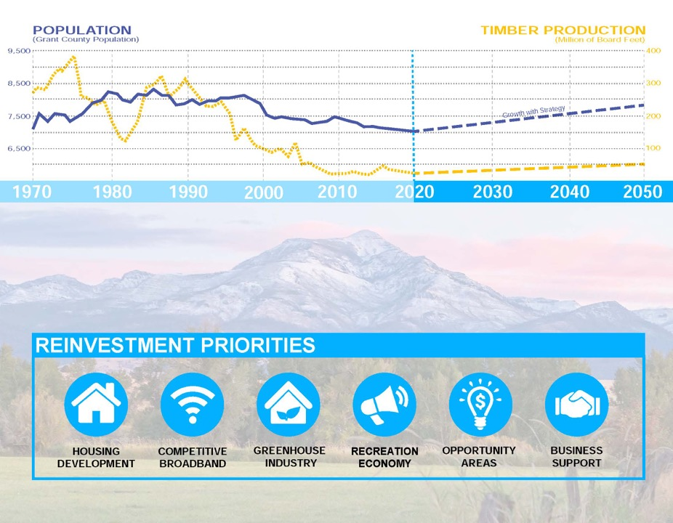
Community Investment Outcomes
Almost $30 million in public investments

Slide 10
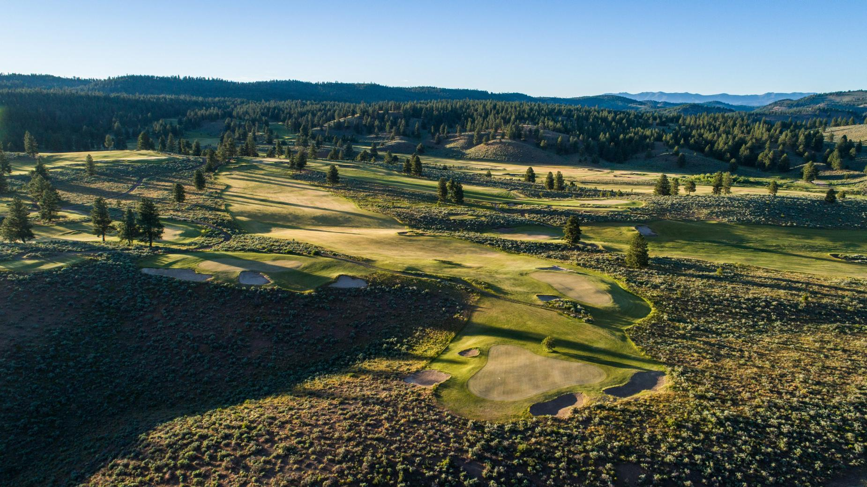
RERC Report Recommendations
RERC Report
Four goals supporting a recreation economy
Goal 1: Promote John Day’s Main Street as a gateway to nearby public lands and communities
Goal 2: Accelerate and incubate John businesses to expand services surrounding outdoor recreation.
Goal 3: Galvanize community support and participation (residents and business owners) in John Day’s recreation economy
Goal 4: Expand outdoor recreation opportunities for all in John Day.

Slide 11
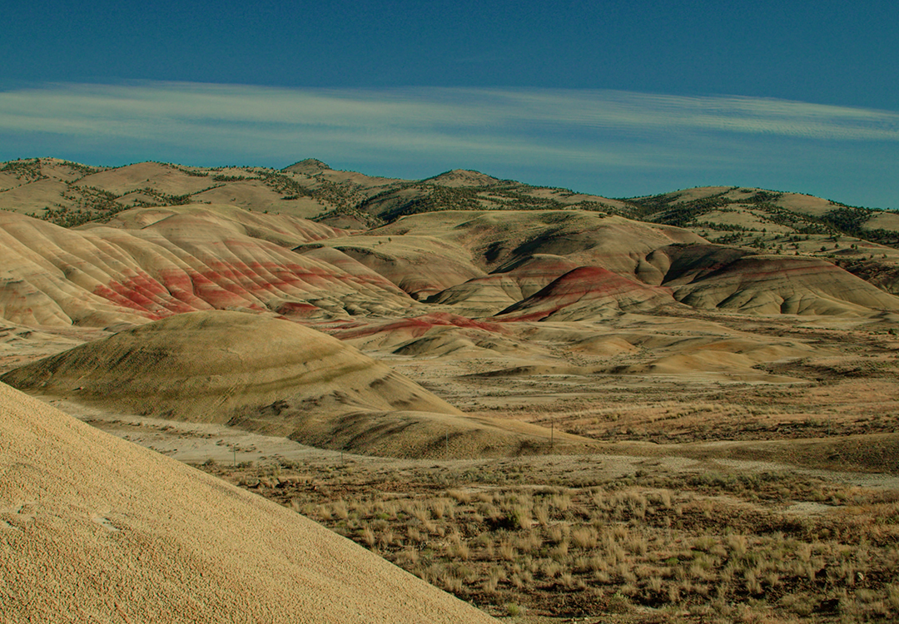
Goal 1: Promote John Day’s Main Street as a gateway to nearby public lands and communities

Slide 12
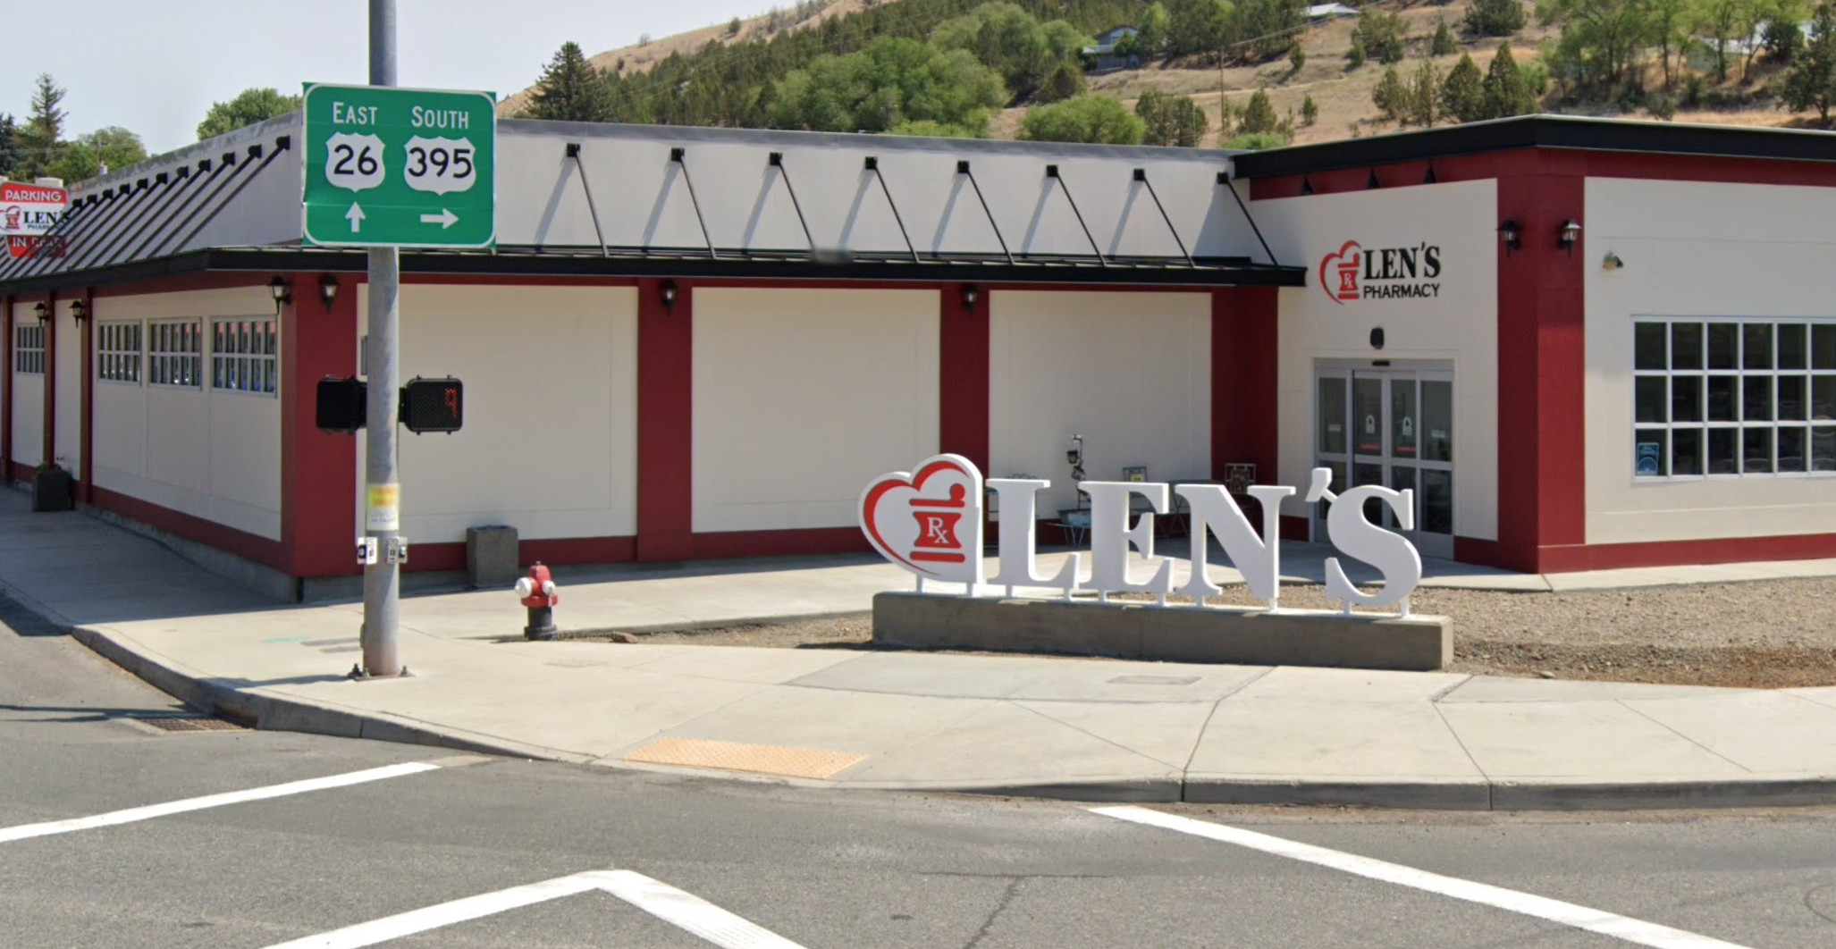
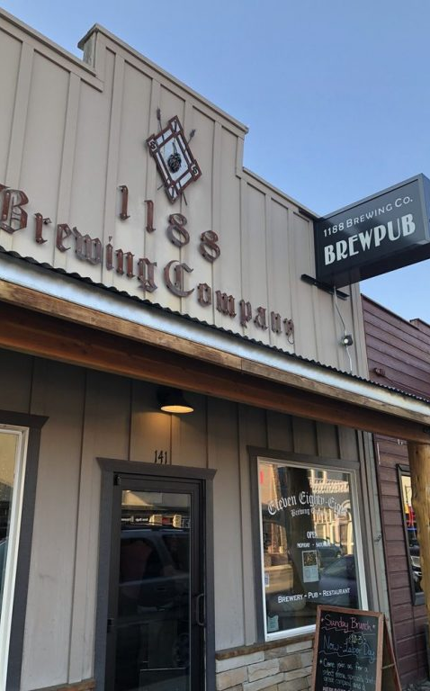
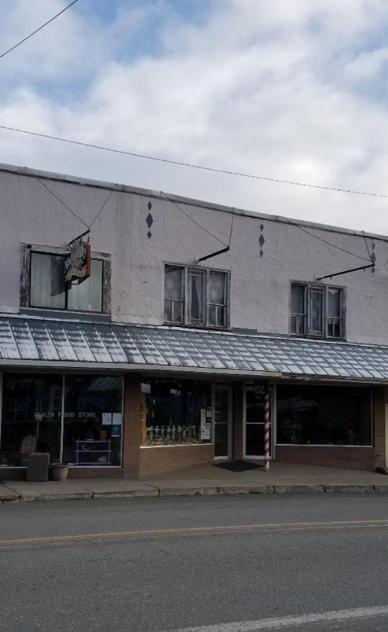
Programs
Goal 1: main street gateway
Developing places and businesses worth visiting
Weaver Building
Len’s Pharmacy
Main Street Grants
Funded with Support of the Oregon Main Street Grant Revitalization program (2018 – 2022)
Notes:
Drive visitors downtown, provide information about recreation at downtown businesses

Slide 13
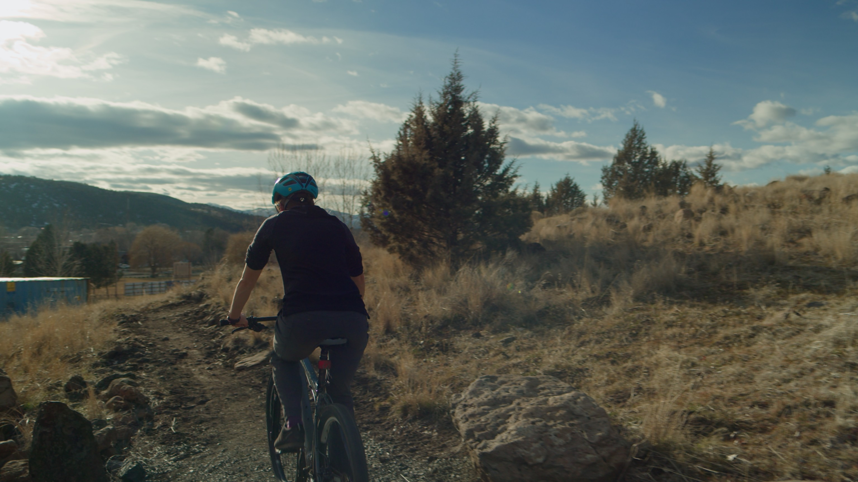
Goal 2: Accelerate and incubate John businesses to expand services surrounding outdoor recreation.

Slide 14

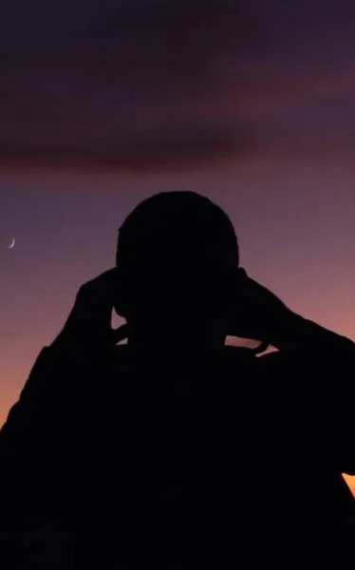
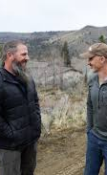



Growing Rural Oregon [GRO]
Goal 2: supporting recreation businesss
Identifying and supporting outdoor recreation opportunities and businesses
Skills building
Youth development
Mentorship
Events

Slide 15
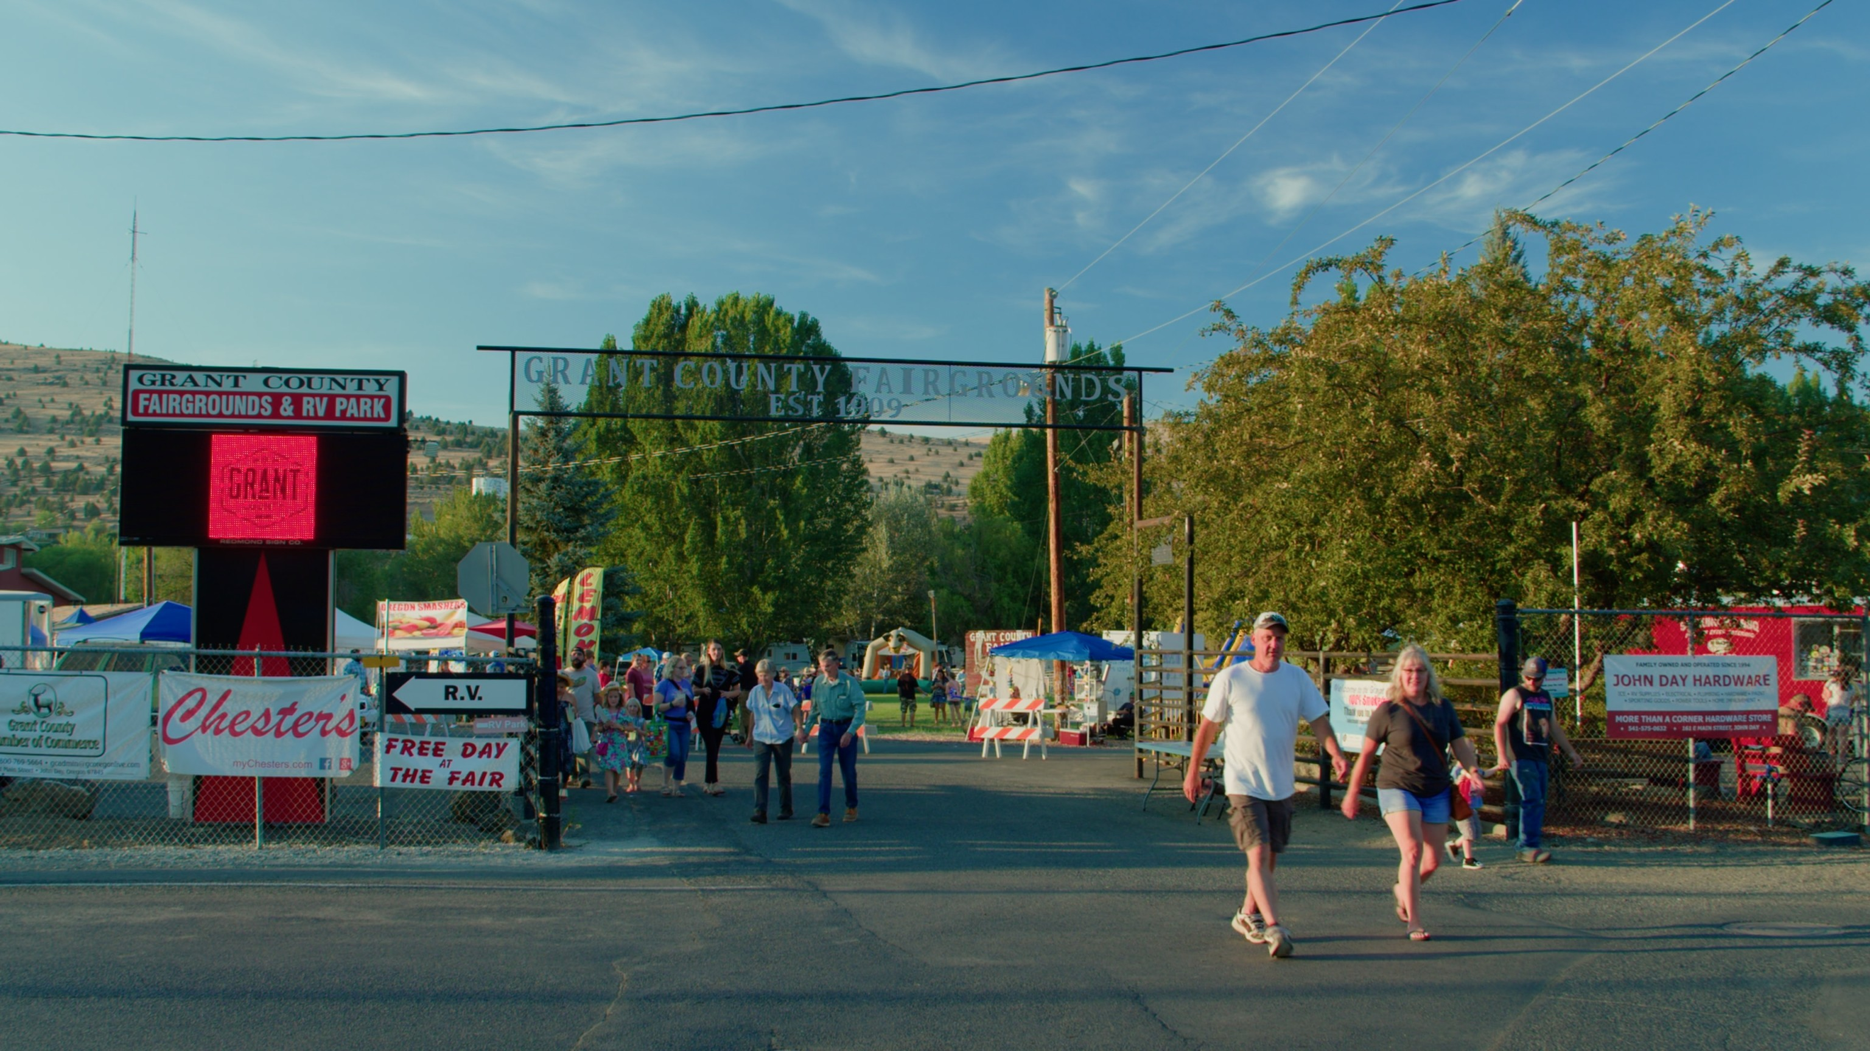
Goal 3: Galvanize community support and participation (residents and business owners) in John Day’s recreation economy

Slide 16
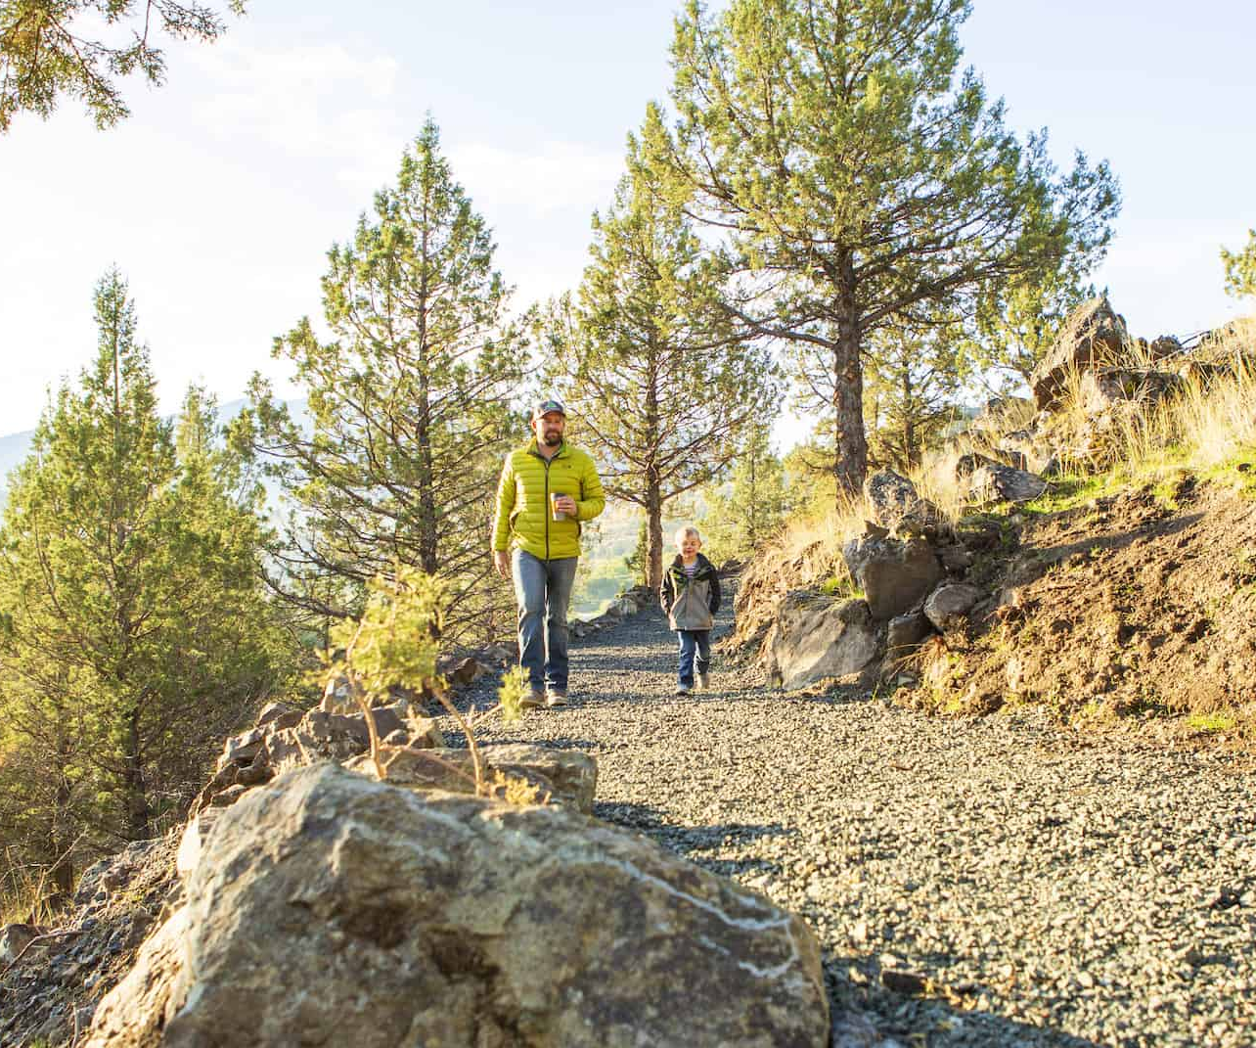
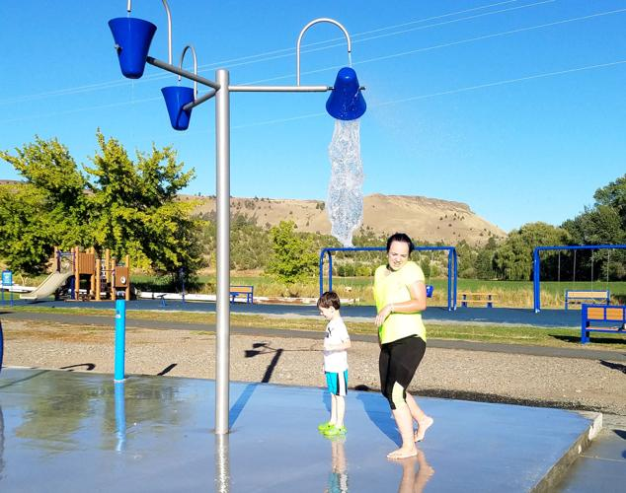
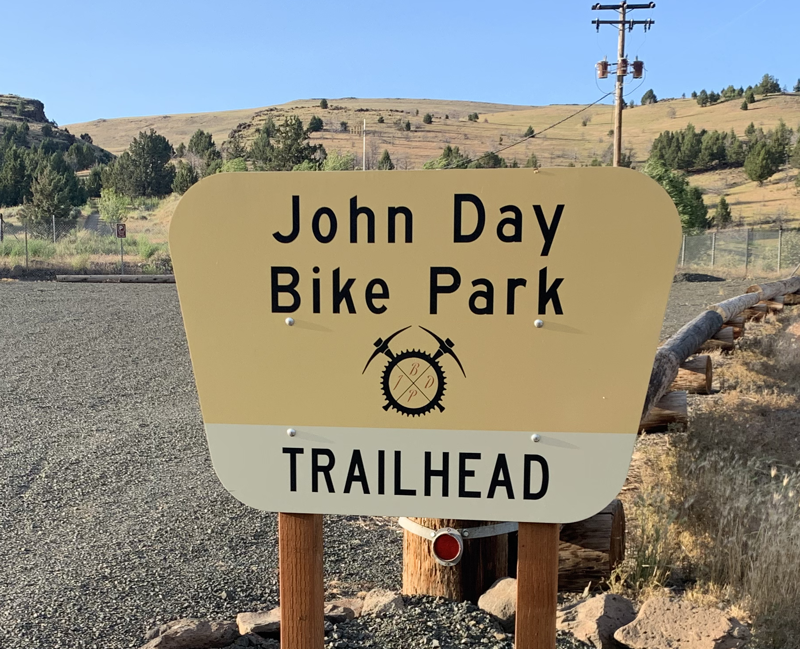
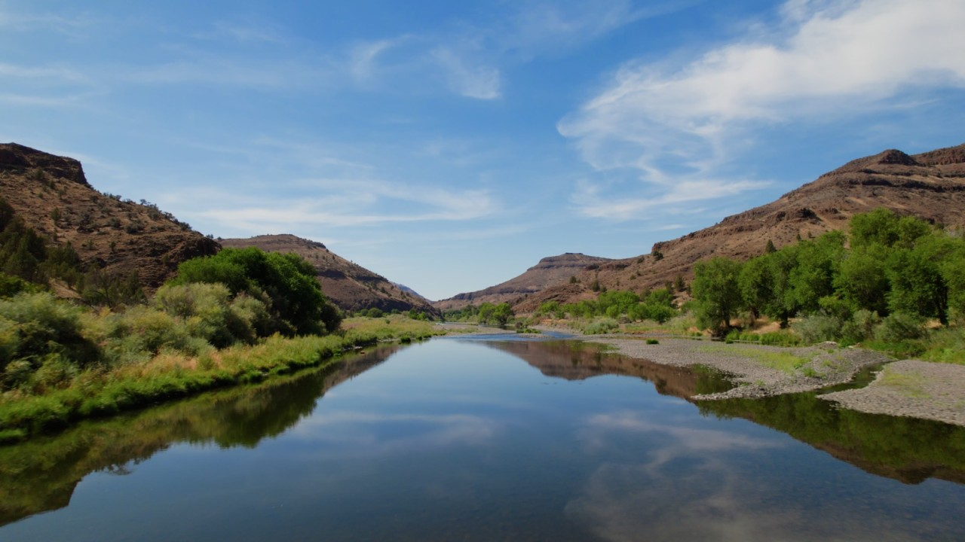
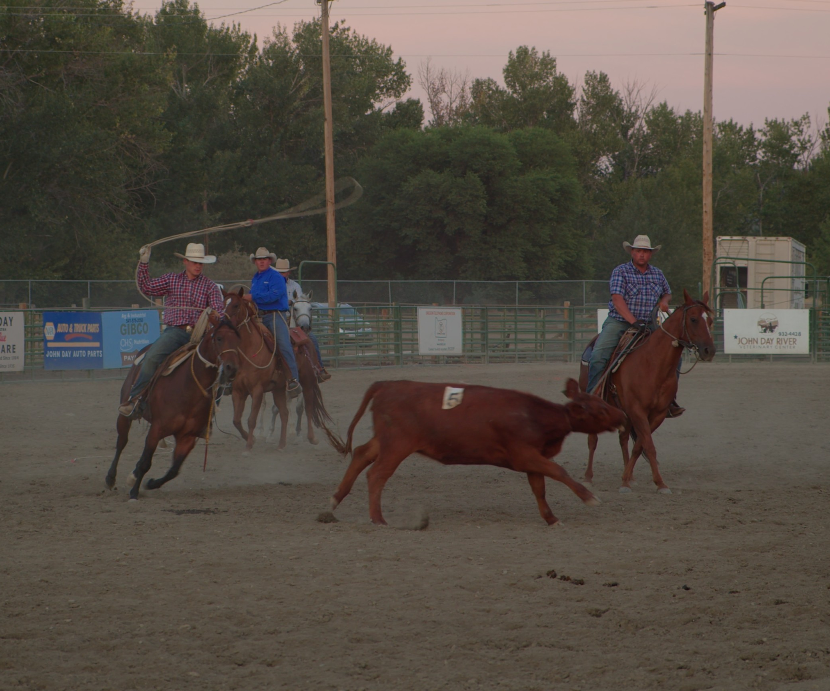
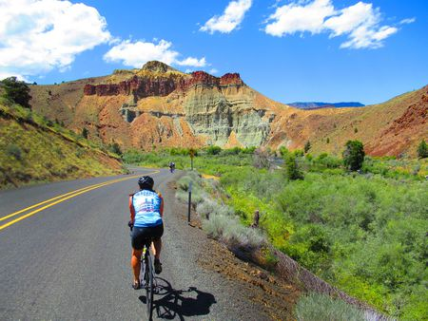
Meeting community needs
Goal 3: Galvanizing community support
Hiring outreach staff, providing recreation programs and places

Slide 17
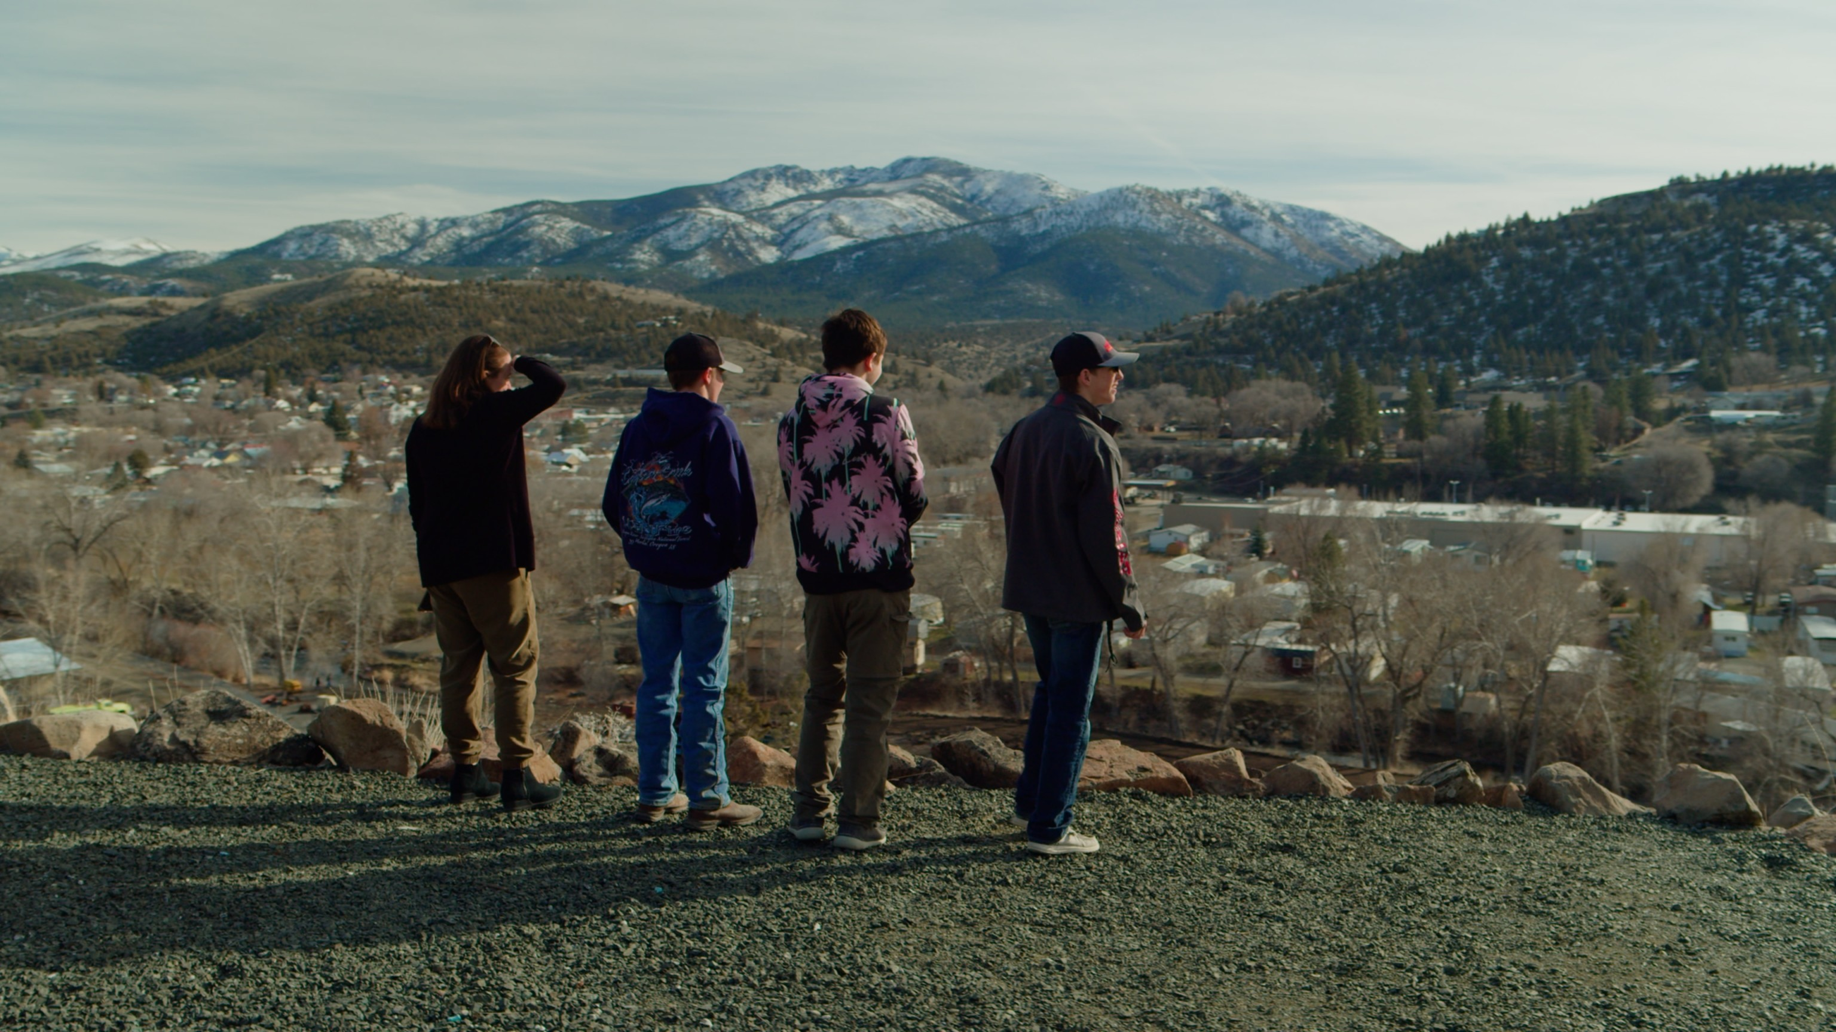
Goal 4: Expand outdoor recreation opportunities for all in John Day.

Slide 18
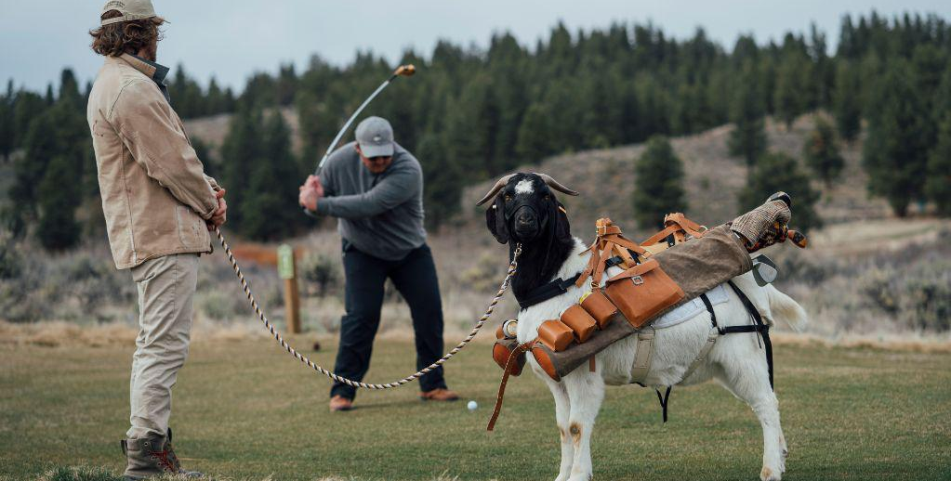
Active Recreation Opportunities
Goal 4: Active recreation
Trails
Mountain Biking
Splashpad
Golf
Parks
Pool For All

Slide 19
Pool for All Project
Goal 4: Active recreation
Central Grant County Swim and Recreation Center

Slide 20
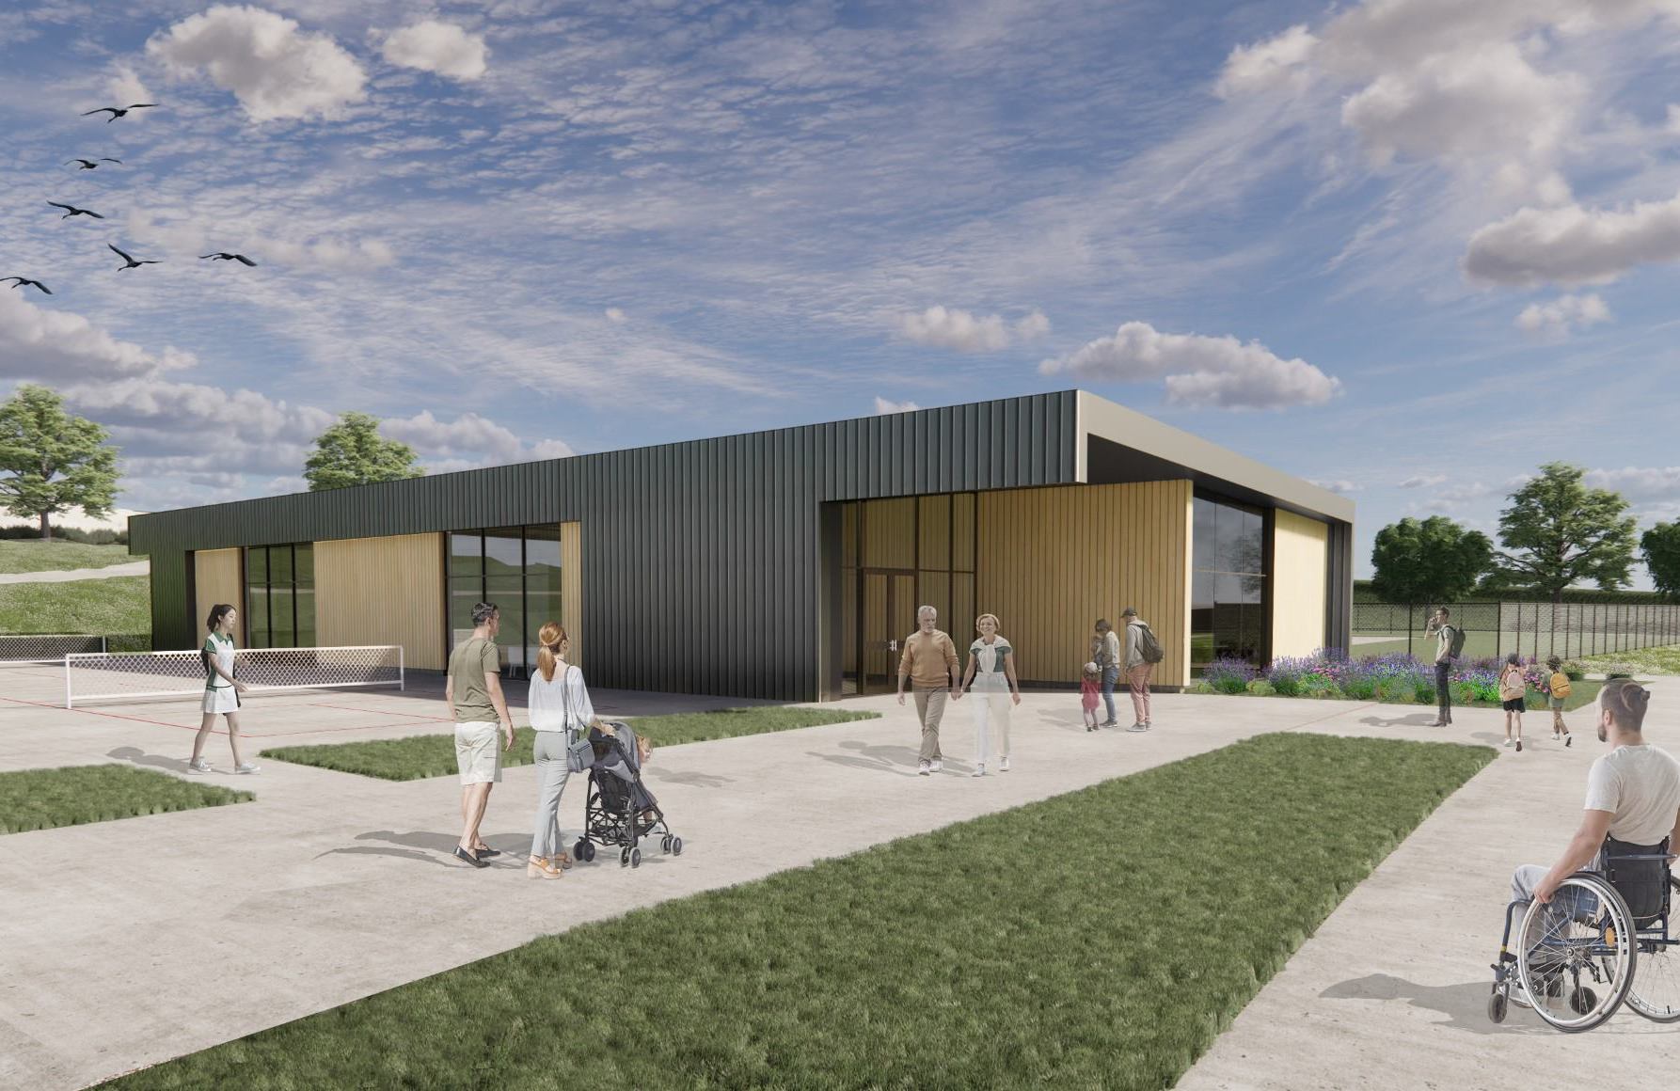
Pool for All Project
Goal 4: Active recreation
Swim Center for all ages and abilities

Slide 21
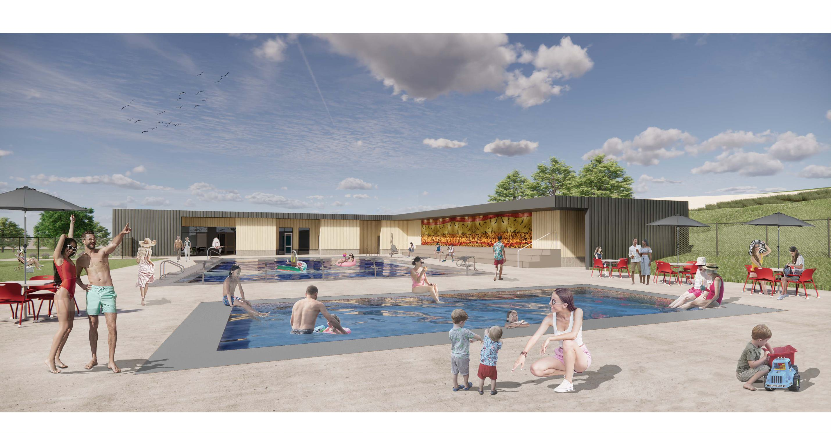
Pool for All Project
Goal 4: Active recreation
Notes:
Therapy pool for young and old swimmers
ADA Accessibility
Costs reduced through government matching programs

Slide 22
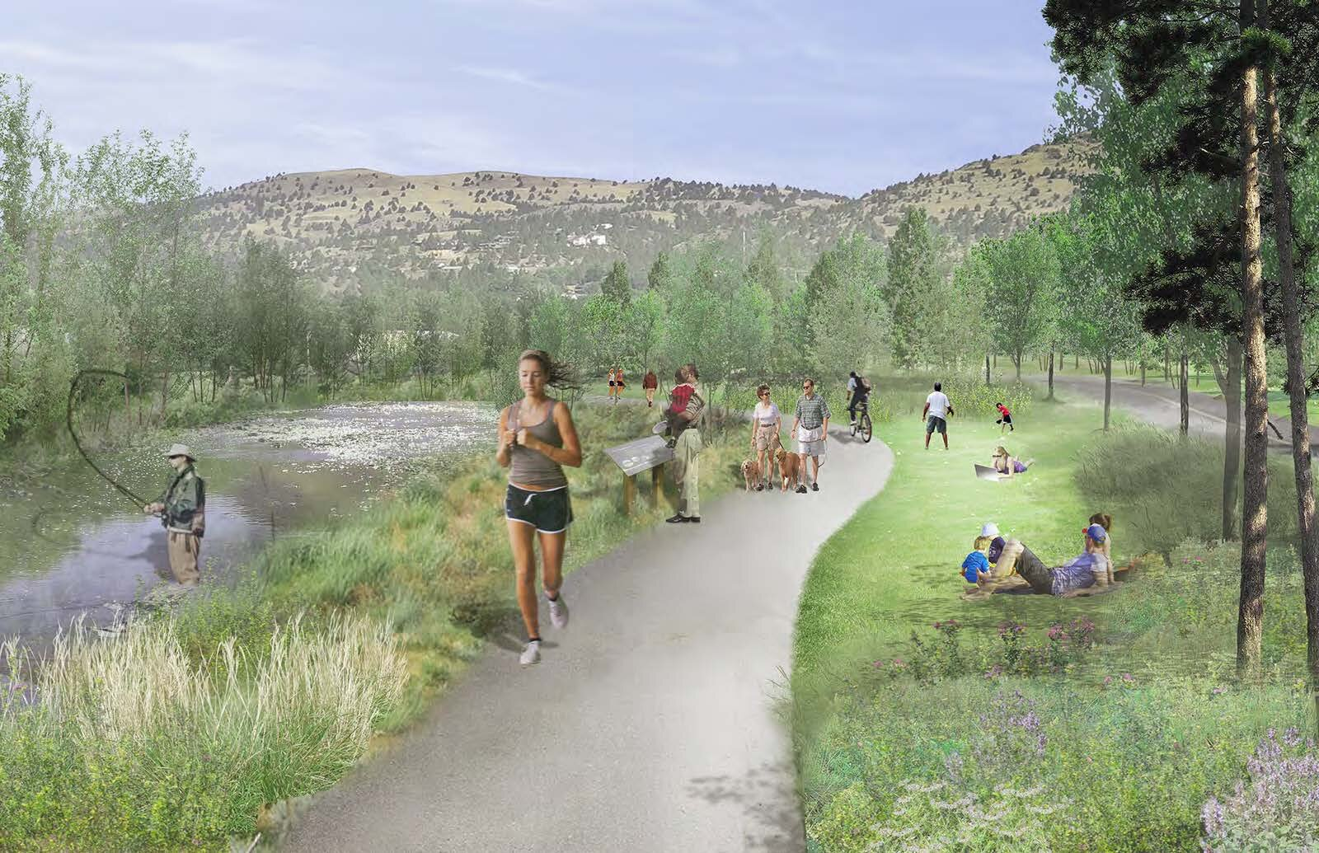
Trails and Camping
Goal 4: Active recreation

Slide 23
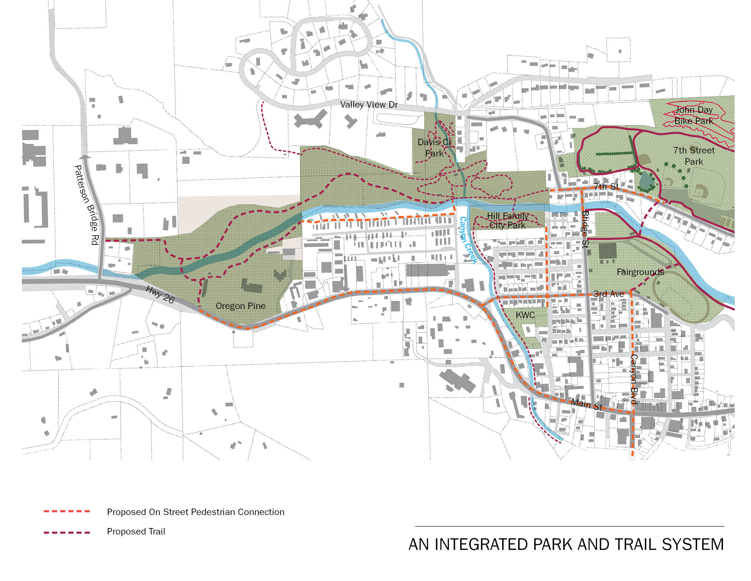
Goal 4: Active recreation
Funded and in construction

Slide 24
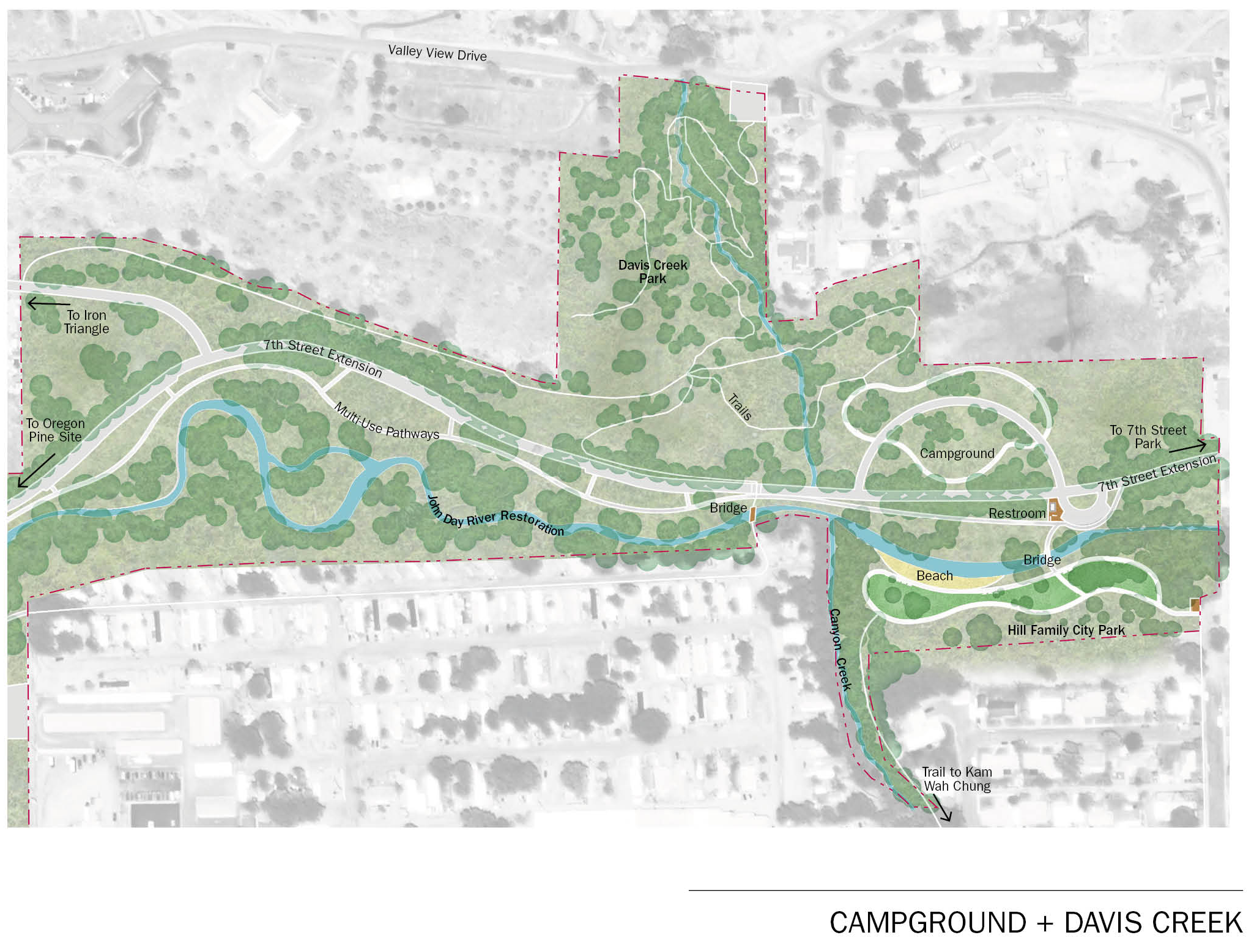
Goal 4: Active recreation
Davis Creek Completed, Campground underway

Slide 25
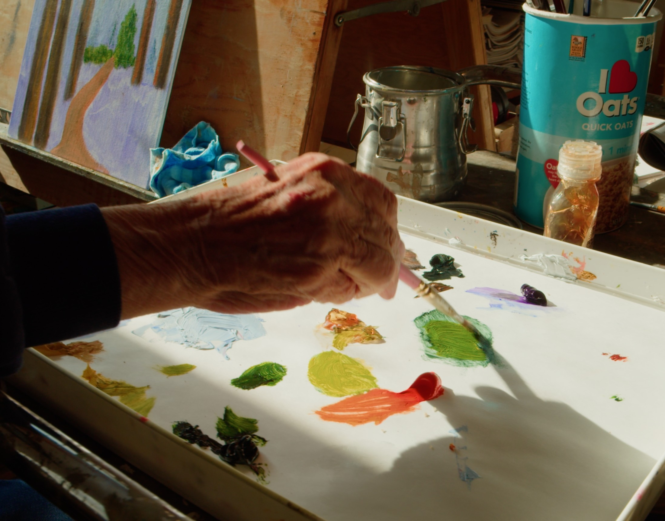
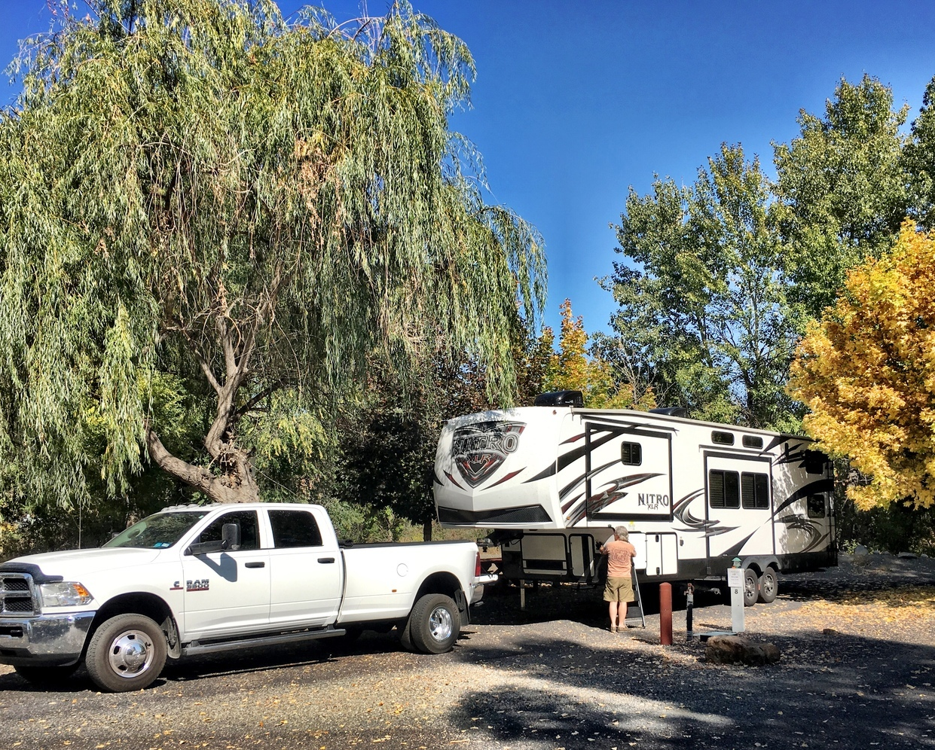
Passive Recreation Opportunities
Goal 4: Passive recreation
Community Arts
Museums
Library Redesign
RV Camping
Kam Wah Chung
Pit Stop

Slide 26
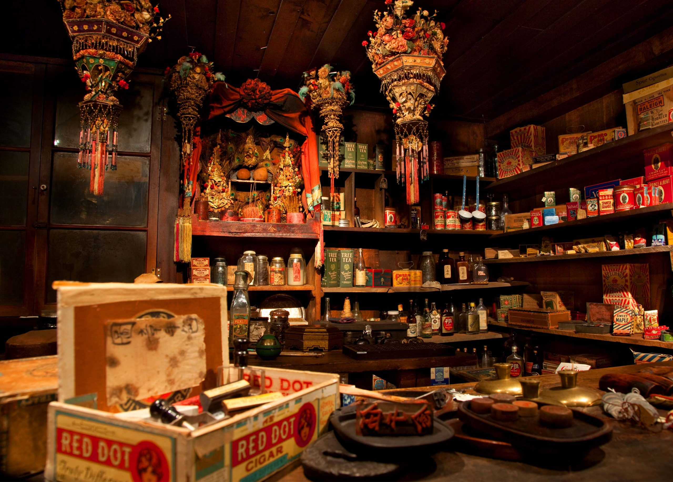
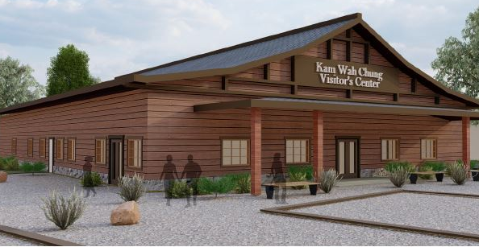
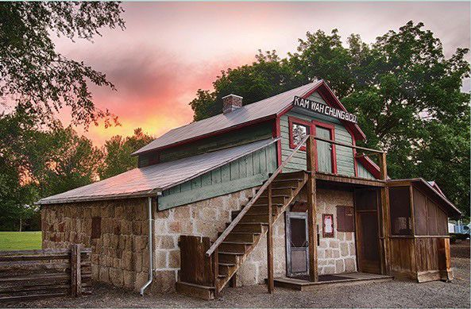
Kam Wah Chung State Heritage Site
Goal 4: Passive recreation
Notes:
Time capsule of TCM and goldrush lifestyle
Partnership to expand with City of John Day
Operated by Oregon State Parks and Rec.

Slide 27
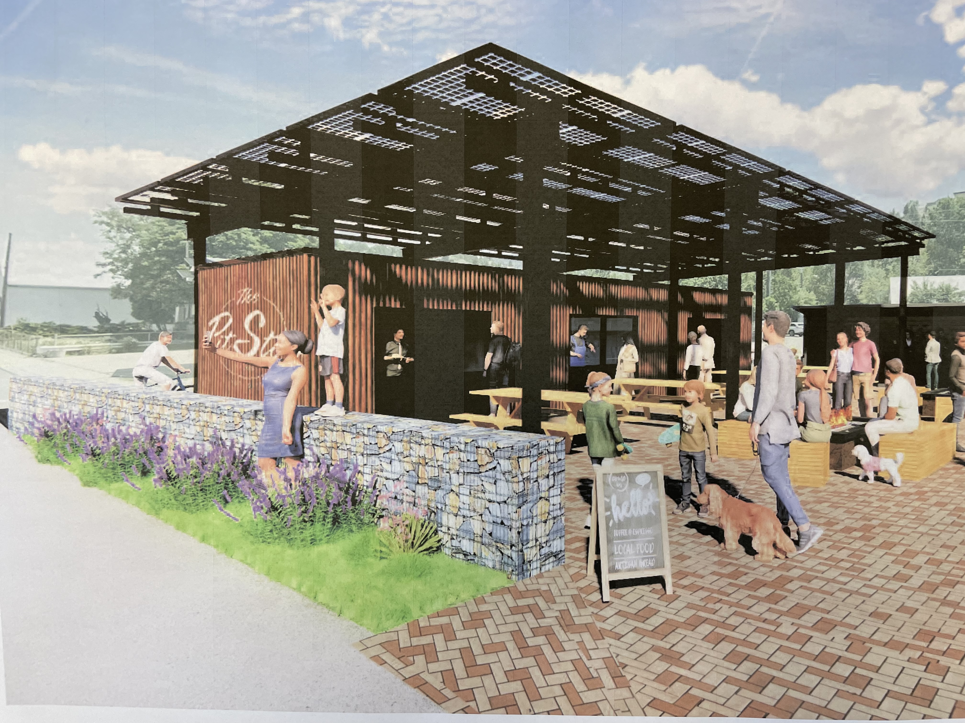
Pit Stop – Outdoor Livingroom
Goal 4: Passive recreation
Notes:
Food carts
Cycling amenities, lockers and pumps
Event space

Slide 28
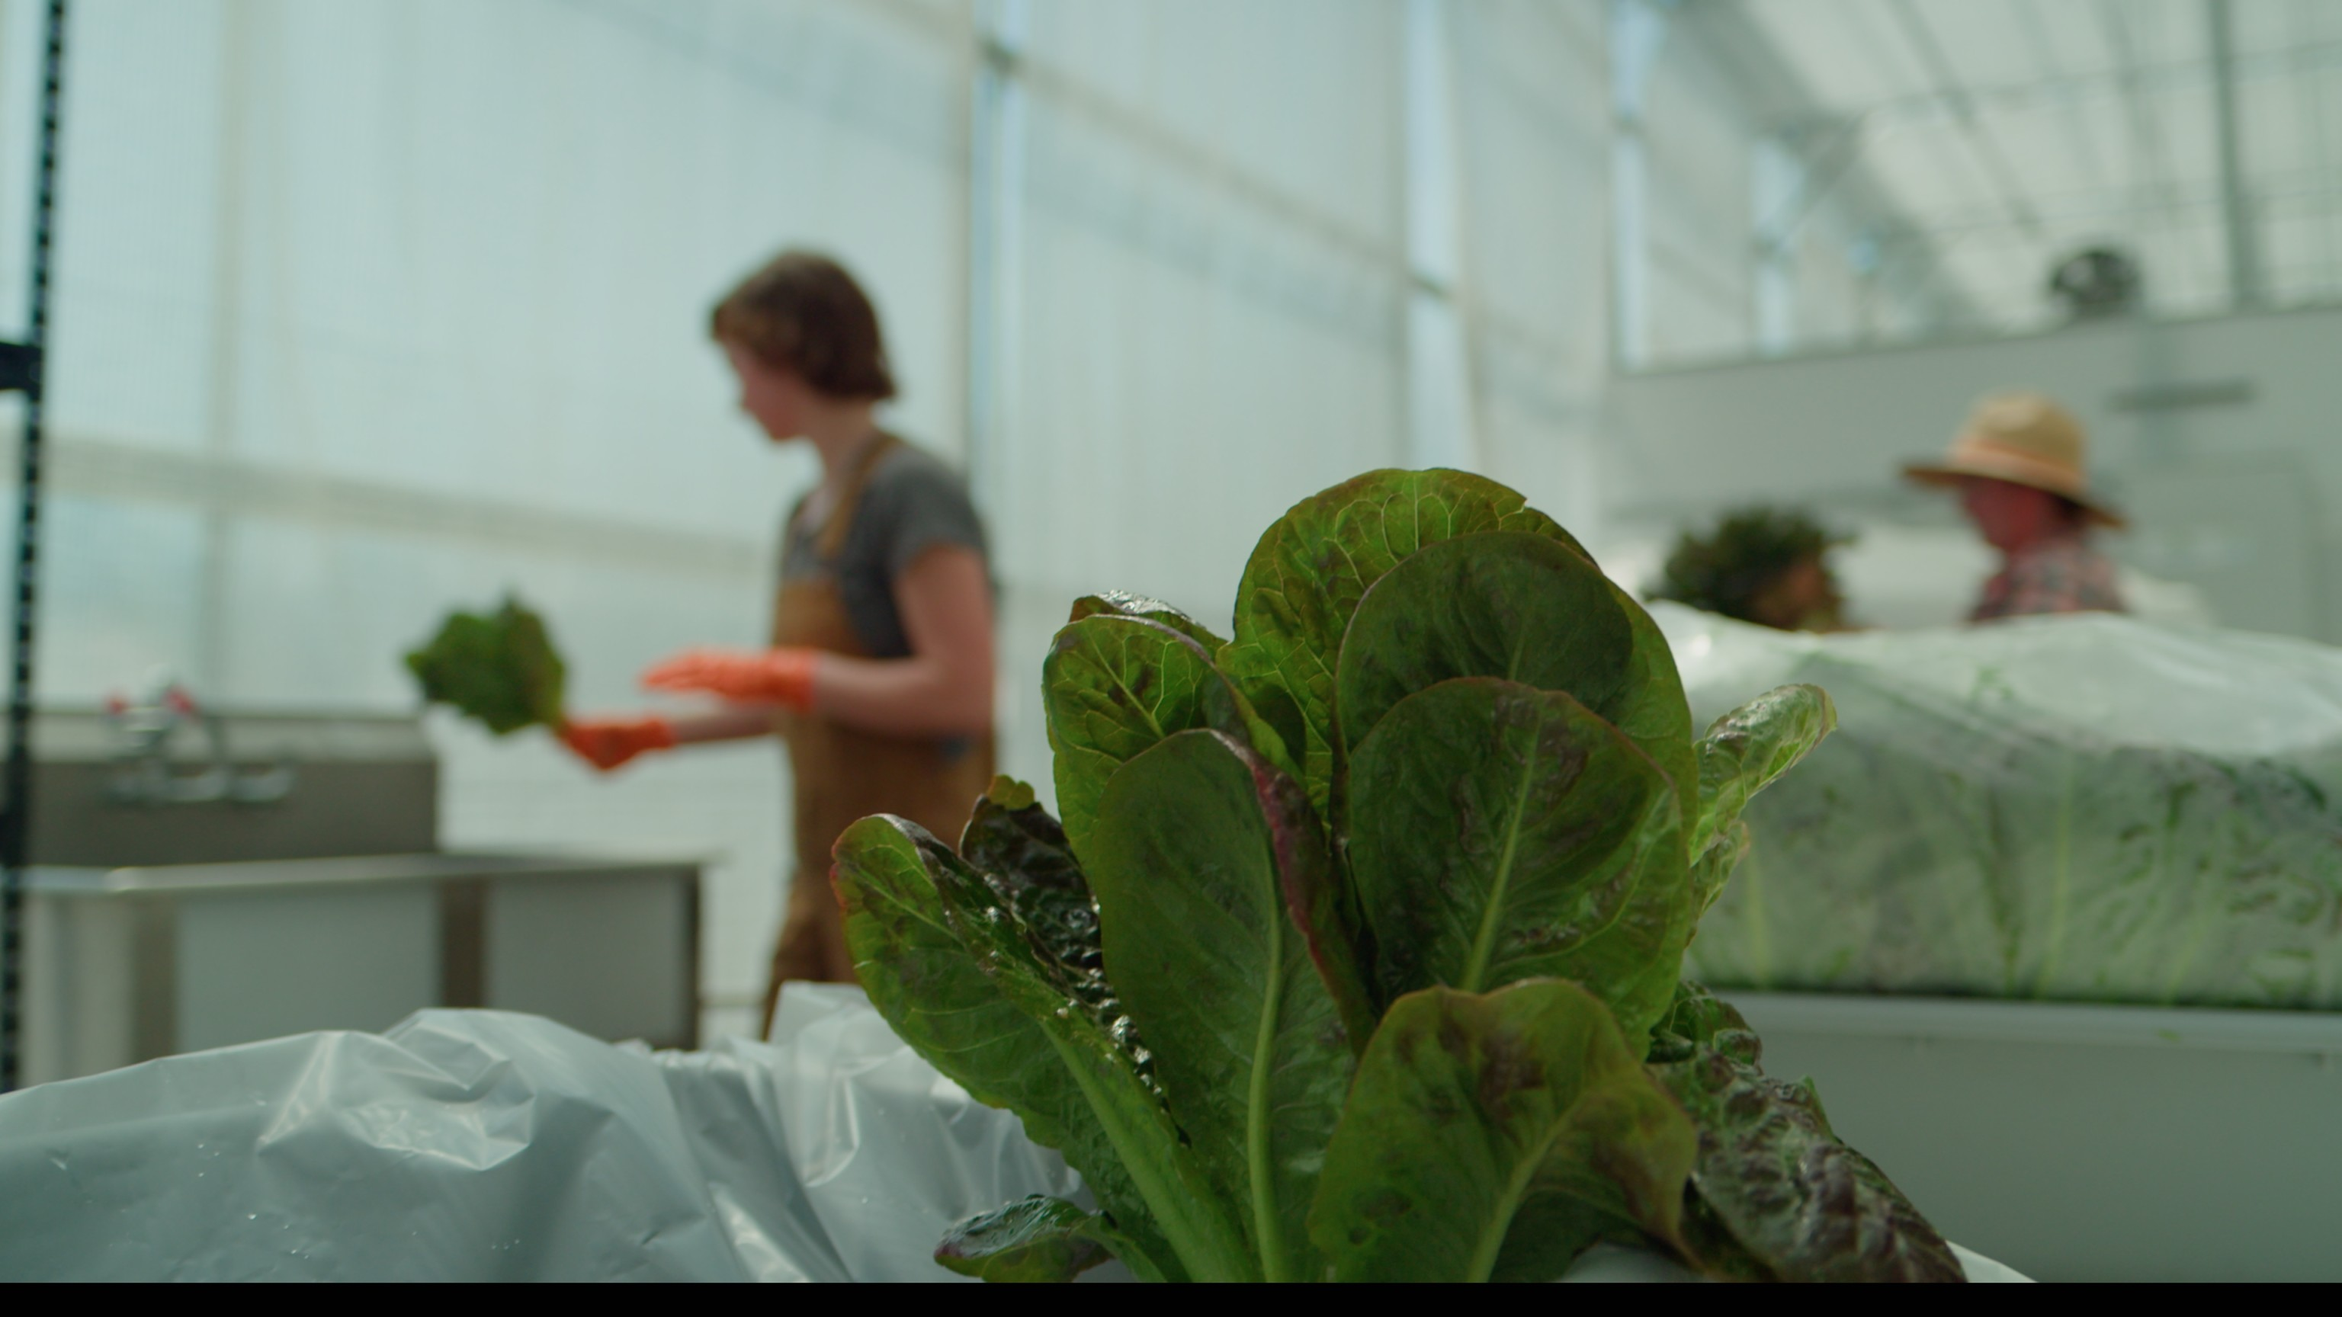
Other strategies:
Sustainability

Slide 29
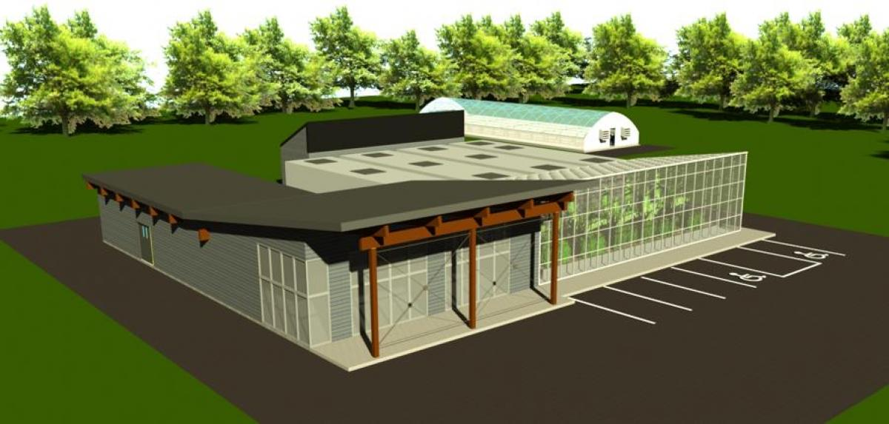
Water Treatment Plant
Sustainability
Class 5 wastewater recycling center
Replaces 74-year-old plant
Provides water for municipal, industrial and agricultural uses
Increases available water for the environment, communities and rights holders

Slide 30
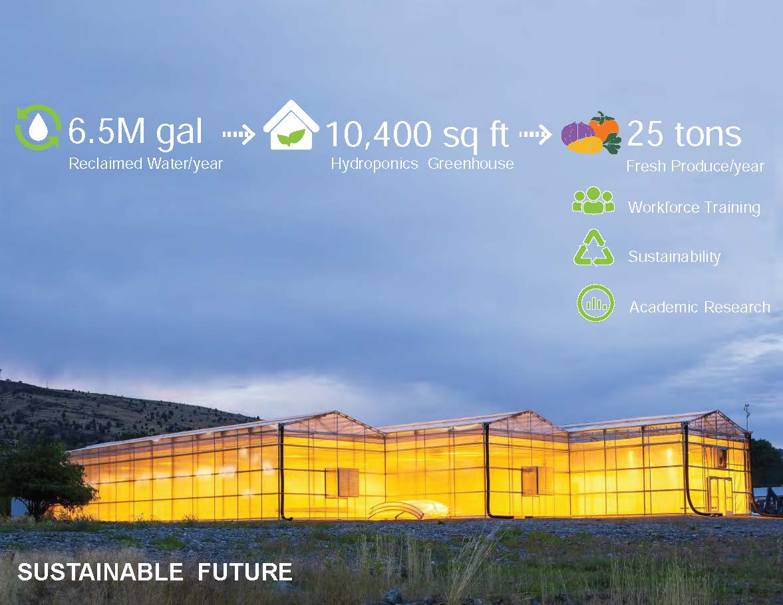
sustainability

Slide 31
Other strategies:
Fundraising
Leveraging, mixing and matching capital
Asset-based, portfolio management approach
Informed fundraising

Slide 32
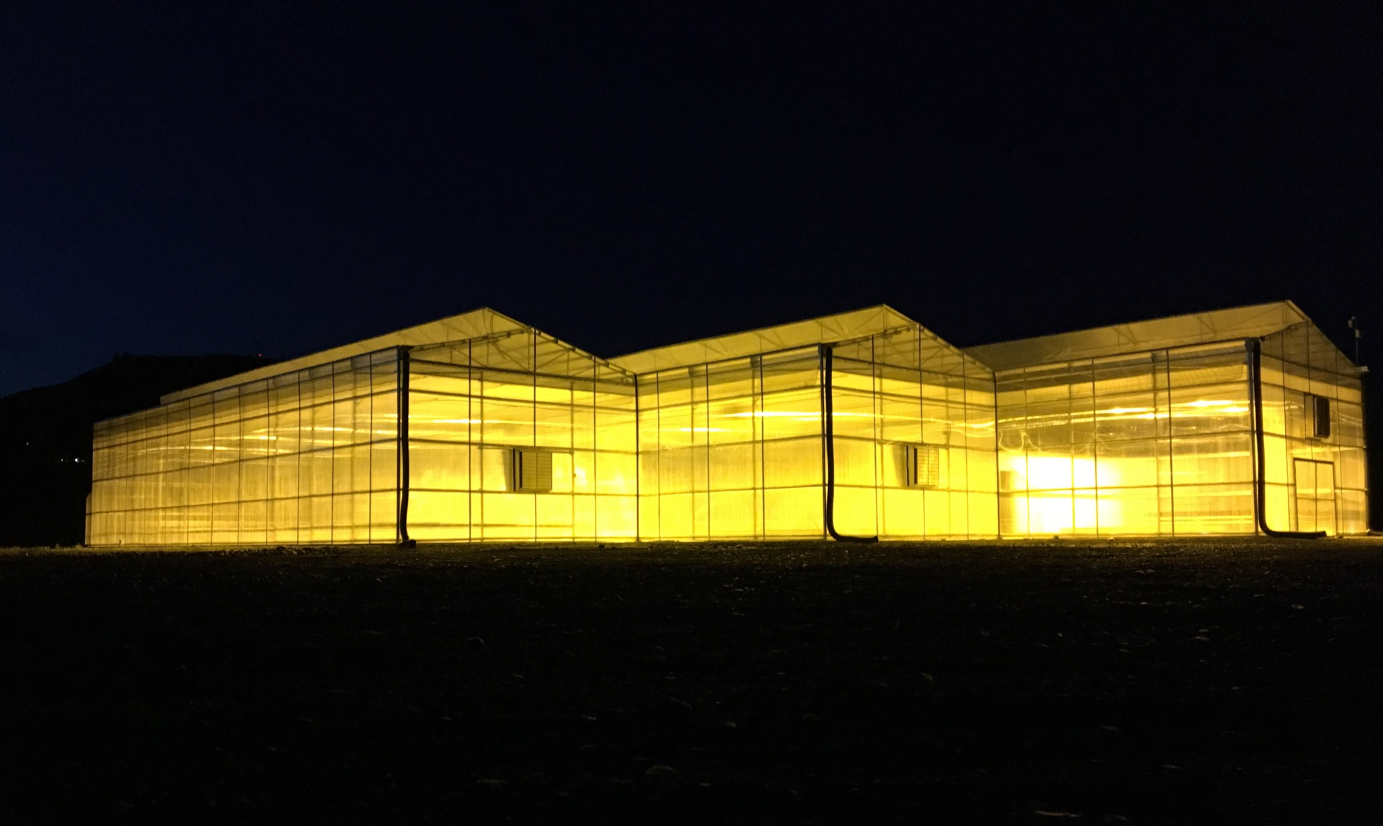
John day swot analysis

Slide 33
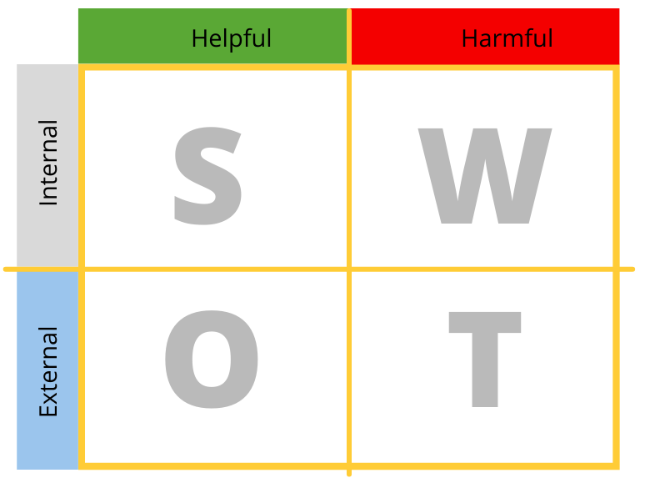




SWOT
SWOT
Keys and challenges to success
Notes:
S Thinking innovatively, sourcing capital, connecting projects to our plans and those of our funders
W Celebrating wins and telling our story locally
O Spectacular unspoiled outdoor recreation
T Losing control of local narratives, working around “never John Day-ers”

Slide 34
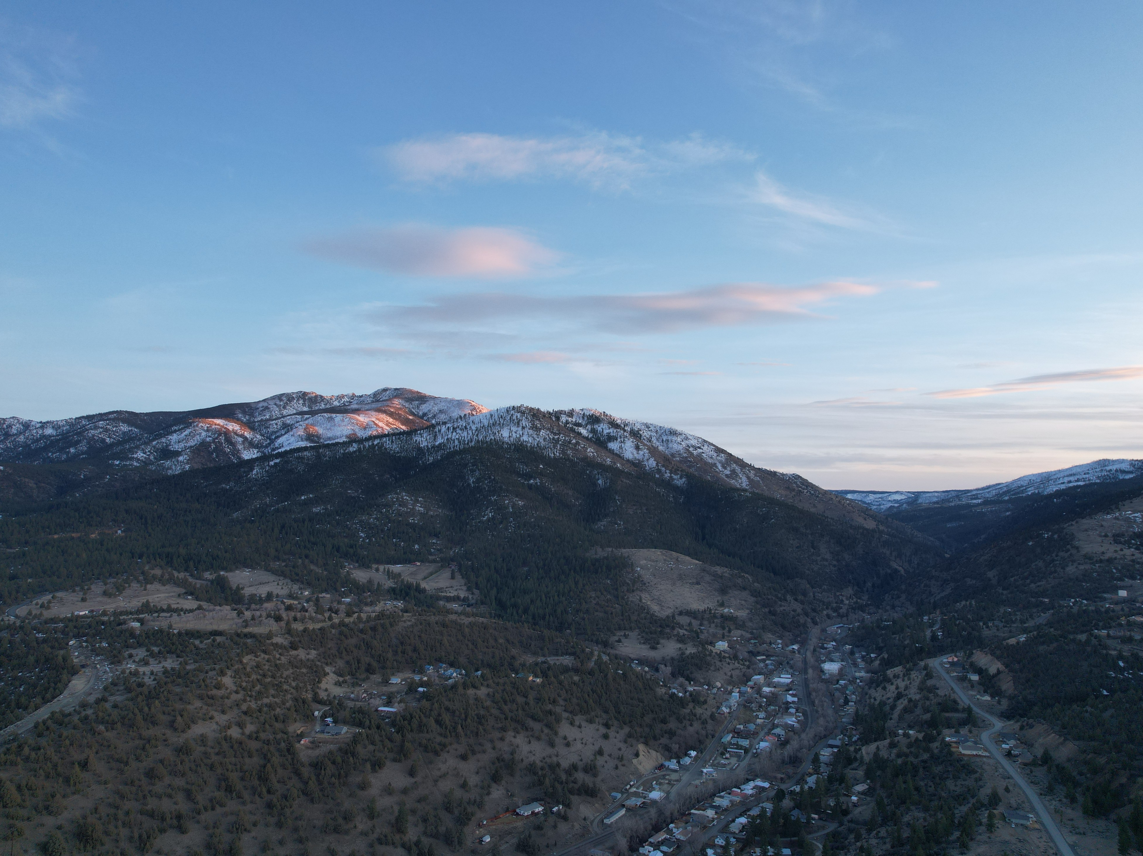
Thank you
City of John Day, OR
Nick Green
green@grantcounty-or.gov
Corum Ketchum
ketchumj@grantcounty-or.gov

