Slide 1
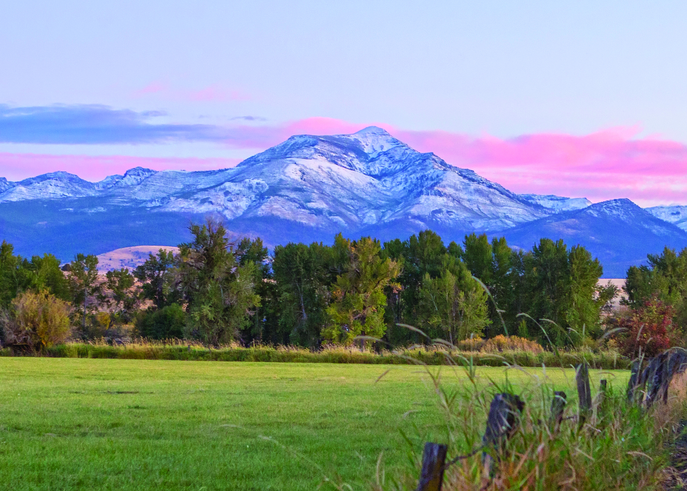
City of John Day, Oregon
Corum Ketchum, Community Dev. Director

Slide 2
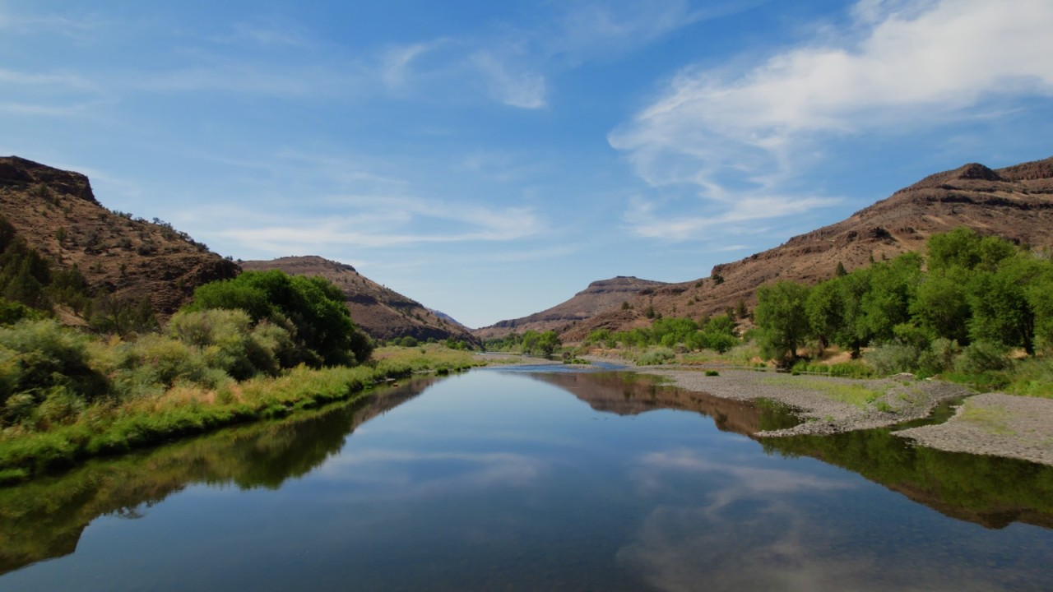
GRO Program Findings
GRO Program Findings
GRO Framework Overview
e2 Entrepreneurial Ecosystems Findings
Highlighted Observations from e2
Road map

Slide 3
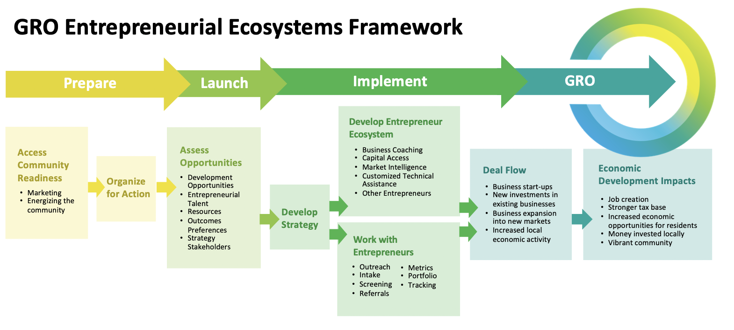
2021 - 2025

Slide 4
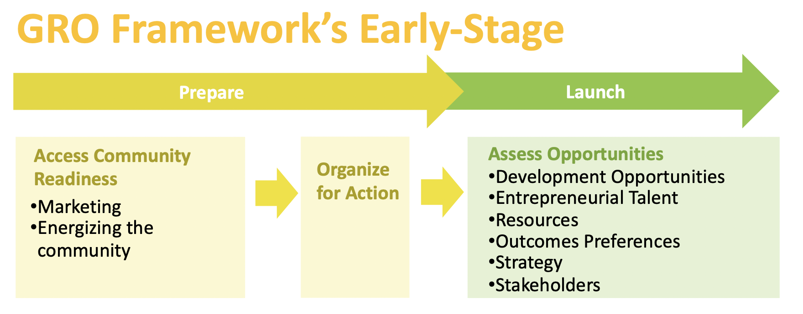
Winter 2021
Spring - Summer 2021

Slide 5
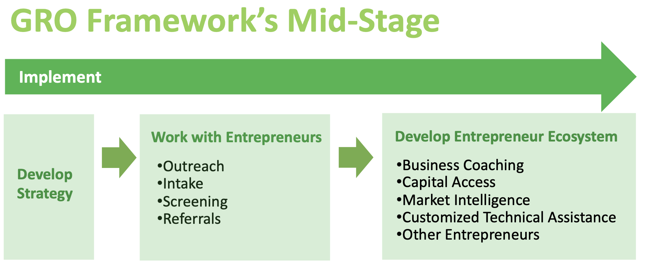
Summer/Fall 2021 – Spring/Summer 2023

Slide 6
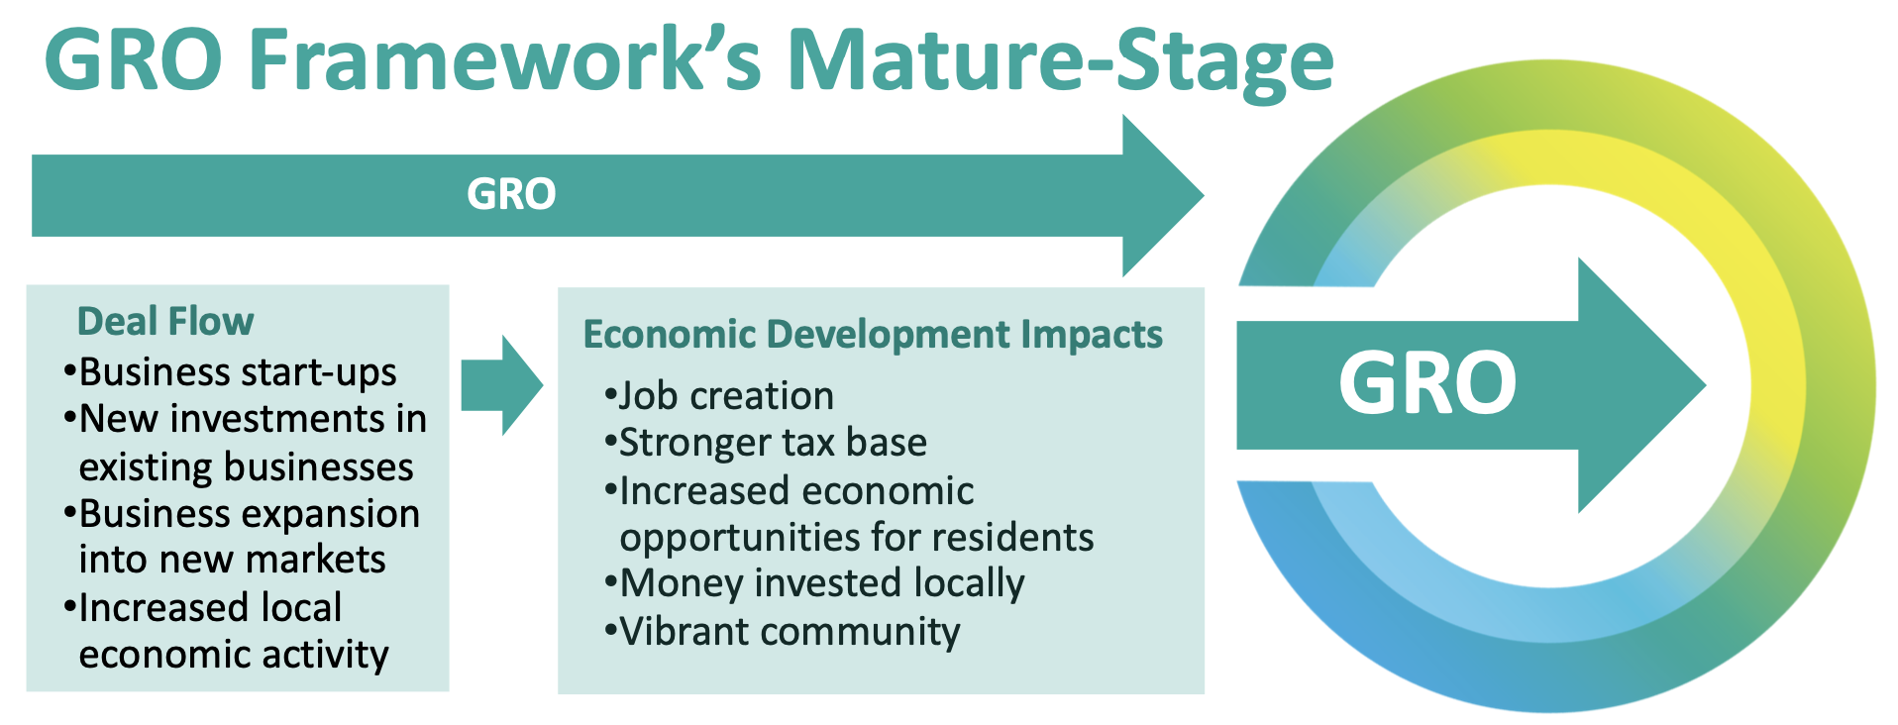
Mid 2023 - 2025

Slide 7
Community Quick Profile
GRO PROGRAM FINDNGS – OVERVIEW
City of John Day
2021 Estimated Population | 1,819
2010 to 2021 Population Change | +4%
2021 Estimated Households | 839
2010 to 2021 Household Change | +5%
2021 Median Age | 47.3
2021 Average Household Size | 2.12

Slide 8
Foundations of Economy
GRO PROGRAM FINDNGS – OVERVIEW
Economic Drivers | Value | %
1. Retiree spending | $137,619,000 | 35%
2. Government administration (wages) | $83,920,000 | 21%
3. Government transfer payments | $36,447,000 | 9%
4. Farming, Forestry, Manufacturing, and Construction | $30,134,000 | 8%
5. Retail trade and hospitality/tourism | $15,399,000 | 4%
6. Other Professional Services | $5,442,000 | 1%
Data for Grant County
Notes:
1. Retiree spending
2. Government administration (employee wages and spending)
3. Farming (agricultural products)
4. Government transfer payments (social security, food security programs, disability payments, etc.)
Hardship Related Payments. According to Headwaters Economics (www.headwaterseconomics.org), Hardship Related Transfer Payments include payments associated with poverty and include Medicaid, Food Stamps (SNAP), Supplemental Security Income (SSI), Unemployment Insurance, and other income maintenance benefits. With the Great Recession and an aging population, hardship payments have grown and become more important for many communities.
Other Transfer Payments. According to Headwaters Economics (www.headwaterseconomics.org), Other Transfer Payments includes veterans’ benefits, education and training, Workers’ Compensation Insurance, railroad retirement and disability, farm payments, other government retirement and disability, and other receipts of individuals and non-profits.
5. Retail trade and hospitality/tourism

Slide 9
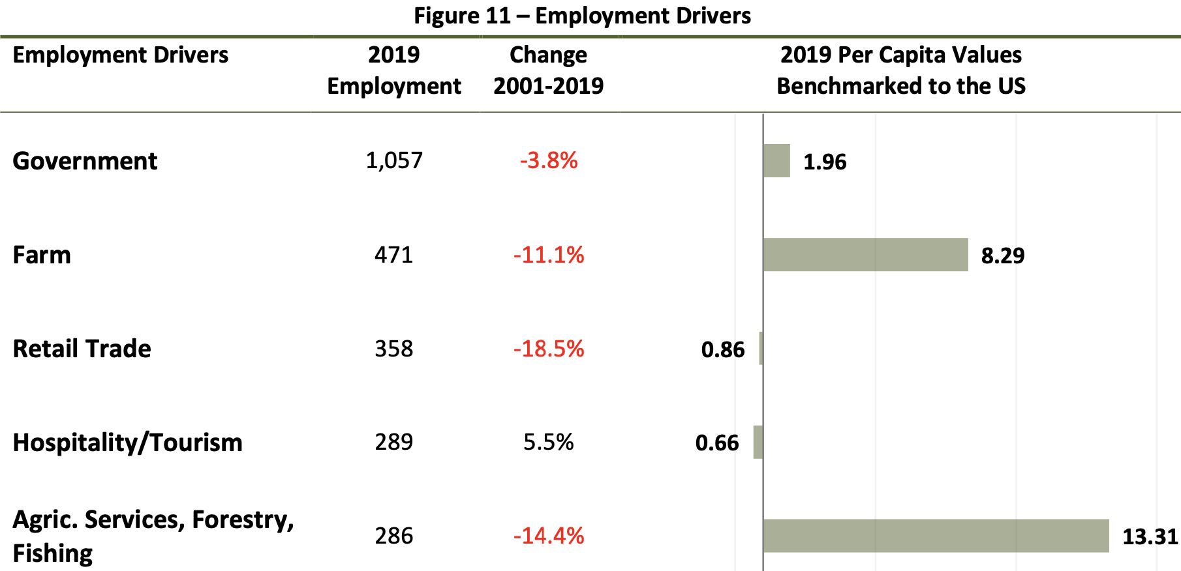
Employment Drivers
GRO PROGRAM FINDNGS – OVERVIEW
Data for Grant County

Slide 10
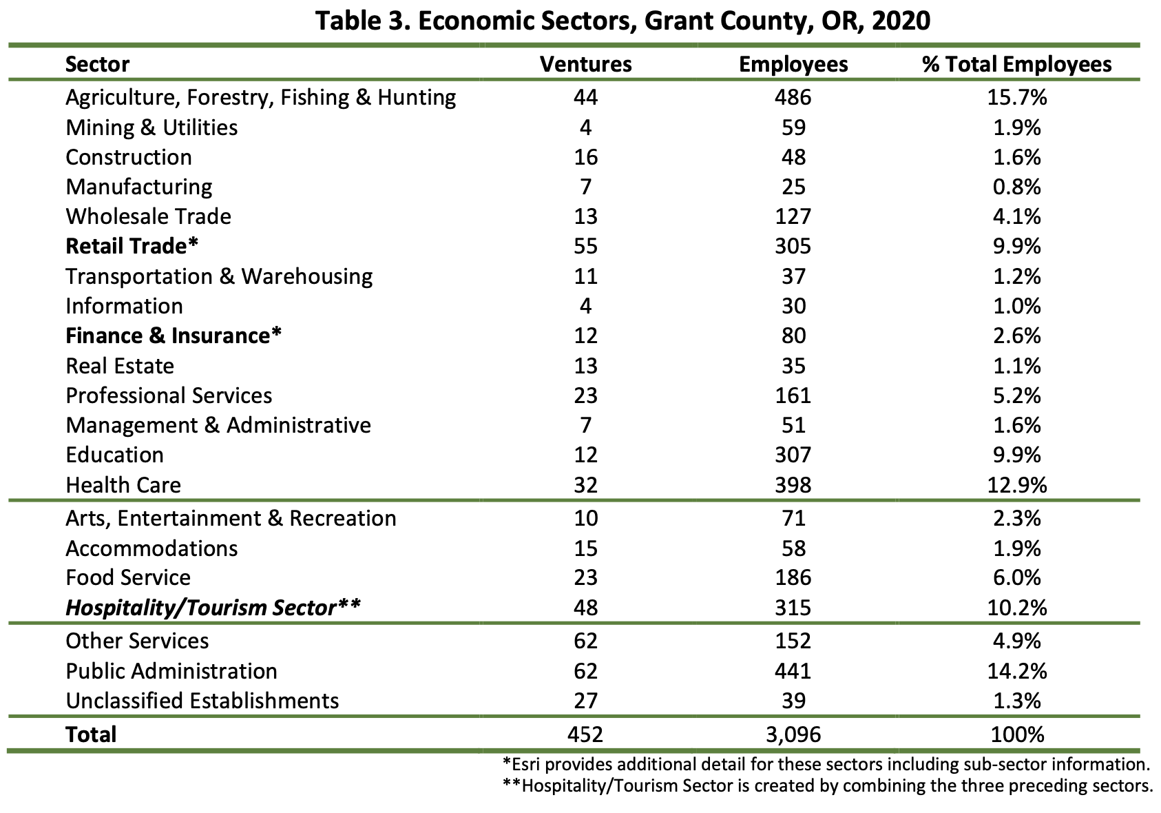
Jobs and Businesses (Ventures)
GRO PROGRAM FINDNGS – OVERVIEW

Slide 11
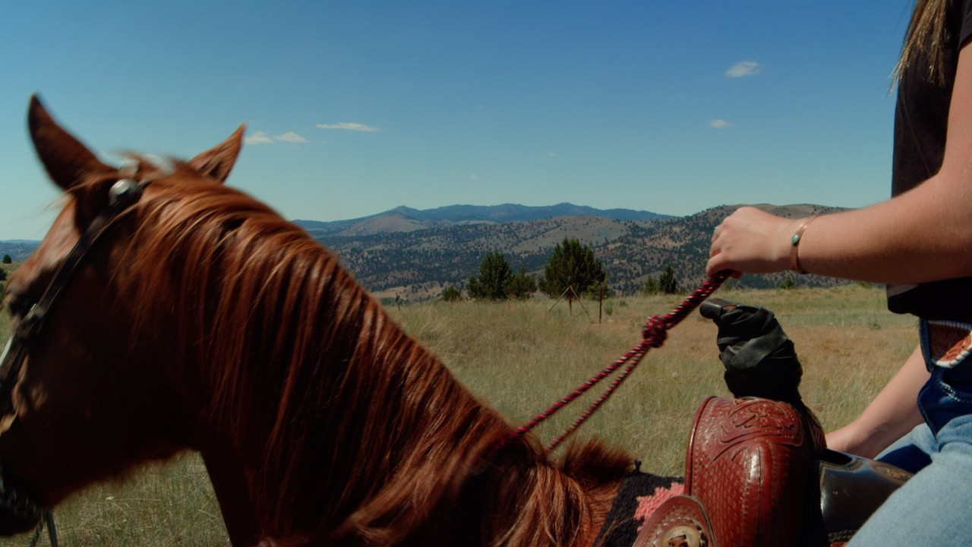
Trends
GRO PROGRAM FINDNGS – Trends
Growth in key groups
Indicators of distress
Growth in tourism/retail
Rising entrepreneurship

Slide 12
Population Changes, John Day
GRO PROGRAM FINDNGS – Trends
Growth in consumers
Retires/Age 60+
Growth in key workers
Prime age/Age 30 to 40
Declines in…
Young people
Middle age

Slide 13
Trends in Earnings Drivers - GC
GRO PROGRAM FINDNGS – Trends

Slide 14
Rise of Remote Workers
GRO PROGRAM FINDNGS – Trends

Slide 15
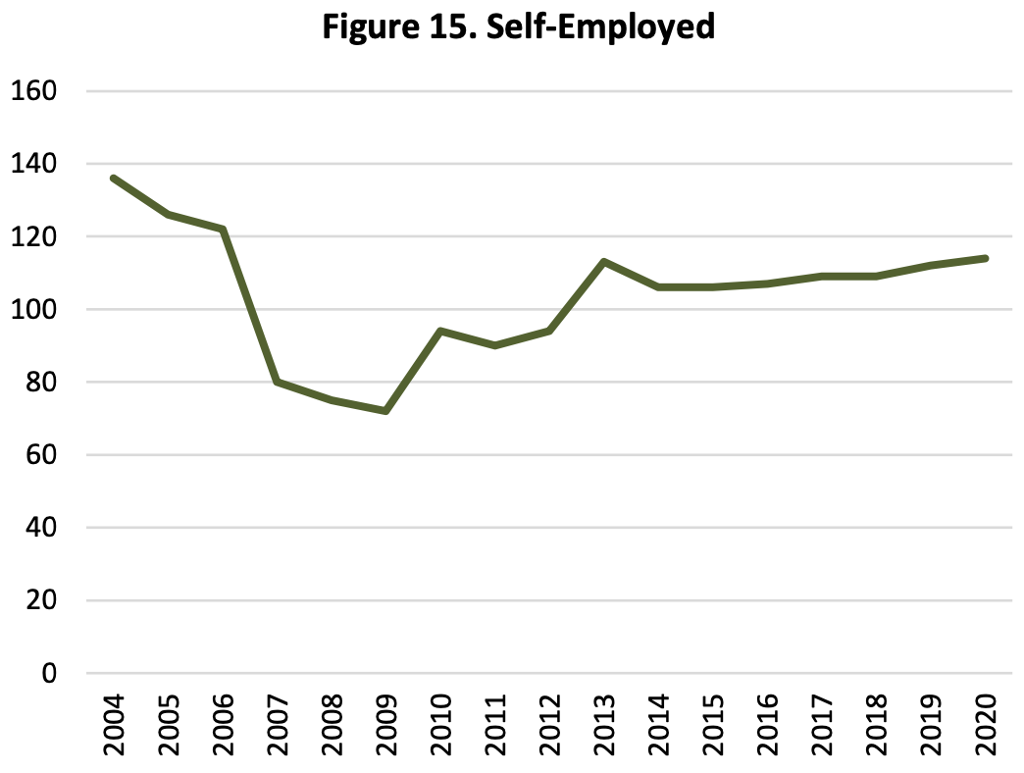
Rising Entrepreneurship, GC Data
GRO PROGRAM FINDNGS – Trends
Who are these self-employed startups?
What are they doing?
How could we help them be more successful?

Slide 16
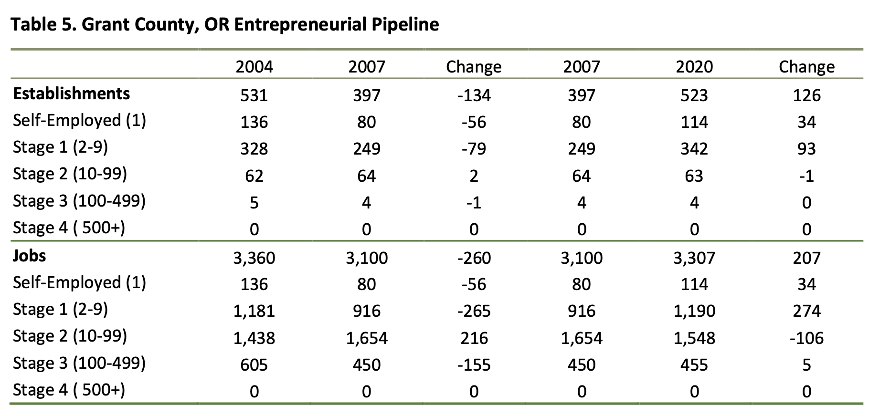
Growing Small Businesses
GRO PROGRAM FINDNGS – Trends

Slide 17
Observations from e2
GRO PROGRAM FINDNGS – Findings
1. Depopulation
2. Cohort Population Growth
3. Employment Trends
4. Earnings Growth
5. Top Economic Drivers
6. Commuters and digital workers
7. COVID Shutdown
8. Permanent Resident Retail Demand Outlook
9. Venture Employment Growth Areas
10. Regional Development
Notes:
1 – Depopulation. Data on pages 5 and 6, as well as more historical population change data, suggests the potential for rooting chronic and severe net outmigration and depopulation is a concern. Esri estimates that for the 2021-2026 future period depopulation will average a moderate 0.32% per year.
2 – Cohort Population Growth. Figure 5 on page 6 offers a more promising demographic trend. There is moderate net growth between 2010 and 2021 with the 20 to 39 year-old age cohorts. These age cohorts are the building blocks for demographic health and renewal.
3 – Employment Trends. Figure 6 on page 7 highlights relative stable and some growth in overall employment indicating economic resiliency. However, Figure 7 on this same page indicates your Labor to Non-Labor Earnings Ratio has dropped to 44%. Your economy is becoming overly dependent upon retirees and governmental transfer payments.
4 – Earnings Growth. Figures 8 and 9 on page 8 indicate recent and relatively strong person income growth including total personal income (Figure 8) and growth in “average earnings per job” (Figure 9). Reasonable real growth in wages and personal income are important for a more prosperous community.
5 – Top Economic Drivers. Figure 10 on page 9 and Figure 11 on page 10 provide top 5 economic driver indicators for Grant County. Top economic drivers include:
Retirees
Government
Farming
Government Transfer Payments
Retail Trade and Hospitality/Tourism
6 – Commuters. Commuters, both in-found (live outside the county and work in Grant County) and out-bound (live in Grant County and work outside the county), are very important to Grant County and its region. Data on page 13 strongly suggests emergence of virtual commuters who are working remotely.
7 – COVID Shutdown Effect. The timing of data collection by www.YourEconomy.org in 2020 coincided with peak COVID-19 related economic shutdowns, over stating the longer-term trends in both ventures and employment. When 2021 data becomes available we anticipate that we will return to pre-pandemic trend lines.
8 – Permanent Resident Retail Demand Outlook. Table 4 beginning on page 16 indicates reasonably strong projected spending growth for most economic sectors. This projected growth by Esri indicates entrepreneurial development opportunities.
9 – Venture Employment Growth Areas. Figure 15 on page 18 indicates growth in self-employment. This data suggests possible nascent entrepreneurial development opportunities. Figure 19 on page 21 indicates moderate job growth with Stage 3 (i.e., 100 to 499 employees).
10 – Regional Development. John Day is a lead community within a vast rural region including Grant County. Embracing and actively supporting regional community economic development, including development in other
Page | 23
communities, is recommended. A stronger region will create development opportunities for John Day and Grant County.

Slide 18
Highlighted Observations from e2
GRO PROGRAM FINDNGS – Observations
Stable John Day population, county wide depopulation likely
Stability in employment and wages/need for diversification
Strong projected retail and recreation growth
Rising remote workers and commuters
Indications of entrepreneurial activity
John Day is situated to take a leading and collaborative role in regional development
Notes:
2. Need for economic diversification
Overreliance on retirees and transfers

Slide 19
Strategic Recommendations
GRO PROGRAM FINDNGS – Recommendations
Supporting natural resource industries and related secondary products
Capturing area spending that is currently going to online retail and big box stores
Leveraging retiring boomers
Encouraging digital commuting and remote working
Notes:
A. Supporting natural resource industries and related secondary products B. Capturing area spending that is currently going to online retail and big box stores C. Leveraging retiring boomers as a source of entrepreneurial talent and a consumer base
D. Encouraging digital commuting and remote working

Slide 20
Strategic Recommendations Cont.
GRO PROGRAM FINDNGS – Recommendations
Transportation Corridors
Recreation and tourism
Growth oriented entrepreneurship
Hub city services
Notes:
E. Taking advantage of transportation corridors to provide services and tourist amenities
F. Diversifying the local economy through recreation and tourism G. Discovering and supporting so called “growth-oriented entrepreneurs” H. Taking advantage of John Day’s status as a “hub city” to lead regional entrepreneurial development services by providing those entrepreneurs markets and programming support to the entrepreneurs in other communities in Grant county

Slide 21
6 Month Roadmap
GRO PROGRAM FINDNGS – Roadmap
Analyzing Opportunities | May
Asset mapping | June
Goal setting | July
Developing a strategic action plan | August
Creating metrics to score progress | September
Resources to track and follow up with entrepreneurs (program clients) | October

Slide 22
Thank you City of John Day
Corum Ketchum
ketchumj@grantcounty-or.gov

