Slide 1
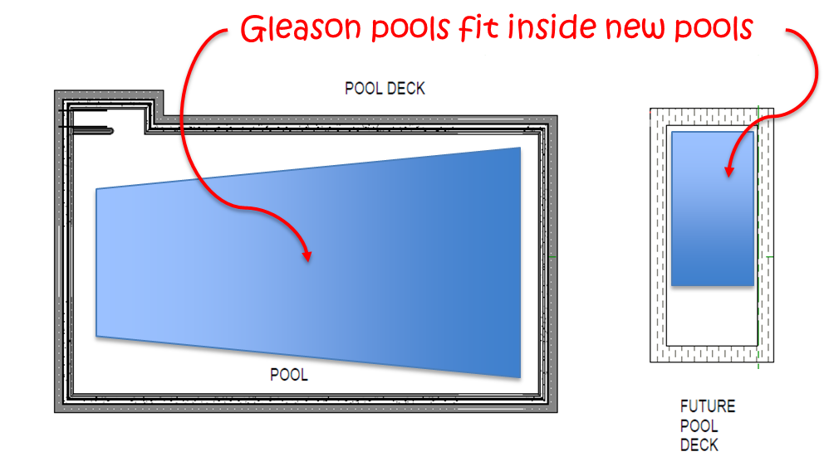
John Day/Canyon City POOL FACILITY
New competition pool is 23% larger (3,200 sf vs. 2,600 sf)
Warm water pool is 30% larger (523 sf vs. 400 sf)
New pool is ADA-accessible for swimmers of all abilities
New pool is designed for year-round operations with addition of a future enclosure

Slide 2
Dimensions for new Pool Facility
John Day/Canyon City POOL FACILITY
Expanded deck space allows for future enclosure, ADA-accessibility, and year-round operations
Area for future pool enclosure

Slide 3
What the pool will cost voters
John Day/Canyon City POOL FACILITY
Construction bond is up to $4 million if approved by voters on May 17th
Bond tax rate is 70 cents per $1,000 assessed value (AV), or $70 per year for a home valued at $100,000, over a 20-year period
Tax only applies within the Parks & Rec District boundaries
Home Values* | Annual Tax Increase | Monthly Equivalent
Median ($80,168.50) | $56.12 | $4.68
Average ($108,993.66) | $76.30 | $6.36
*Assessed Values based on 2021-2022 Grant County Assessor’s Office tax roles for properties within the John Day/Canyon City Parks & Recreation District
About half of all property owners will
pay less than $5 per month

Slide 4
Anticipated operating budget
John Day/Canyon City POOL FACILITY
Operating expenses ~ $103,100
$45,600 for personnel services
$57,500 for materials and services
Operating revenues
$38,150 in user-generated revenues
$16,000 contributed by John Day
$46,950 transfer from JDCC General Fund, which receives over $240,000 in taxes each year
Operating cost is less than 20 percent of Parks District’s annual budget
Click to open anticipated
Fy24 operating budget

Slide 5
Pool Facility Renderings
John Day/Canyon City POOL FACILITY
Warm Water / Therapy Pool

Slide 6
Pool Facility Renderings
John Day/Canyon City POOL FACILITY
3D Rendering

Slide 7
Pool Facility Renderings
John Day/Canyon City POOL FACILITY
West Elevation

Slide 8
Pool Facility Renderings
John Day/Canyon City POOL FACILITY
West Elevation

Slide 9
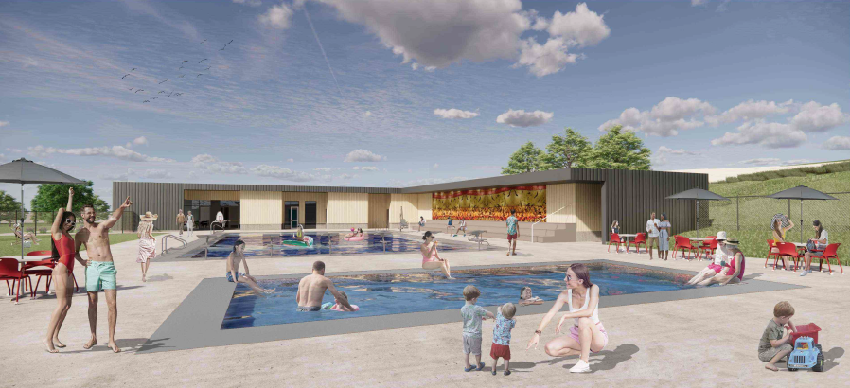
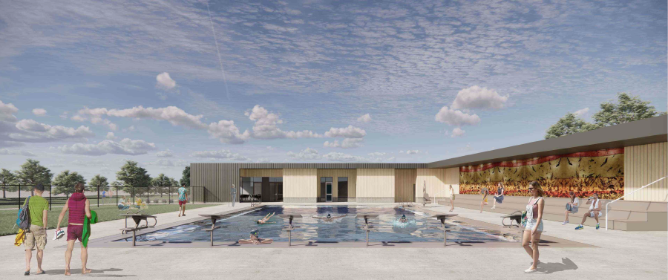
John Day/Canyon City POOL FACILITY

