Slide 1

Cyber Mill Initiative:
Impact Report
February 24, 2021

Slide 2
Public Investment in Infrastructure
History shows that public investment in private infrastructure provides significant public and individual benefits.
When history, economic impact and need considered jointly, it is clear:
  the single most impactful action government can take is to invest capital resources in infrastructure deployment and broadband adoption programs.

Slide 3
Cyber Mill Survey
Notes:
Conducted community outreach by sending survey out to public to get their input on the Cyber Mill
Over 200 responses (so far)
Results displayed on the following slides

Slide 4
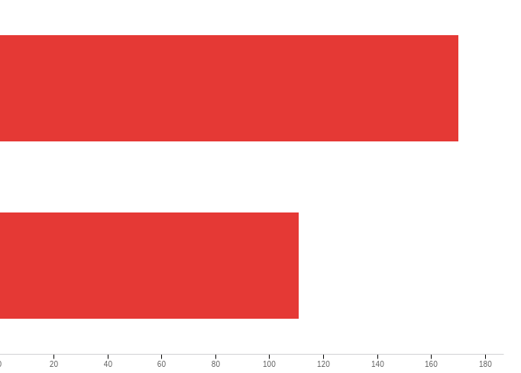
“Do you currently have access to high quality Wi-Fi in your home?”
Yes
60.50%
No
39.5%

Slide 5
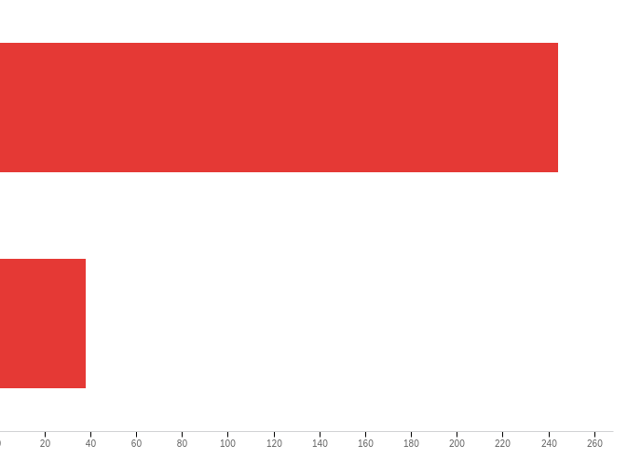
“Do you currently have access to a computer in your home?”
Yes
86.52%
No
13.48%

Slide 6
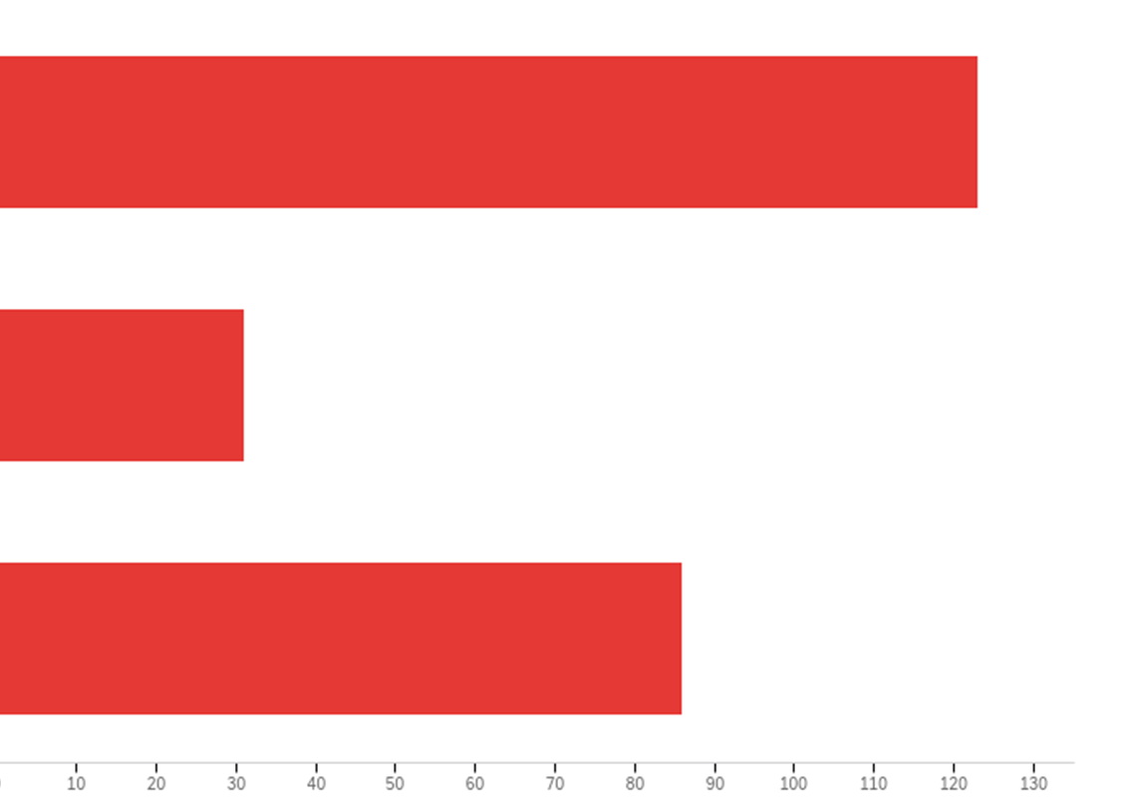
“Is the computer access adequate for all the people in your household?”
Yes
51.25%
No
12.92%
Sometimes
35.83%

Slide 7
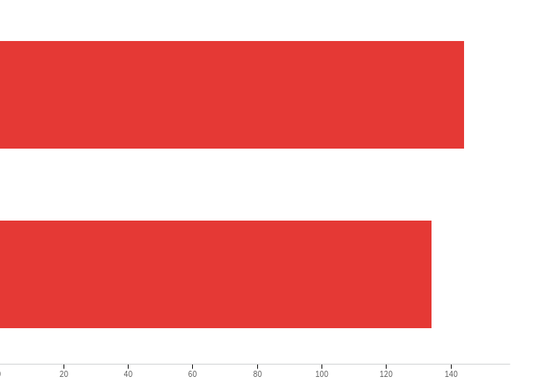
“Do you have access to printing, scanning, copying in your home?”
Yes
51.80%
No
48.20%

Slide 8
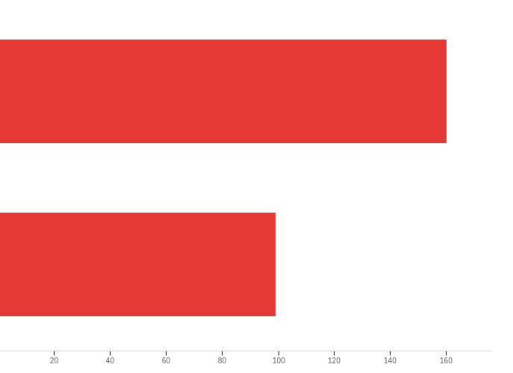
Do you need access to high quality internet, printing, scanning, or technology?
Yes
63.78%
No
38.22%

Slide 9
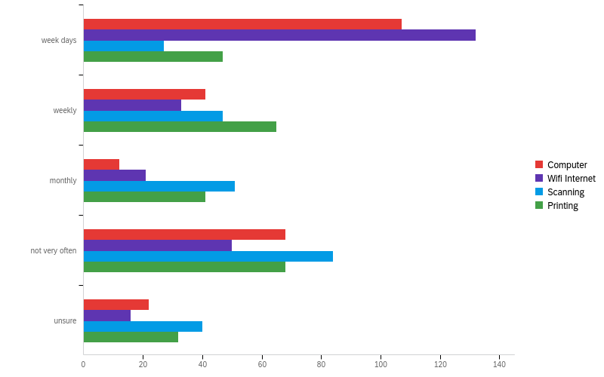
“How often would you anticipate using any of these services (internet, scanning, computers, printing)?” Choose a usage rate:

Slide 10
“How often would you anticipate using any of these services (internet, scanning, computers, printing)?” Choose a usage rate:
Question | Week Days | Weekly | Monthly | Not very often | Unsure
Computer | 42.80% | 16.40% | 4.80% | 27.20% | 8.80%
Wi-Fi Internet | 52.38% | 13.10% | 8.33% | 19.84% | 6.35%
Scanning | 10.83% | 18.88% | 20.48% | 33.73% | 16.06%
Printing | 18.58% | 25.69% | 16.21% | 26.88% | 12.65%

Slide 11
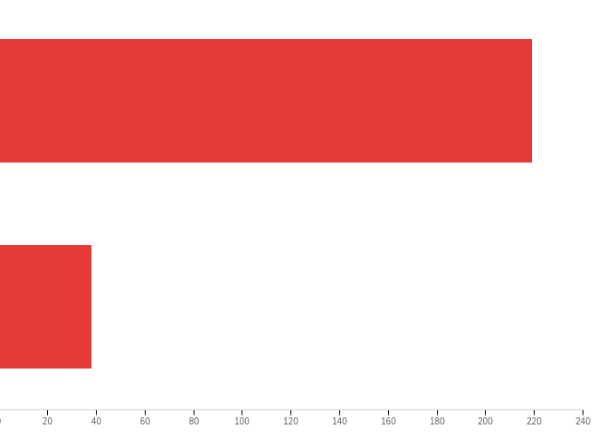
“All levels of public and private funding for these services have been approached. To date some funding has been obtained. In order to move forward in our communities it is crucial to have local investment from Grant County.
Would you support the use of Grant County funds for this service in our communities?”
Yes
85.21%
No
14.79%

Slide 12
Policy Recommendations of Closing Digital Divide
1) Invest public funds in deployment and adoption initiatives (including assistance with devices and digital literacy training);
2) Promulgate policies that change laws and regulations to promote sustainable deployment and
adoption;
3) Require significant public benefits as a condition of mergers and acquisitions; and
4) Have other branches of government and community anchor institutions include broadband adoption and digital literacy in the continuum of care and services they can provide.

Slide 13
Together, We Can Make Sound Public Policy
Together, the understanding developed here provides a rational basis for our policy recommendations, including authorizing additional funding for broadband infrastructure deployment and adoption assistance programs, the initial premise being that public investment in such programs is sound public policy because it:
  (1) Offers significant benefit to the households who are directly impacted by the interventions;
  (2) Has significant public benefit to society overall;
  (3) Is a prudent use of public funds that yields economic impacts significantly greater than the amount invested;
  (4) Is not achievable with private sector funds alone; and
  (5) Has broad public support as a policy goal.

Slide 14
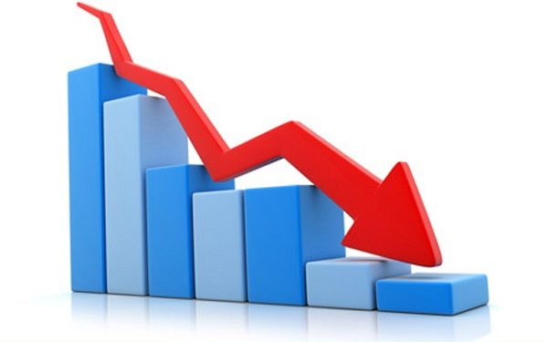
Lost Revenue to Grant County if No Action Taken

Slide 15

Example: Cost of Trip to Bend
Fuel: $54
Food: $40
Other shopping: $100+
Over $200 per trip = Lost revenue in our community

Slide 16

Example: Education
Student accessing K-12 education = $9,400 (each student per district)
College students:
  Will save $10,000 in housing
  Will eat and shop in Grant County spending approximately $3,600 locally
  1 college student will provide $13,600 to our county!

Slide 17
Smart Phones Just Don’t Cut It
Tasks such as creating a resume, using the web to search for available positions, filling out online applications, and contacting employers are reported as much more difficult when job-seekers’ only internet access is via smartphones, emphasizing the need for meaningful internet access.

Slide 18
Summary
85% of the public supports the county investing funds in the Cyber Mill project
Local revenue is lost to other communities if we can’t provide a service like the Cyber Mill
The single most impactful action government can take is to invest capital resources in infrastructure deployment and broadband adoption programs

Slide 19

Thank you!

