Slide 1
DOWNTOWN PARKING
DOWNTOWN PARKING OPTION | JOHN DAY
South Canyon Electric Vehicle site
City Hall site
South Canton site
North Canyon site

Slide 2
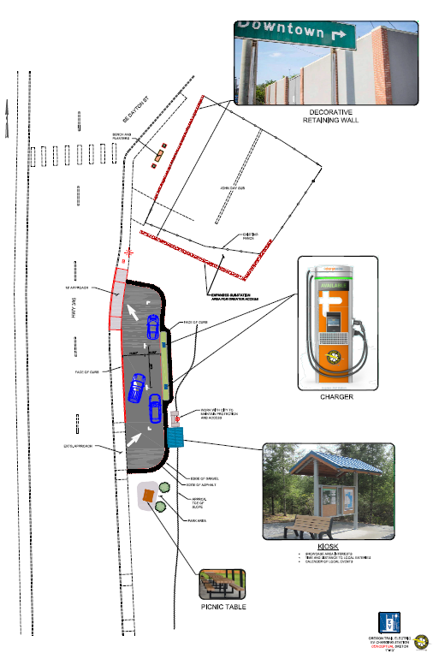
S. CANYON
DOWNTOWN PARKING OPTION | JOHN DAY
2 electric vehicle stations
Picnic area
Public art / rest area
City donates land
OTEC develops/maintains

Slide 3
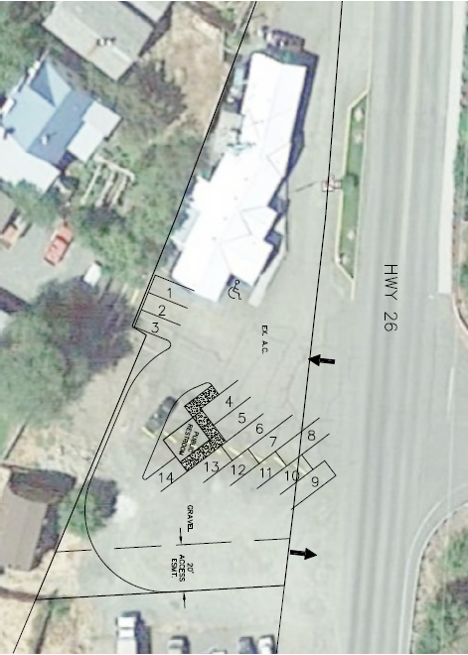
CITY HALL
DOWNTOWN PARKING OPTION | JOHN DAY
14 spaces
Public restroom
Asphalt/gravel finish
Development cost $83,281

Slide 4
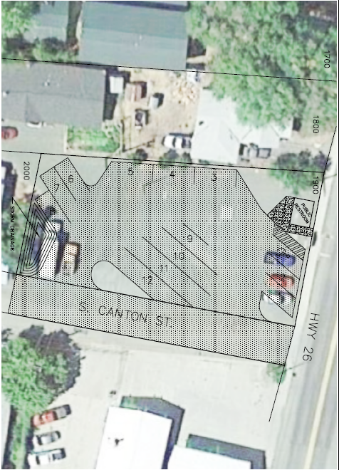
S. CANTON
DOWNTOWN PARKING OPTION | JOHN DAY
12 spaces
4 pull-through/RV
Public restrooms
Asphalt finish
0.4-acre site
Purchase price $60,000
Development cost $112,392

Slide 5
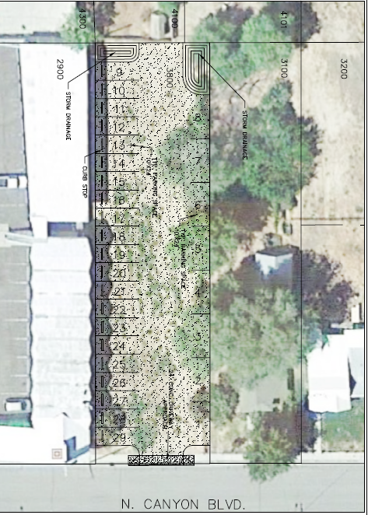
N. CANYON
DOWNTOWN PARKING OPTION | JOHN DAY
29 spaces
Employee parking
Gravel finish
0.33-acre site
Purchase price $50,000
Development cost $41,166

