Slide 1
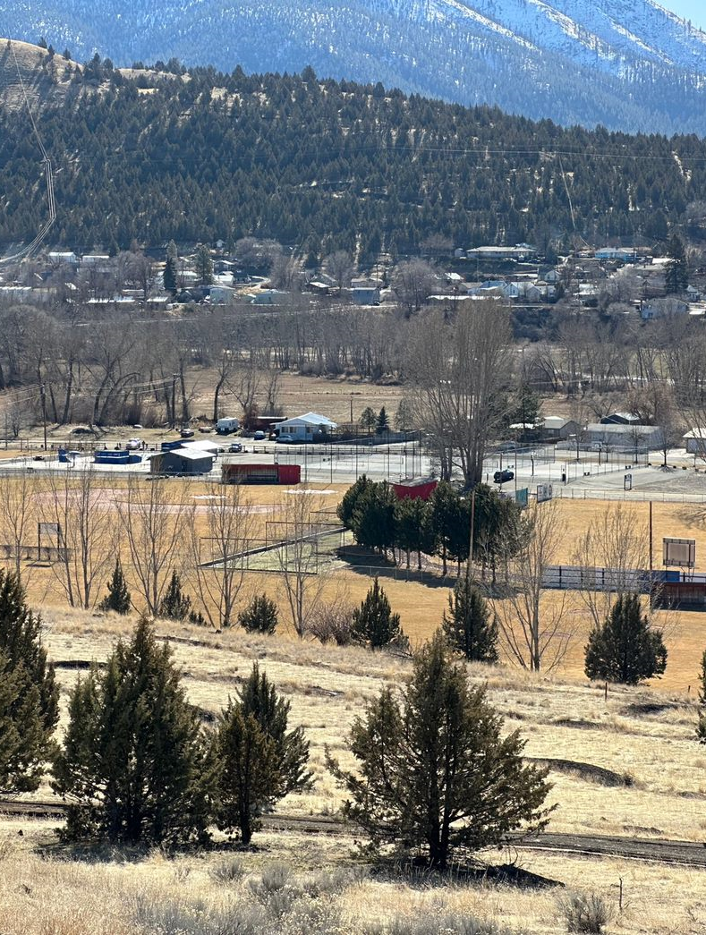
Rural Transportation Equity Project Update
Rural transportation equity project
June 13, 2023
Aaron Lieuallen, Senior Project Manager
Susanna Julber, Consor SPC
Madeline Phillips, DLCD
Matt Kittelson, Kittelson Associates

Slide 2
Project Background
Rural transportation equity Program
City of John Day applied for and was awarded grant funding in 2022 through the Department of Land Conservation and Development (DLCD).
Program Goals: Identify areas where sidewalks, multi-use paths, bicycle lanes, and access to transit could be improved throughout the community.
Emphasis on transportation options for those who have mobility limitations and who may experience challenges in accessing community resources, employment centers, and critical services without a car.
Project team has been asking the community to provide feedback to help identify gaps in the City’s sidewalks, bike lanes, and/or trails, that may result in barriers for people to get to amenities, particularly to support lower income community members that may not have easy connections to parks, schools, and services.

Slide 3
Project Objectives
Rural transportation equity project
Identify safer, easier connections for pedestrians and bicyclists traveling between neighborhoods, schools, parks, trails, transit stops, and businesses in the area.
Provide a blueprint for John Day to apply for future construction funding for accessibility, sidewalk, trails, and bicycle improvements.
Lay the groundwork for user-friendly transportation enhancements that will help everyone in town access activity centers.
Plan for safe alternatives and options for travel for those without access to a car.

Slide 4
Project Timeline
Rural Transportation equity project
Dec ‘22-
March
July ‘23-
Beyond
Community
input on gaps
& opportunities
Open House #1, survey,
other outreach events
May
Final draft Plan based on community input-
City Council
City Council review
& adoption of plan;
Future: City applies for
funding for design &
construction
Research,
site Visits, Interviews,
develop draft gap analysis-
“Origin Destination Study”
Refine Plan to include
priority projects,
community input
on draft Plan
April
June

Slide 5
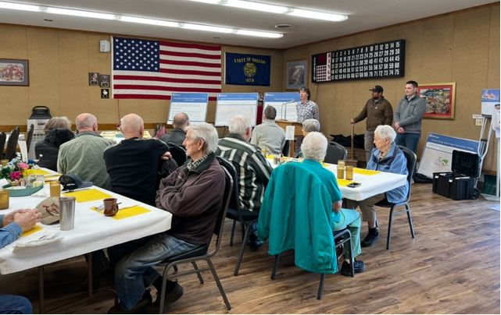
Public Engagement Process
Rural transportation equity project
Community engagement – stakeholder interviews, targeted presentations, survey, open house.
Created draft project list.
Reviewing again with public for priority projects.
Adoption process allows for public hearings and additional review.

Slide 6
Projects Originated from:
Rural transportation equity project
Community feedback
On the ground research
2009 Local Street Plan- 41 Projects
Projects accomplished:
Multiuse path along the north side of the John Day River from Bridge Street to Patterson Bridge (Project 5).
Roadway between Valley View Drive and Patterson Bridge Street. The street is currently unpaved but is planned to be paved in 2024 (Project 10).
Charolais Drive extension to the east and south to connect to 7th Street. The street is currently unpaved but is planned to be paved in 2024 (Project 13).
The sidewalk along Canyon Blvd from 6th Street to Grant Union High school is partially completed and planned to be fully completed in 2023 (Project 31).

Slide 7
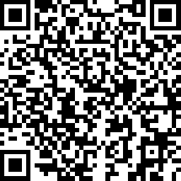
Draft Multimodal Connectivity Projects
Rural transportation equity project
https://www.surveymonkey.com/r/JohnDayProjects

Slide 8
Next Steps
Rural transportation equity project
Draft Connectivity Plan work finalized June 30.
Please fill out prioritization survey!
Meet with City leadership/ Mayor to map out adoption process.
City Council consideration of this to become part of the Local Street Network Plan.
Goal: position the City for funding opportunities in the future.

Slide 9
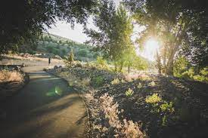
Discussion- Q & A
Rural transportation equity project

